Slide 2
Story Telling Time ამბის მოყოლის დროა
Young Learners დაწყებითი კლასები

Slide 3
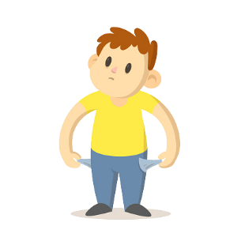
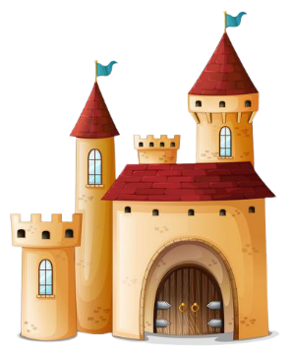
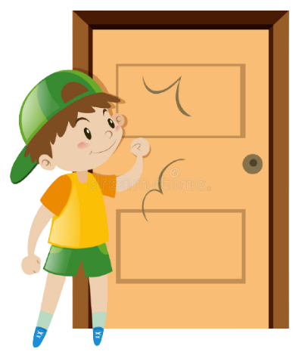
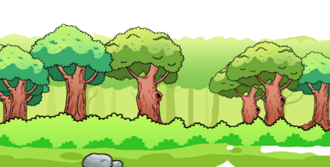
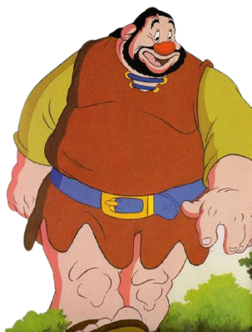
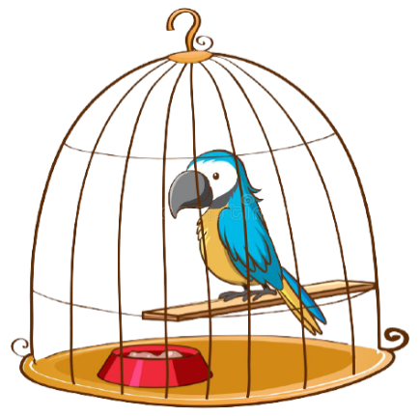
poor ღარიბი
forest ტყე
castle სასახლე, ციხესიმაგრე
knock კაკუნი
huge ძალიან დიდი
tiny ძალიან პატარა
giant გოლიათი
cage გალია
fairy ფერია
coin მონეტა

Slide 4
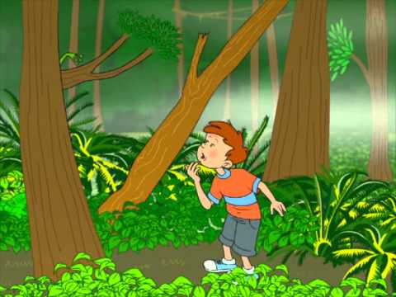
Once upon a time a poor boy Sam lived on a farm with his family.
One day Sam walked to the forest to get some wood.
There was a castle next to the forest.

Slide 5
Is anybody there?
Sam wanted to see what was in the castle, so he walked inside. He knocked on the door but nobody answered him. He called, “Is anybody there?” but again nobody answered him.

Slide 6
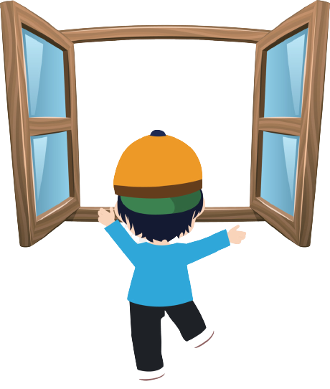
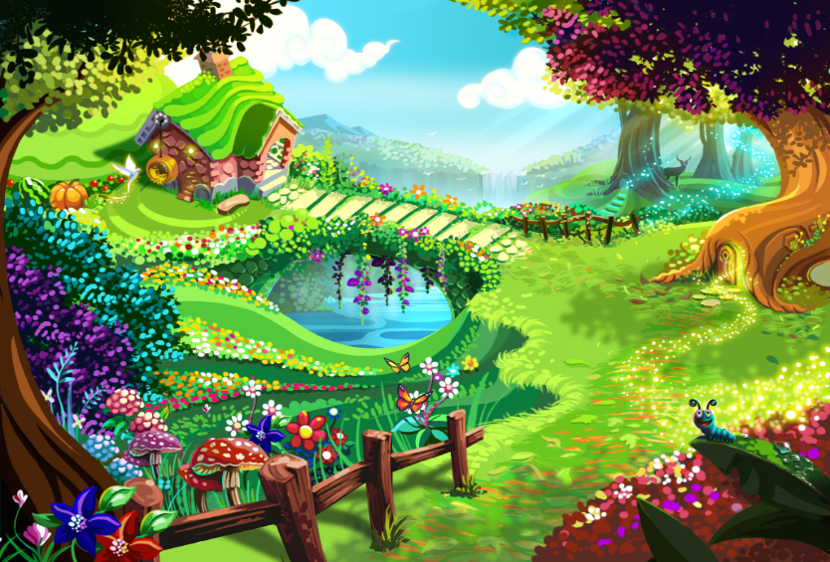
Sam looked out of the window.
He could see a huge tree outside. Sam climbed up the tree and at the top of the tree there was a beautiful garden.

Slide 7
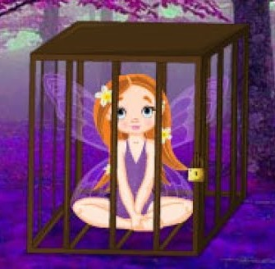
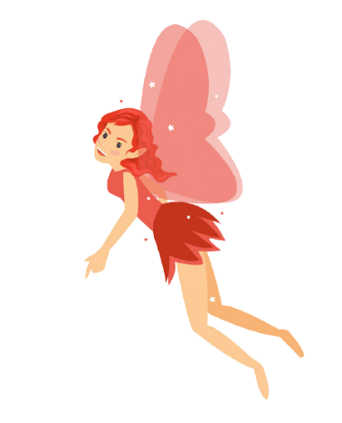
Sam entered and saw a tiny fairy flying in the cage. “Please, please help me!” she whispered. “A giant caught me,” she cried.
.
Sam was a brave boy, he opened the cage, climbed down the huge tree and chopped it down. So, Sam saved the tiny fairy. She thanked him and flew away.

Slide 8
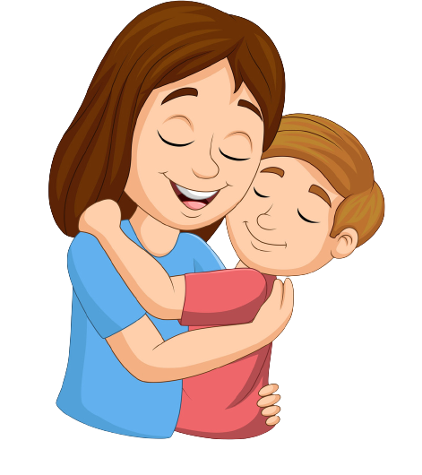
When Sam returned home, his family was so happy, because while Sam was out somebody brought them a big jar full of golden coins. Sam said it was from the tiny fairy. This is how she thanked him.
The end.

Slide 9
1. Sam lived with his family on a farm. 2. He climbed up the tree. 3. Sam opened the cage. 4. He saved a tiny fairy.

Slide 10
1. Sam _____ not live in a city. 2. _____ Sam open the cage? 3. _____ the fairy return to the castle? 4. Sam’s family _____ not want to see the castle. 5. _____ the fairy bring golden coins to Sam’s family?

Slide 11
_____ ______ ______ ______ ______ ______
Homework N1 საშინაო დავალება N1
Write the words for the given pictures.
დაწერეთ მოცემული სურათების შესაბამისი სიტყვები.

Slide 12
e.g. Did Sam live on a farm? The king _______ not live in the castle. _______ Sam’s family have coins? The fairy _______ not climb up the tree.
Homework N2 საშინაო დავალება N2
Fill in the gaps using did. შეავსეთ გამოტოვებული ადგილები did დამხმარე ზმნის გამოყენებით.

Slide 13
Please send your homework to:
საშინაო დავალება გამოგვიგზავნეთ
შემდეგ მისამართზე:

