Slide 2
Psychology | ფსიქოლოგია
English for Specific Purposes | Level A2

Slide 3
Agenda
გაკვეთილის გეგმა
Introduction - შესავალი
Personality and Birth Order
პიროვნული თვისებები და დაბადების რიგითობა
Vocabulary - ლექსიკა
Reading Comprehension - წაკითხულის გააზრება
Grammar - გრამატიკა
Summary- შეჯამება
Homework- საშინაო დავალება

Slide 4
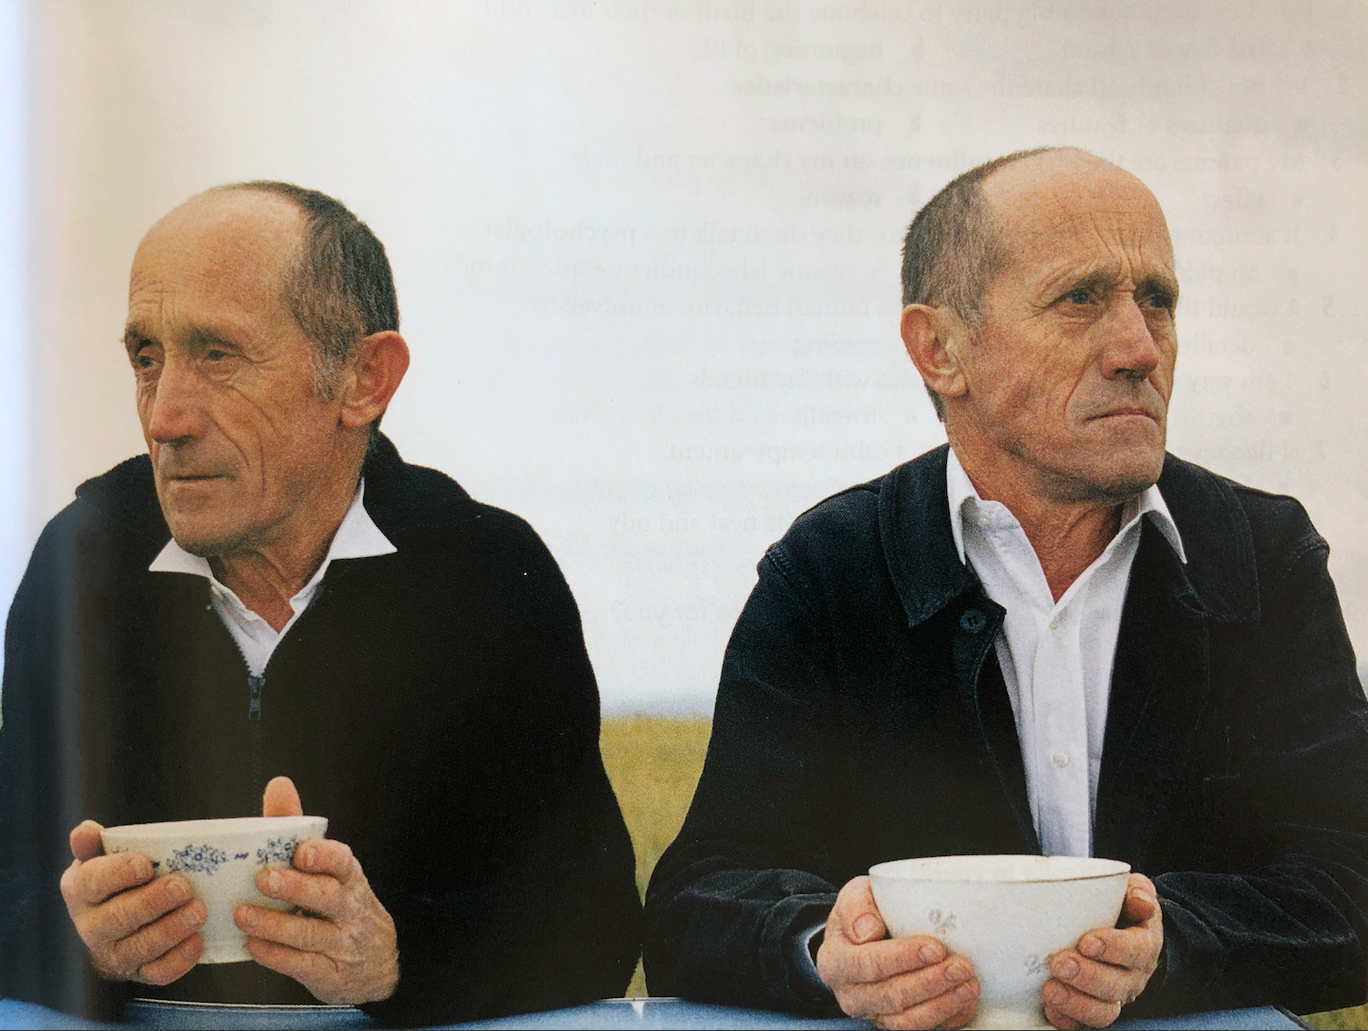
Introduction შესავალი
What do you notice about the people in the picture? Can you describe how you think they feel?

Slide 5
Vocabulary ლექსიკა
independent
(adj.)
დამოუკიდებელი
hard –working
(adj.)
შრომისმოყვარე
loyal
(adj.)
ერთგული
Vocabulary
ლექსიკა
generous
(adj.)
გულუხვი
shy
(adj.)
მორცხვი
reliable
(adj.)
საიმედო, სანდო

Slide 6
Vocabulary
ლექსიკა
hard-working
(adj.)
შრომისმოყვარე
She was always very hard-working at school.

Slide 7
„
Vocabulary
ლექსიკა
independent
(adj.)
დამოუკიდებელი
She was independent in her decisions.

Slide 8
Vocabulary
ლექსიკა
loyal
(adj.)
ერთგული
She's very loyal to her friends.

Slide 9
Vocabulary
ლექსიკა
generous
(adj.)
გულუხვი
Generous people are always ready to help others.

Slide 10
Vocabulary
ლექსიკა
reliable
(adj.)
სანდო, საიმედო
She is so reliable. You can trust her.

Slide 11
Vocabulary
ლექსიკა
shy
(adj.)
მორცხვი
She is so shy. She doesn’t like speaking in front of the audience.

Slide 12
Vocabulary
ლექსიკა
shy
reliable
hard-working
generous
independent
loyal
He's so ………. he always volunteers for charity.

Slide 13
Vocabulary
ლექსიკა
shy
reliable
loyal
independent
hard-working
She is very ……….; she is always staying late at the office.

Slide 14
Vocabulary
ლექსიკა
shy
reliable
loyal
independent
The more she travelled by herself, the more ………. she felt.

Slide 15
Vocabulary
ლექსიკა
shy
reliable
loyal
Nick is very ………. if he says he'll do something, he'll do it.

Slide 16
Vocabulary
ლექსიკა
shy
loyal
She is so ………. She never communicates with strangers.

Slide 17
Vocabulary
ლექსიკა
loyal
Everyone wants to have a ………. friend like him.

Slide 18
Vocabulary
ლექსიკა
sibling
(n.)
ღვიძლი და ან ძმა
Influence (v.)
ზეგავლენის მოხდენა
Vocabulary
ლექსიკა
traits
(n.)
დამახასიათებელი თვისება
verbal (adj.)
სიტყვიერი, ზეპირი
responsible
(adj.)
პასუხისმგებლობის მქონე
peacemaker
(n.)
მშვიდობისმყოფელი
gender
(n.)
სქესი

Slide 19
Vocabulary
ლექსიკა
verbal
(adj.)
სიტყვიერი, ზეპირი
Good politicians should have good verbal skills.

Slide 20
Vocabulary
ლექსიკა
sibling
(n.)
ღვიძლი და ან ძმა
She had two siblings one brother and one sister.

Slide 21
Vocabulary
ლექსიკა
traits
(n.)
დამახასიათებელი თვისება
Most leaders have positive traits.

Slide 22
Vocabulary
ლექსიკა
influence
(v.)
ზეგავლენის მოხდენა
What influenced you to choose a career in nursing?

Slide 23
Vocabulary
ლექსიკა
gender
(n.)
სქესი
Discrimination on the basis of gender is not allowed.

Slide 24
Vocabulary
ლექსიკა
responsible
(adj.)
პასუხისმგებლობის გრძნობის მქონე
He is a hard-working and responsible employee.

Slide 25
Vocabulary
ლექსიკა
peacemaker
(n.)
მშვიდობისმყოფელი
She is a peacemaker in the group.

Slide 26
Reading Comprehension
წაკითხული გააზრება

Slide 27
Do you think these children are related?
Notes:
personalities? do you think the youngest is different from the oldest?
and what about the middle ones
you are right
this all depends on birth order

Slide 28
Birth order means your place or position in the family compared to your siblings. You are either the oldest child, the youngest child, or somewhere in the middle. Or perhaps you are an only child with no brothers or sisters.
Research shows that our position in our family often has a big influence on our personality. There are certain qualities that are common for first born children, middle children, etc.
Notes:
personalities? do you think the youngest is different from the oldest?
and what about the middle ones
you are right
this all depends on birth order

Slide 29
Let’s start with the first born child, the oldest. First-borns are usually serious, responsible, and organised. They are natural leaders. This is because in many families, the oldest child helps to take care of younger ones. Also in many cultures, everyone expects the first child to become the head of the family someday.
Notes:
personalities? do you think the youngest is different from the oldest?
and what about the middle ones
you are right
this all depends on birth order

Slide 30
The middle child is the family peacemaker. If there is a problem in the family, they try to fix it. Also, middle children are very social. Their friends are very important to them, because they don’t always feel special in their family.
Lastborn children are very sweet and loving. They enjoy touching and hugging. They can also be very funny, since, as the last child, they have to work for attention.
Notes:
personalities? do you think the youngest is different from the oldest?
and what about the middle ones
you are right
this all depends on birth order

Slide 31
Only children are very comfortable around adults, and they are very verbal. They talk a lot and they know a lot of words. That’s because their parents are always talking to them.
Of course, these personality traits are very common, but every child is different. And every family is different. Our birth order influences our personality, but other things like culture, gender, family size, and life experiences are also important.
Notes:
personalities? do you think the youngest is different from the oldest?
and what about the middle ones
you are right
this all depends on birth order

Slide 32
False
Reading Activity
კითხვის დავალება
Birth order has very little influence on people’s personality.
It is true that our birth order influences our personality.

Slide 33
False
Reading Activity
კითხვის დავალება
First born children are natural followers.
First born children are natural leaders.

Slide 34
True
Reading Activity
კითხვის დავალება
Middle children are often peacemakers.
If there is a problem in the family, middle children try to fix it. They are real peacemakers.

Slide 35
False
Reading Activity
კითხვის დავალება
Youngest children are often serious.
The youngest children are usually funny.

Slide 36
False
Reading Activity
კითხვის დავალება
Only birth order influences personality.
Culture, gender, family size, these are also very important.

Slide 37
Grammar
გრამატიკა
The youngest children are usually funny.
They never argue with others. They are always happy.

Slide 38
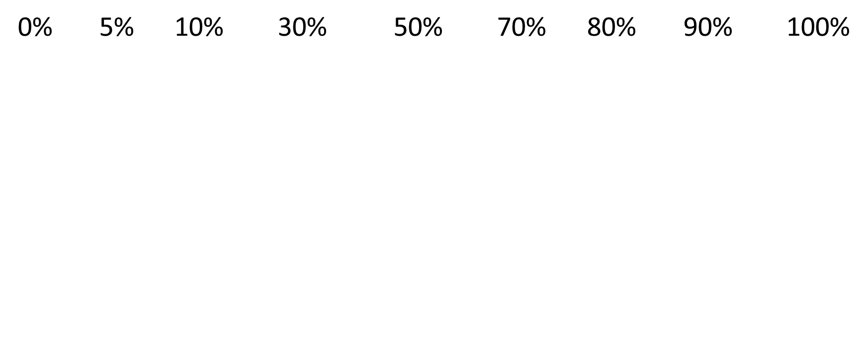
Grammar
გრამატიკა
Never
Rarely
Seldom
Occasionally
Sometimes
Often
Frequently
Usually
Always

Slide 39
Grammar
გრამატიკა
Adverbs of frequency go after the verb “to be”.
I am never late for work.
She is always happy.
Are you often tired?
I am not usually that busy.

Slide 40
Grammar
გრამატიკა
I often go to school by bus.
She always wears a dress.
Do you often cry for sad movies?
He doesn’t always feel happy.
Frequency adverbs go before the other verbs.

Slide 41
Grammar
გრამატიკა
Other frequency words usually go at the end of the sentence.
We do gardening every weekend.
He checks his e-mails every day.
Do you go to the gym twice a week?

Slide 42
Grammar Activity
გრამატიკის დავალება
Our teacher, Mr Smith, is late for lessons. (seldom)
Our teacher, Mr Smith, is seldom late for lessons.

Slide 43
Grammar Activity
გრამატიკის დავალება
The siblings help each other with housework. (regularly)
The siblings regularly help each other with housework.

Slide 44
Grammar Activity
გრამატიკის დავალება
I am bored in the math's class. (often)
I am often bored in the math’s class.

Slide 45
Grammar Activity
გრამატიკის დავალება
He is happy with his results. (rarely)
He is rarely happy with his results.

Slide 46
Grammar Activity
გრამატიკის დავალება
He doesn’t visit his psychologist. (often)
He doesn't often visit his psychologist.

Slide 47
Summary
შეჯამება
Vocabulary
Psychology|
ფსიქოლოგია
Reading about Birth Order
Adverbs of Frequency

Slide 48
Homework
საშინაო დავალება
Write a short description of a family member.

Slide 49
Homework
საშინაო დავალება
I’d like to describe my brother. He’s the youngest member of our family. He’s funny and tries to make people laugh all the time. He’s also very strong-willed and accomplishes anything he puts his mind to. He’s also very responsible and organised. When me or my sister need help, he’s always the one to help us even though he ‘s the youngest. He’s also very smart and gets good grades in school. Our whole family’s proud of him.

