Slide 2
Architecture ǀ არქიტექტურა
English for Specific Purposes | Level B2

Slide 3
Agenda
გაკვეთილის გეგმა
Introduction - შესავალი
Architecture
არქიტექტურა
Vocabulary - ლექსიკა
Reading Comprehension - წაკითხულის გააზრება
Grammar - გრამატიკა
Summary- შეჯამება
Homework- საშინაო დავალება

Slide 4
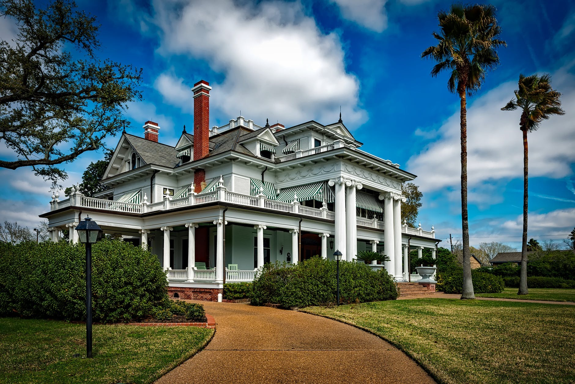
Introduction შესავალი
What’s your dream house like?

Slide 5
high-rise building (n.)
მრავალსართულიანი
შენობა
semi-detached house
(n.)
სახლი, რომელსაც მომიჯნავე სახლთან საერთო კედელი აქვს
slum
(n.)
ჯურღმული, ქალაქის ღარიბული და კეთილმოუწყობელი რაიონი
Vocabulary
ლექსიკა
mansion
(n.)
დიდი საკუთარი სახლი
hovel
(n.)
ქოხი

Slide 6
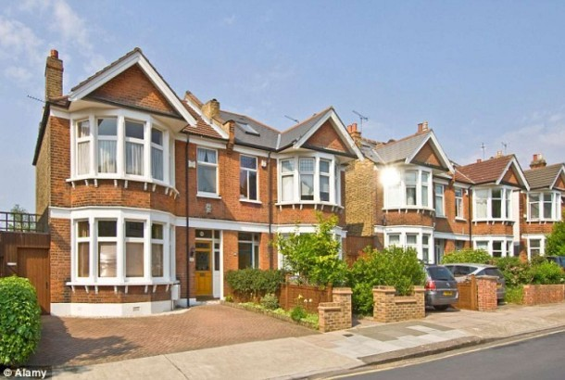
Vocabulary
ლექსიკა
semi-detached house
(n.)
სახლი, რომელსაც მომიჯნავე სახლთან საერთო კედელი აქვს
They live in a semi-detached house.

Slide 7
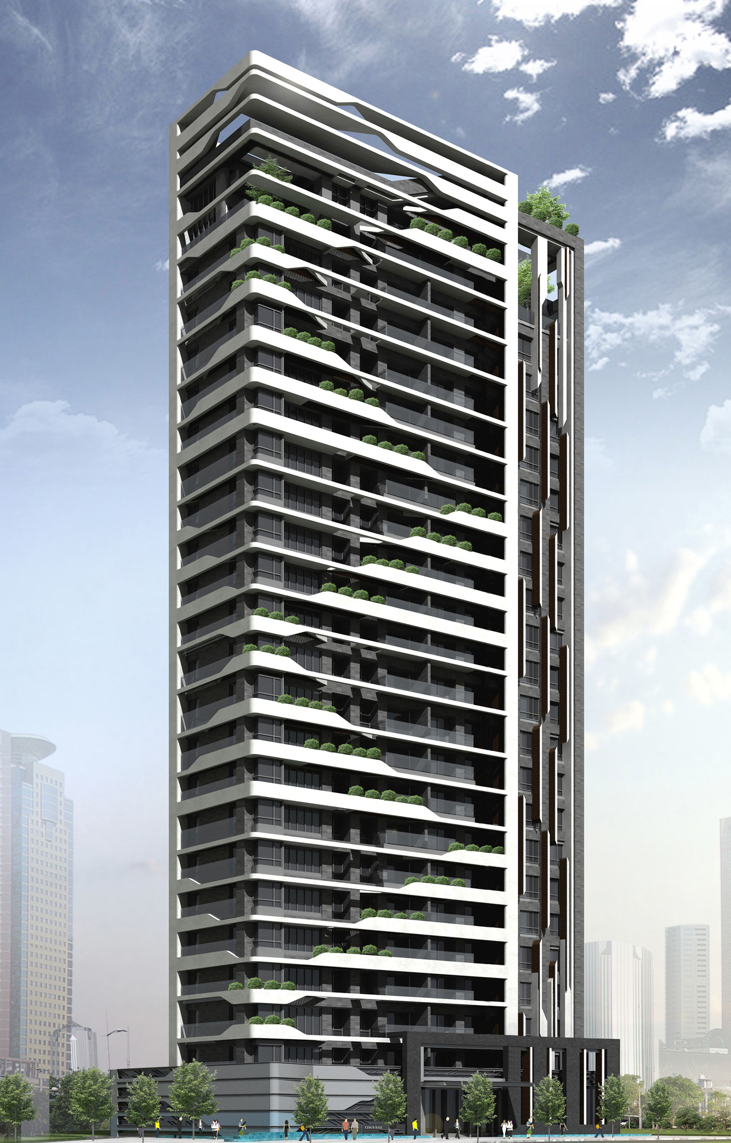
Vocabulary
ლექსიკა
high-rise building
(n.)
მრავალსართულიანი
შენობა
She lives in a high-rise building overlooking the river.

Slide 8
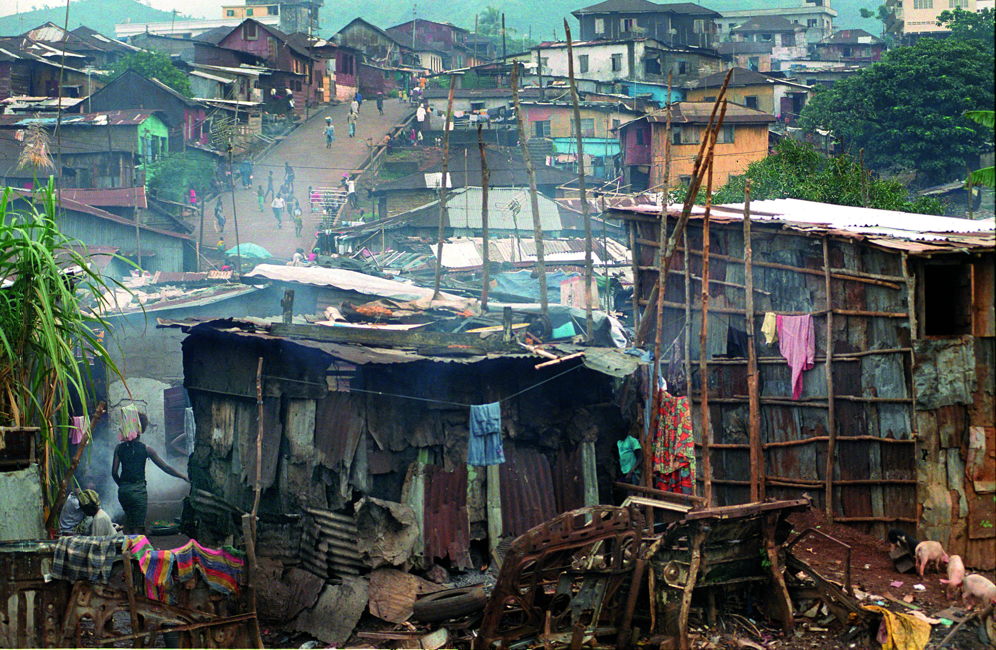
Vocabulary
ლექსიკა
slum
(n.)
ჯურღმული, ქალაქის ღარიბული და კეთილმოუწყობელი რაიონი
We shall try our best to remedy the conditions in the slums.

Slide 9
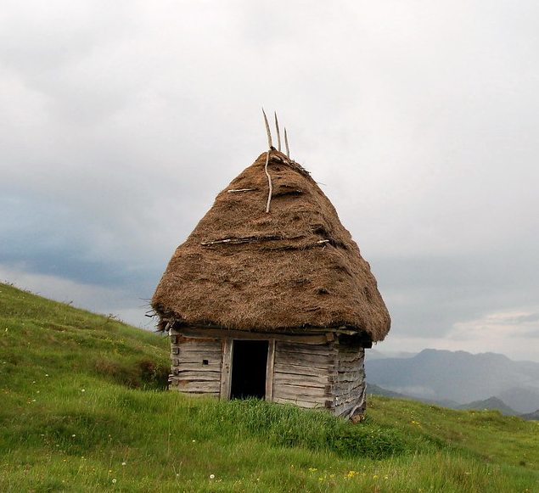
Vocabulary
ლექსიკა
hovel (n.)
ქოხი
“From the same materials one man builds palaces, another a hovel.”

Slide 10
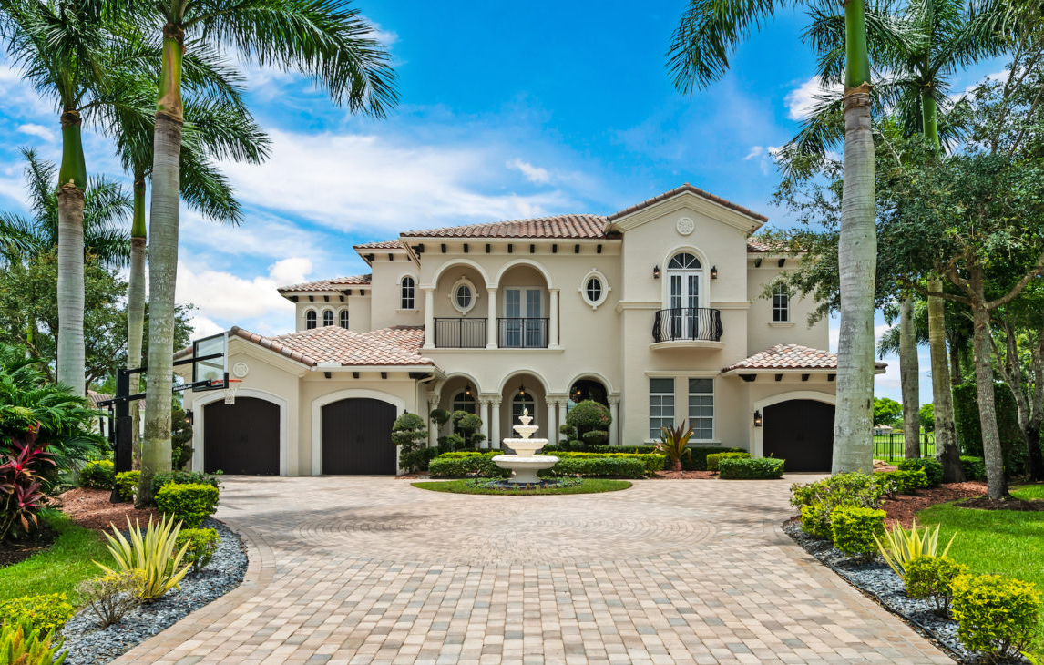
Vocabulary
ლექსიკა
mansion
(n.)
დიდი საკუთარი სახლი
The street is lined with enormous mansions where the rich and famous live.

Slide 11
Vocabulary
ლექსიკა
semi-detached house
high-rise building
slum
hovel
mansion
A small home that is dirty and in a bad condition.

Slide 12
Vocabulary
ლექსიკა
semi-detached house
high-rise building
slum
mansion
A very large, expensive house.

Slide 13
Vocabulary
ლექსიკა
semi-detached house
high-rise building
slum
A house that is joined to another similar house only on one side.

Slide 14
Vocabulary
ლექსიკა
high-rise building
slum
A very poor and crowded area, especially of a city.

Slide 15
Vocabulary
ლექსიკა
high-rise building
A tall modern building with many floors.

Slide 16
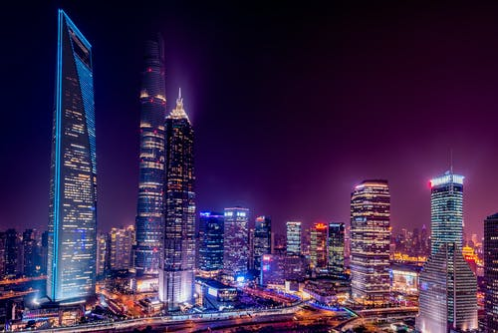
Which city has the best architecture, in your opinion?

Slide 17
renowned
(adj.)
სახელგანთქმული, ცნობილი
prosperous
(adj.)
მდიდარი, წარმატებული, აყვავებული
marvel
(n.)
საოცრება
Vocabulary
ლექსიკა
to embody
(v.)
განხორციელება
work of art
(n.)
ხელოვნების ნიმუში
ingenuity
(n.)
შემოქმედებითობა

Slide 18
Vocabulary
ლექსიკა
prosperous
(adj.)
მდიდარი, წარმატებული, აყვავებული
The area is becoming more and more prosperous.

Slide 19
Vocabulary
ლექსიკა
renowned
(adj.)
სახელგანთქმული, ცნობილი
The region is renowned for its outstanding natural beauty.

Slide 20
Vocabulary
ლექსიკა
marvel
(n.)
საოცრება
The panoramic view was a real marvel.

Slide 21
Vocabulary
ლექსიკა
work of art
(n.)
ხელოვნების ნიმუში
The new building in the city centre was a real work of art.

Slide 22
Vocabulary
ლექსიკა
ingenuity
(n.)
შემოქმედებითობა
I was impressed by the ingenuity of the architects.

Slide 23
Vocabulary
ლექსიკა
to embody
(v.)
განხორციელება,
რეალიზება, ხორცის შესხმა
His paintings embody the very essence of the immediate post-war years.

Slide 24
Reading Comprehension
წაკითხულის გააზრება
The world’s tallest building. A living wonder. A stunning work of art. An incomparable feat of engineering. Burj Khalifa is all that. In concept and execution, Burj Khalifa has no peer.
More than just the world’s tallest building, Burj Khalifa is an unprecedented example of international cooperation, a symbolic beacon of progress, and an emblem of the new, dynamic and prosperous Middle East.
It is also tangible proof of Dubai’s growing role in changing world. In fewer than 30 years, this city has transformed itself from a regional centre to a global one. This success was not based on oil reserves, but on reserves of human talent, ingenuity and initiative. Burj Khalifa embodies that vision.
Mr. Alabbar, Chairman of Emaar Properties, said: “Burj Khalifa goes beyond its imposing physical speculations. In Burj Khalifa, we see the triumph of Dubai’s vision of breaking seemingly impossible and entirely new benchmarks.”

Slide 25
Reading Comprehension
წაკითხულის გააზრება
Defining the Toronto skyline at 554 metres, the CN Tower is the world’s tallest tower, a record it has held for over three decades. As Toronto, Ontario and Canada’s most recognisable icon, the CN Tower is an internationally renowned architectural triumph, an engineering wonder of the modern world, a world-class entertainment and dining destination and a “must-see” for anyone visiting Toronto. Each year, over 1.5 million people visit Canada’s National Tower to take in the breathtaking views and enjoy all the CN Tower has to offer. Over the years, millions of dollars have been invested in expanding and revitalising the CN Tower to continue to provide visitors with world class experience.

Slide 26
Reading Comprehension
წაკითხულის გააზრება
In 1995, the CN Tower was classified as one of the Seven Wonders of the Modern World by the American Society of Civil Engineers. Canada’s Wonder of the World shares this destination with the Empire State Building, the Chunnel under the English Channel, the Golden Gate Bridge in San Francisco, Itaipu Dam on the Brazil/Paraguay border, the Panama Canal, and the North Sea Protection Works off the European Coast.
Since the CN Tower opened, Canadians and tourists from around the world have made the trip to Toronto to celebrate this marvel of engineering. Besides serving as a telecommunications hub, the CN Tower provides a wide range of unique attractions, exhibits and food and beverage venues.

Slide 27
Reading Comprehension
წაკითხულის გააზრება
Which building is in a city that has become an international centre?
Burj Khalifa
It is also tangible proof of Dubai’s growing role in changing world. In fewer than 30 years, this city has transformed itself from a regional centre to a global one.

Slide 28
Reading Comprehension
წაკითხულის გააზრება
Which building mentions the possibility of eating there?
CN Tower
CN Tower is an internationally renowned architectural triumph, an engineering Wonder of the Modern World, a world-class entertainment and dining destination and a “must-see” for anyone visiting Toronto.

Slide 29
Reading Comprehension
წაკითხულის გააზრება
Which building claims to be an example of countries working together?
Burj Khalifa
More than just the world’s tallest building Burj Khalifa is an unprecedented example of international cooperation, a symbolic beacon of progress, and an emblem of the new, dynamic and prosperous Middle East.

Slide 30
Reading Comprehension
წაკითხულის გააზრება
Which building claims to be a top tourism destination?
CN Tower
Since the CN Tower opened, Canadians and tourists from around the world have made the trip to Toronto to celebrate this marvel of engineering.

Slide 31
Grammar
გრამატიკა
CLEFT SENTENCES WITH WHAT

Slide 32
Grammar
გრამატიკა
In a cleft sentence with What, the word order is changed to give emphasis to what comes first in the sentence. A what – clause is often used to emphasize emotions such as like, need, feel, think, want, dislike, and prefer.
e.g. What I want to do now is to travel to Toronto.

Slide 33
Grammar
გრამატიკა
Form
What + noun/pronoun + emotive verb + verb to be + noun or noun clause
Example
We need to distinguish between modern and traditional buildings.
What we need to do is to distinguish between modern and traditional buildings.
A what-clause with the auxiliary do is used to emphasize the event or action.
He left the door unlocked.
What he did was leave the door unlocked.
What + subject +do + verb to be + verb clause
I analyze all of the experiment data.
What I do is analyse all of the experiment data.

Slide 34
Grammar Activity
გრამატიკის დავალება
They decided to redecorate the house.
What they decided to do was to redecorate the house.

Slide 35
Grammar Activity
გრამატიკის დავალება
They wanted to discuss the solutions to the problems of noise pollution.
What they wanted to discuss was the problem of noise pollution.

Slide 36
Grammar Activity
გრამატიკის დავალება
I need to interview the people who worked on the construction site.
What I need to do is (to) interview the people who worked on the construction site.

Slide 37
Grammar Activity
გრამატიკის დავალება
She always asks for the quietest room in the hotel.
What she asks for is the quietest room in the hotel.

Slide 38
Summary
გაკვეთილის შეჯამება
Architecture
არქიტექტურა
Vocabulary
Reading: Renowned buildings
Grammar: Cleft Sentences with what

Slide 39
Homework
საშინაო დავალება
Write a paragraph describing what great architecture means to you.

Slide 40
Homework
საშინაო დავალება
Brilliant architecture can be a great source of inspiration for artists and designers, through the structural shapes, unique design concepts and decorative details. These elements can provide inspiration for design projects of all kinds.
A building tells us a lot about a country's culture and way of life during the period it was built. It's a bit like looking at a historical photograph, but unlike in a photo, buildings evolve after construction is finished. Time affects the building's aesthetic, as the usual wear and tear demands renovation, plus the changing tastes of society have their own impact on the design and functionality of a building.

