Slide 2
Culinary ǀ კულინარია
English for Specific Purposes | Level B2

Slide 3
Agenda
გაკვეთილის გეგმა
Introduction - შესავალი
Culinary
კულინარია
Vocabulary - ლექსიკა
Reading Comprehension - წაკითხულის გააზრება
Grammar - გრამატიკა
Summary- შეჯამება
Homework- საშინაო დავალება

Slide 4
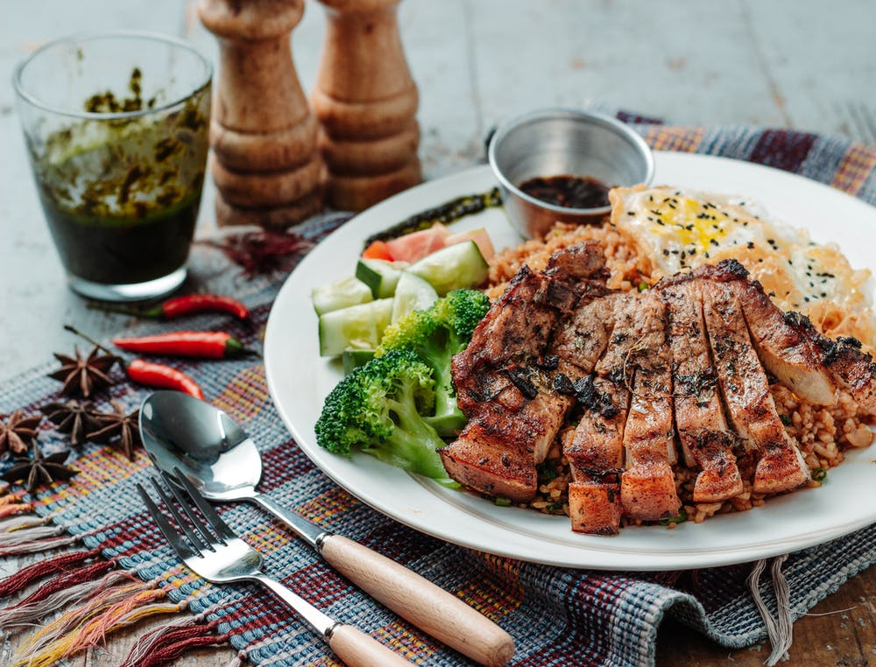
Introduction
შესავალი
What kind of food do you enjoy eating?
Are there local products or from other countries?

Slide 5
to dice
(v.)
კუბის ფორმით დაჭრა
to whip
(v.)
ადღვება , ათქვეფა
to dress
(v.)
შეკაზმვა
Vocabulary
ლექსიკა
to mince
(v.)
საკეპ მანქანაში გატარება
to grate
(v.)
სახეხზე გახეხვა

Slide 6
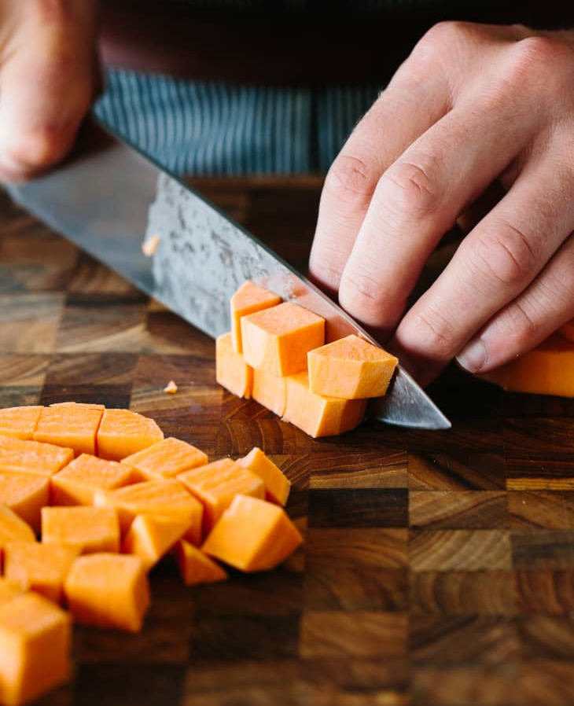
Vocabulary
ლექსიკა
to dice
(v.)
კუბის ფორმით დაჭრა
Dice carrots before putting into soup.

Slide 7
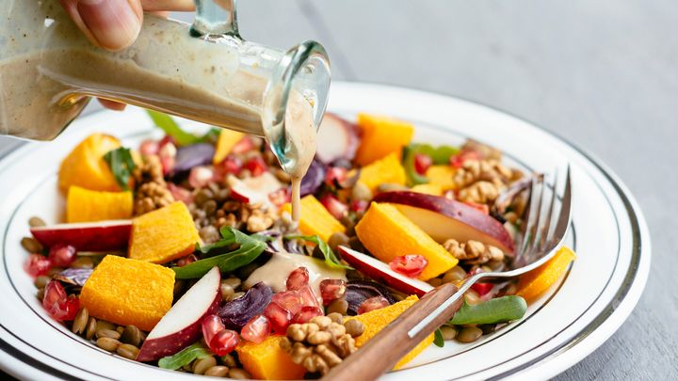
Vocabulary
ლექსიკა
to dress
(v.)
შეკაზმვა
Dress the salad with the proper dressing.

Slide 8
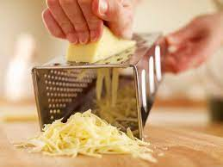
Vocabulary
ლექსიკა
to grate
(v.)
სახეხზე გახეხვა
Grate cheese on spaghetti.

Slide 9
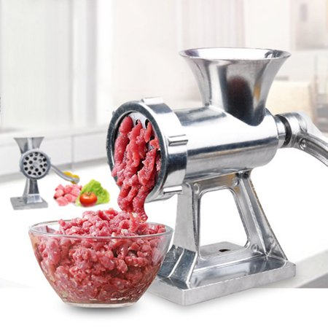
Vocabulary
ლექსიკა
to mince
(v.)
საკეპ მანქანაში გატარება
Mince the meat for Cautlettes.

Slide 10
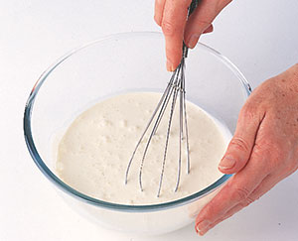
Vocabulary
ლექსიკა
to whip
(v.)
ადღვება,ათქვეფა
Whip the cream for the cake.

Slide 11
Vocabulary
ლექსიკა
whip
mince
grate
dress
dice
To cut meat into very small pieces using a machine.

Slide 12
Vocabulary
ლექსიკა
whip
grate
dress
dice
To mix food very quickly in order to put air into it.

Slide 13
Vocabulary
ლექსიკა
grate
dress
dice
To rub cheese, vegetables, chocolate, etc. against a grater in order to cut them into small pieces.

Slide 14
Vocabulary
ლექსიკა
dice
dress
Do add flavour to a salad by putting a mixture of liquids such as oil and lemon juice on it.

Slide 15
Vocabulary
ლექსიკა
dice
To cut something in small square pieces.

Slide 16
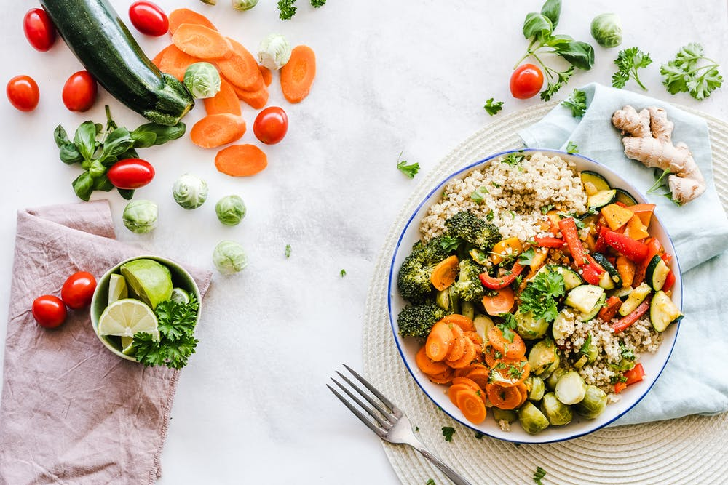
Which foods are shared in our culture?

Slide 17
prominent
(adj.)
მნიშვნელოვანი, გამოჩენილი
grain
(n.)
მარცვლეული
nourishment
(n.)
საკვები
Vocabulary
ლექსიკა
to feed
(v.)
გამოკვება
root
(n.)
ფესვი
cleansing
(adj.)
გამწმენდი

Slide 18
Vocabulary
ლექსიკა
prominent
(adj.)
მნიშვნელოვანი, გამოჩენილი
Gordon Ramsay is a prominent cook.

Slide 19
Vocabulary
ლექსიკა
nourishment (n.)
საკვები
Young babies obtain all the nourishment they need from their mother's milk.

Slide 20
Vocabulary
ლექსიკა
root
(n.)
ფესვი
Many customs have deep roots in the past.

Slide 21
Vocabulary
ლექსიკა
cleansing
(adj.)
გამწმენდი
Some food have cleansing quality.

Slide 22
Vocabulary
ლექსიკა
to feed
(v.)
გამოკვება
I always try to feed my children healthy food.

Slide 23
Vocabulary
ლექსიკა
grain
(n.)
მარცვლეული
Grains are very healthy to eat in the morning.

Slide 24
Reading Comprehension
წაკითხულის გააზრება
Paragraph 1:
We usually understand when someone speaks or writes to us, and many gestures and facial expressions have meaning, too. But have you ever considered what and how we eat as a form of communication? Food serves this purpose in two fundamental ways. In many cultures, people share food at mealtimes. Sharing bread or other foods is a common human tradition that can promote unity and trust. Food can also have a specific meaning, and play a prominent role in a family or culture's celebrations or traditions. The foods we eat and when and how we eat them are often unique to a particular culture, or may even differ between rural and urban areas within one country.

Slide 25
Reading Comprehension
წაკითხულის გააზრება
Paragraph 2:
In most cultures, bread represents nourishment. It is also one of the most commonly shared foods in the world. Sharing bread, whether during a special occasion or at the family dinner table, is a common symbol of companionship and togetherness. In fact, the word companion comes from the Latin roots com- (together) and pools (bread). Many cultures also celebrate birthdays and marriages with elaborately decorated cakes that are cut and shared among the guests. Early forms of cake were simply a kind of bread, so this tradition has its roots in the custom of sharing bread.
Paragraph 3:
Food also plays an important role in many New Year celebrations. In the southern United States, pieces of corn bread represent blocks of gold for prosperity in the new year. In Greece, people share a special cake called Vasilopita. A coin is baked into the cake, which signifies success in the new year for the person who receives it. Most of the foods eaten during the Chinese New Year have symbolic significance. Sometimes this is based on their shape; for instance, long noodles symbolise long life. The symbolism can also be based on the sound of the word in Chinese; for example, people give out oranges because the word for "orange" sounds like the word for "wealth".

Slide 26
Reading Comprehension
წაკითხულის გააზრება
Paragraph 4:
Food could also be part of a ceremony. For example, many cultures have ceremonies to celebrate the birth of a child, and food can play a significant role. In China, when a baby is one month old, families name and welcome their child in a celebration that includes giving red-coloured eggs to guests. In Afghanistan, parents feed babies butter and sugar for the first six days of life to symbolise cleansing. In a ceremony around 100 days after a child's birth, Japanese families symbolically feed the baby by putting different kinds of food to its lips, and sometimes putting a single grain of rice in it’s mouth. This ritual expresses their hope that the baby will never be hungry. In many cultures, round foods such as grapes, pomegranates, bread and moon cakes are eaten at welcome celebrations to symbolise family unity.

Slide 27
Reading Comprehension
წაკითხულის გააზრება
Nutrition is essential for life, so it is not surprising that food is such an important part of different cultures around the world. The food people eat during celebrations and ceremonies can symbolise many things, but sharing food is one custom that almost all humans have in common. This means you have to experience food sharing ceremony at some point of your life and you should enjoy it fully.

Slide 28
Reading Comprehension
წაკითხულის გააზრება
What is the main idea?
The importance of good food in culture
The high cost of eating well
The importance of healthy eating

Slide 29
Reading Comprehension
წაკითხულის გააზრება
Food is important in many New Year celebrations around the world.
Paragraph 1
Around the world food is important in welcoming ceremonies for young children.
Paragraph 2
Food can bring people together.
Paragraph 3
Food is a way of communicating.
Paragraph 4

Slide 30
Grammar
გრამატიკა
Future in the Past

Slide 31
Grammar
გრამატიკა
Future in the Past is the tense used when we are talking about the past and we want to refer to something which was in the future relative to that past time.

Slide 32
Grammar
გრამატიკა
Future in the Past structures are the past form of will and to be going to:
Subject + would + verb + …
Subject + was/were + going to + verb + …

Slide 33
Grammar
გრამატიკა
Example
The owner of the restaurant said that she would take care of the customers.
I read they were going to open a new restaurant.

Slide 34
Grammar Activity
გრამატიკის დავალება
We couldn't be at that party, because we .......... abroad the following day.
a. would go
b. were going
c. went

Slide 35
Grammar Activity
გრამატიკის დავალება
Peter decided he ... to France on holidays.
a. will go
b. would go
c. went

Slide 36
Grammar Activity
გრამატიკის დავალება
I ... to the party, but Peter made me come.
a. wouldn't go
b. wasn't going
c. wasn't going to go

Slide 37
Grammar Activity
გრამატიკის დავალება
I was sure we …………………… a delicious meal.
were going to cook
would cook
cooked

Slide 38
Summary
გაკვეთილის შეჯამება
Culinary
კულინარია
Vocabulary
Reading about culture and food
Grammar: Future in the Past

Slide 39
Homework
საშინაო დავალება
Write a paragraph about a special dish eaten in your culture, on a special day.

Slide 40
Homework
საშინაო დავალება
A special desert eaten in our culture is known as Gozinaki. Gozinaki is sweet desert made of walnuts and made for Christmas and New Year celebrations. To make Gozinaki you need to cut walnuts into small pieces. You need to take honey and put it on the pan, boil it and add pieces of walnuts. You need to mix the walnuts with honey and roll it out on the table. When it is flat you need to cut it into pieces and eat it during the New Year celebration.

