Slide 2
Days of the Week კვირის დღეები
Young Learners
დაწყებითი კლასები

Slide 3
What day is it today?

Slide 4
Monday ორშაბათი
Tuesday სამშაბათი
Wednesday ოთხშაბათი
Thursday ხუთშაბათი
Friday პარასკევი
Saturday შაბათი
Sunday კვირა

Slide 5
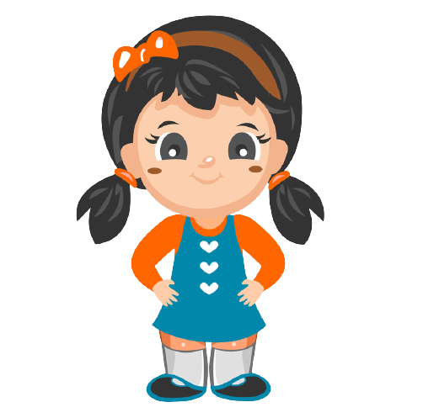
This is Mary. She is nine years old. She goes to school. Every Monday Mary reads English books with her friends. Every Tuesday she rides a bicycle in the park. On Wednesdays she plays music at Music Club. On Thursdays she has dance classes. Every Friday Mary goes to the gym. On Saturdays and Sundays Mary helps her mum and they cook together.

Slide 6
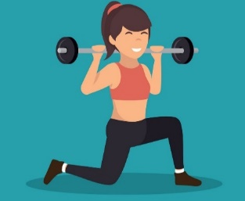
This is Mary. She is nine years old. She goes to school. Every Monday Mary reads English books with her friends. Every Tuesday she rides a bicycle in the park. On Wednesdays she plays music at Music Club. On Thursdays she has dance classes. Every Friday Mary goes to the gym. On Saturdays and Sundays Mary helps her mum and they cook together.
Monday ორშაბათი
Tuesday სამშაბათი
Wednesday ოთხშაბათი
Thursday ხუთშაბათი
Friday პარასკევი

Slide 7
1. Does Mary have dance classes on Thursdays? ___ 2. Does Mary help her mum on Fridays? ___ 3. Does Mary ride a bicycle on Mondays? ___ 4. Does Mary play music on Wednesdays? ___ 5. Does Mary cook on Saturdays and Sundays? ___
This is Mary. She is nine years old. She goes to school. Every Monday Mary reads English books with her friends. Every Tuesday she rides a bicycle in the park. On Wednesdays she plays music at Music Club. On Thursdays she has dance classes. Every Friday Mary goes to the gym. On Saturdays and Sundays Mary helps her mum and they cook together.
Yes
No
No
Yes
Yes

Slide 8
Cardinal Numbers რაოდენობითი რიცხვითი სახელი
Ordinal Numbers რიგობითი რიცხვითი სახელი
1
2
3
4
5
6
7
8
9
10
the 1st
the 2nd
the 3rd
the 4th
the 5th
the 6th
the 7th
the 8th
the 9th
the 10th
one
two
three
four
five
six
seven
eight
nine
ten
the first
the second
the third
the fourth
the fifth
the sixth
the seventh
the eighth
the ninth
the tenth

Slide 9
the second Monday the fifth Tuesday the seventh Wednesday the first Thursday the sixth Friday the fourth Saturday the third Sunday
Homework N1 საშინაო დავალება N1
Match the ordinal numbers with the days of the week. დაუკავშირეთ რიგობითი რიცხვითი სახელები კვირის დღეებს.

Slide 10
e.g. odyaMn Monday uTesyad ________________ ydadWesen ________________ hrTduyas ________________ rFyadi ________________ Suyadrta ________________ ySudna ________________
Homework N2 საშინაო დავალება N2
Unscramble the names of the days of the week. დაალაგეთ მოცემული ასოები სწორი თანმიმდევრობით კვირის დღეების შესადგენად.

Slide 11
Please send your homework to:
საშინაო დავალება გამოგვიგზავნეთ
შემდეგ მისამართზე:

