Slide 1
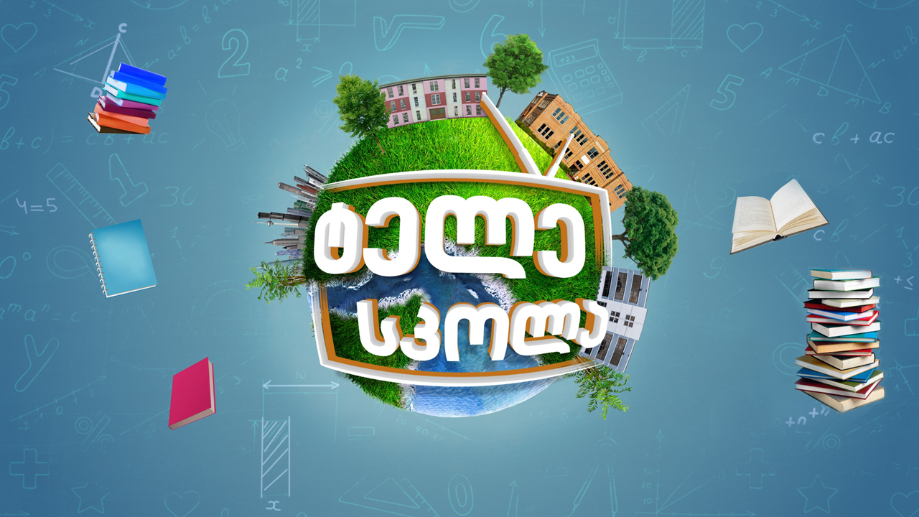

Slide 2
Law ǀ სამართალი
English for Specific Purposes | Level B2

Slide 3
Agenda
გაკვეთილის გეგმა
Introduction - შესავალი
Law
სამართლი
Vocabulary - ლექსიკა
Reading Comprehension - წაკითხულის გააზრება
Grammar - გრამატიკა
Summary- შეჯამება
Homework- საშინაო დავალება

Slide 4
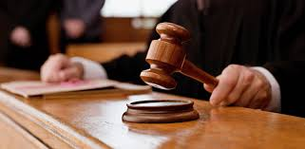
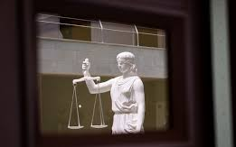
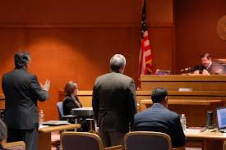
Introduction შესავალი
What are these photos related to?
What is the function of the court?

Slide 5
witness
(n.)
თვითმხილველი, მოწმე
lawsuit
(n.)
სასამართლო პროცესი, საქმე
evidence
(n.)
სამხილი
Vocabulary
ლექსიკა
investigation
(n.)
გამოძიება
jury
(n.)
ნაფიცი მსაჯულები

Slide 6
Vocabulary
ლექსიკა
witness
(n.)
თვითმხილველი, მოწმე
According to (eye) witnesses, the robbery was carried out by two teenage boys.

Slide 7
Vocabulary
ლექსიკა
evidence
(n.)
სამხილი
A jury has heard all the evidence in this case.

Slide 8
Vocabulary
ლექსიკა
jury
(n.)
ნაფიცი მსაჯულები
Not surprisingly, the jury found them both guilty.

Slide 9
Vocabulary
ლექსიკა
investigation
(n.)
გამოძიება
The bank conducted its own internal investigation into the robbery.

Slide 10
Vocabulary
ლექსიკა
lawsuit
(n.)
სასამართლო პროცესი, საქმე
Two of the directors filed a lawsuit against their former employer.

Slide 11
Vocabulary
ლექსიკა
lawsuit
witness
evidence
jury
investigation
Objects, documents or official statements that are used to prove something is true or not true, especially for legal or insurance purposes

Slide 12
Vocabulary
ლექსიკა
lawsuit
witness
jury
investigation
A problem taken to a law court by an ordinary person or an organisation rather than the police in order to obtain a legal decision

Slide 13
Vocabulary
ლექსიკა
witness
jury
investigation
A group of people who have been chosen to listen to the facts in a court action and decide whether a person is guilty or not guilty or whether a claim has been proved

Slide 14
Vocabulary
ლექსიკა
witness
investigation
The act or process of examining a crime, problem, statement, etc. carefully, especially to discover the truth

Slide 15
Vocabulary
ლექსიკა
witness
A person who sees an event happening, especially a crime or an accident

Slide 16
defence
(n.)
დაცვა
liberty
(n.)
თავისუფლება
unjust
(adj.)
უსამართლო
Vocabulary
ლექსიკა
to enact
(v.)
დადგენა, მიღება (კანონის)
discretion
(n.)
შეხედულება
statute
(n.)
კანონი, პარლამენტის მიერ დამტკიცებული

Slide 17
Vocabulary
ლექსიკა
liberty
(n.)
თავისუფლება
For most citizens, liberty means the freedom to practise their religious or political beliefs.

Slide 18
Vocabulary
ლექსიკა
defence
(n.)
დაცვა
Now he says he's done nothing wrong, and I assume that will be his defence in court.

Slide 19
Vocabulary
ლექსიკა
unjust
(adj.)
უსამართლო
New laws will protect employees against unjust dismissals.

Slide 20
Vocabulary
ლექსიკა
to enact
(v.)
დადგენა, მიღება (კანონის)
A package of economic sanctions is to be enacted against the country.

Slide 21
Vocabulary
ლექსიკა
statute
(n.)
კანონი, პარლამენტის მიერ დამტკიცებული
The salaries of most federal workers are set by statute.

Slide 22
Vocabulary
ლექსიკა
discretion
(n.)
შეხედულება, მოქმედების თავისუფლება
I leave the decision to your discretion.

Slide 23
Reading Comprehension
წაკითხულის გააზრება

Slide 24
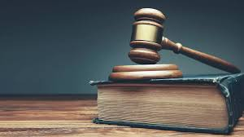
Reading Comprehension
წაკითხულის გააზრება
When were the first laws made?
By the 22nd century BC, Ur-Nammu, an ancient Sumerian ruler, formulated the first extant law code, consisting of casuistic statements ("if... then..."). Around 1760 BC, King Hammurabi further developed Babylonian law, by codifying and inscribing it in stone.
Who writes laws?
A legislator (or lawmaker) is a person who writes and passes laws, especially someone who is a member of a legislature. Legislators are usually politicians and are often elected by the people of the state.

Slide 25
Reading Comprehension
წაკითხულის გააზრება
"Even when laws have been written down, they ought not always to remain unaltered."
These words by Aristotle, the famous ancient Greek philosopher, could have been
written to describe English law and its sources.
Where else would you find constitutional laws without any constitution? Most people have heard of the Magna Carta (1215). It is often described as the corner stone of liberty and the chief defence against arbitrary and unjust rule in England by establishing for the first time a very significant constitutional principle, namely that the power of the king could be limited.

Slide 26
Reading Comprehension
წაკითხულის გააზრება
Through the ages this principle has continued to be upheld in spite of various monarchs, civil war and riots resulting in Parliament making itself sovereign and
representing the will of the people.
As a result, all legislative power is placed in the hands of Parliament. There is no legal limit to the power of Parliament and the courts are bound by all legislation that is enacted by Parliament. So, what is the role of the judiciary?
The courts interpret the law, which means that although Parliament enacts the
law, the courts decide how they are to be applied. These decisions are treated as
precedents and subsequent law courts will follow these decisions if they have similar issues to determine.

Slide 27
Reading Comprehension
წაკითხულის გააზრება
This doctrine of precedent developed from common law which itself is based on custom and dates from ‘time immemorial’ (or at least 1189). Often before government wrote new laws, judges applied local and ancient customs, in order ensure that judgements were consistent and relied on decisions made in previous cases. This has also led to the principle that a judge is bound by the decision of a superior court when reaching a decision in a similar case.
Judges do not exercise their discretion in an arbitrary way by resting their judgements upon the general principles of case law and can have influence upon the development of enacted law.
Accordingly, the courts can exercise a considerable degree over the practical application of statutes although governments make new laws which modify or clarify the common law.

Slide 28
True
Reading Activity
კითხვის დავალება
Power of the king was limited by Magna Carta.
Most people have heard of the Magna Carta (1215). It is often described as the corner stone of liberty and the chief defence against arbitrary and unjust rule in England by establishing for the first time a very significant constitutional principle, namely that the power of the king could be limited.

Slide 29
False
Reading Activity
კითხვის დავალება
Parliament’s powers are limited.
There is no legal limit to the power of Parliament.

Slide 30
False
Reading Activity
კითხვის დავალება
The decision of one court does not affect another.
Precedent means that a judge is bound by the decision of a superior Court in a similar case.

Slide 31
True
Reading Activity
კითხვის დავალება
The court decides how the law, enacted by the Parliament,
must be applied.
The courts interpret the law, which means that although Parliament enacts the law, the courts decide how they are to be applied.

Slide 32
Grammar
გრამატიკა
Conditionals

Slide 33
Grammar
გრამატიკა
Second Conditional
Form
If + past simple or past continuous, would + bare infinitive
Use
Impossible, unlikely or hypothetical conditions in the present or future and their results in the present or future
Advice
If you worked in that company, you would have more opportunities to get promoted.
If I were you, I would change the job.

Slide 34
Grammar
გრამატიკა
Watch out!
We can also use might or could instead of would, depending on the meaning. (Note: could here often means would be able to)
If we were older, we could go on holiday on our own.
We can also use could in the if clause. Here, it means was/were able to.
If I could drive, I’d buy a car.

Slide 35
Grammar
გრამატიკა
Third Conditional
Form
If + past perfect (simple or continuous), would + have + past participle
Use
Hypothetical conditions in the past and their results in the past.
Example
If he had won the competition, he would have built the new shopping mall.
If we had anticipated the risks, we would have saved the company.

Slide 36
Grammar
გრამატიკა
Watch out!
We can also use might, could or should instead of would, depending on the meaning.
If I had done some revision, I might/could/should have passed the exam.

Slide 37
Grammar Activity
გრამატიკის დავალება
I would call/would have called him now if I were you.

Slide 38
Grammar Activity
გრამატიკის დავალება
I wouldn’t have bought it if I did not try/had not tried it.

Slide 39
Grammar Activity
გრამატიკის დავალება
We would find a solution if you have given/gave us advice.

Slide 40
Grammar Activity
გრამატიკის დავალება
She would be/would have been pleased yesterday if you had gone with her.

Slide 41
Summary
გაკვეთილის შეჯამება
Law
სამართალი
Vocabulary
Reading
Grammar: Conditionals (2nd and 3rd)

Slide 42
Homework
საშინაო დავალება
Write a paragraph about the most important human right.

Slide 43
Homework
საშინაო დავალება
The most important human right depends on the country you live in. The status of human rights varies greatly around the world. While some countries are more likely to violate civil and political rights, others more frequently fail to protect social, cultural and economic rights. What human right is most important to you may depend on where you live, what your profession and gender is, where you are coming from, whether or not you are part of a minority, if you are a child or an elderly person, it may depend on your social status, your wealth or caste, your health or ethnicity and many other factors.

