Slide 2
Architecture|არქიტექტურა
English for Specific Purposes | Level A2

Slide 3
Agenda
გაკვეთილის გეგმა
Introduction - შესავალი
Architecture
არქიტექტურა
Vocabulary - ლექსიკა
Reading Comprehension - წაკითხულის გააზრება
Grammar - გრამატიკა
Summary- შეჯამება
Homework- საშინაო დავალება

Slide 4
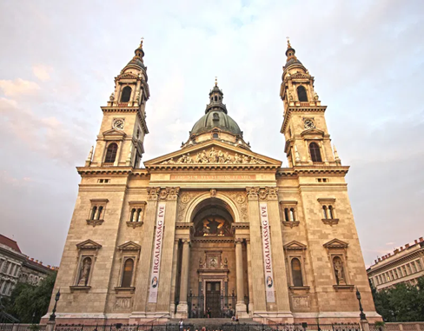
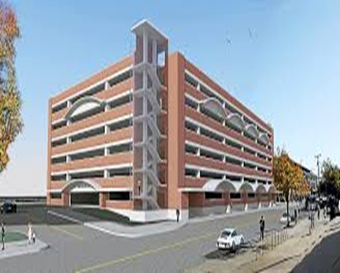
Introduction შესავალი
What do you think about the buildings?
Which one do you like and why?

Slide 5
ancient
(adj.)
ანტიკური, უძველესი
ruined
(adj.)
დანგრეული
modern
(adj.)
თანამედროვე
Vocabulary
ლექსიკა
attractive
(adj.)
მიმზიდველი, ლამაზი
ugly
(adj.)
მახინჯი

Slide 6
Vocabulary
ლექსიკა
ruined
(adj.)
დანგრეული
It is an old and ruined castle.

Slide 7
Vocabulary
ლექსიკა
ancient
(adj.)
უძველესი, ანტიკური
It is an ancient church dating back to the IV century.

Slide 8
Vocabulary
ლექსიკა
modern
(adj.)
თანამედროვე
Modern buildings are often more environmentally friendly.

Slide 9
Vocabulary
ლექსიკა
ugly
(adj.)
მახინჯი
I think, apartment buildings painted bright colours are ugly.

Slide 10
Vocabulary
ლექსიკა
attractive
(adj.)
მიმზიდველი, ლამაზი
The fountain next to the entrance makes the building very attractive.

Slide 11
Vocabulary
ლექსიკა
ancient
ugly
attractive
modern
ruined
After the war, the city was ……….

Slide 12
Vocabulary
ლექსიკა
ancient
ugly
attractive
modern
The countryside was …………………………. . Everyone liked it.

Slide 13
Vocabulary
ლექსიკა
ugly
ancient
modern
The financial district has been built recently, so there are a lot of ……………………….. buildings.

Slide 14
Vocabulary
ლექსიკა
ugly
ancient
Across the street from our building, all we can see is an ……………………. building.

Slide 15
Vocabulary
ლექსიკა
ancient
There is a church on the top of a mountain that is very ……….

Slide 16
amazing
(adj.)
საოცარი, განსაცვიფრებელი
palace
(n.)
სასახლე
restore
(v.)
აღდგენა
stone
(n.)
ქვა
Vocabulary
ლექსიკა
massive
(adj.)
მასიური, დიდი
elegant
(adj.)
ელეგანტური

Slide 17
Vocabulary
ლექსიკა
amazing
(adj.)
საოცარი, განსაცვიფრებელი
The city architecture is really amazing.

Slide 18
Vocabulary
ლექსიკა
palace
(n.)
სასახლე
The palace is open to the public during the summer months.

Slide 19
Vocabulary
ლექსიკა
restore
(v.)
აღდგენა
The building was restored at the beginning of the 20th century.

Slide 20
Vocabulary
ლექსიკა
elegant
(adj.)
ელეგანტური
The guests were sitting in an elegant dining room.

Slide 21
Vocabulary
ლექსიკა
massive
(adj.)
მასიური, დიდი
They have a massive house.

Slide 22
Vocabulary
ლექსიკა
stone
(n.)
ქვა
The house had a big stone wall around it.

Slide 23
Reading Comprehension
წაკითხულის გააზრება

Slide 24
Reading Comprehension
წაკითხულის გააზრება
Which is the most beautiful building you have ever seen?
Do you know its history?

Slide 25
Colosseum
Colosseum is an ancient building in Rome. It is an amazing building which shows the power of Roman Empire. It was built in 80 AD. It’s a big amphitheater and it was used to show the fights between the gladiators and wild animals. It is made of stones and although it was damaged during the earthquake, its main structure has been standing for 2 000 years. It looked ruined but recently, it has been restored.

Slide 26
The Taj Mahal
The Taj Mahal is in Agra, India. It is an amazing building which was built by Emperor Shah Jahan in memory of his wife who died. It looks like a palace. It looks very traditional but there are some modern elements. It was built using the materials from all over India and Asia, and used 1000 elephants in order to help and move the materials. The building was restored several years ago.

Slide 27
The Eiffel Tower
The Eiffel Tower in Paris is one of the favourite sights for tourists. It looks so beautiful and elegant. It was designed in 1889. At that time some people didn’t like it and thought that it was ugly. It’s massive. It’s about 300 meters tall and it was the world’s tallest structure until about 1930.

Slide 28
False
Reading Activity
კითხვის დავალება
The Colosseum is a modern building in Rome.
The Colosseum is an ancient building in Rome.

Slide 29
False
Reading Activity
კითხვის დავალება
The Colosseum was destroyed by the earthquake.
Although it was damaged during the earthquake it’s main structure has been standing for 2,000 years.

Slide 30
False
Reading Activity
კითხვის დავალება
The Taj Mahal is a modern building in Europe.
The Taj Mahal is in Agra, India.

Slide 31
True
Reading Activity
კითხვის დავალება
In the past, some people thought that the Eiffel Tower was not beautiful at all.
At that time some people didn’t like it and thought that it was ugly.

Slide 32
Grammar
გრამატიკა
The building was designed in 1889.
It was restored several years ago.

Slide 33
Grammar
გრამატიკა
We often use the past simple passive:
when we prefer not to mention who or what did the action (for example, it's not known, it's obvious or we don't want to say)
New bridge was built in the city last year.

Slide 34
Grammar
გრამატიკა
We often use the past simple passive:
so that we can start a sentence with more important or more logical information.
The city was destroyed by the earthquake in 2008.

Slide 35
Grammar
გრამატიკა
We often use the passive:
in more formal or scientific writing.
New methods of construction were discovered by engineers several years ago.

Slide 36
Grammar
გრამატიკა
We can mention the doer of the action by adding the preposition “by”
The building was designed by the architect.

Slide 37
Grammar
გრამატიკა
Past Simple Passive
Form
Object + past form of to be (was/were) + past participle + by + subject.
I was informed about the updates yesterday.
The buildings were reconstructed last year.

Slide 38
Grammar
გრამატიკა
Negative form
Object + negative of to be in past (was not/were not) + past participle + by + subject.
The plan was not shown to me.
They were not informed on time.
Question form
to be in the past (was/were) + object + past participle + by + subject
Was the research done by the scientists?
Were the buildings destroyed by the earthquakes?

Slide 39
Grammar Activity
გრამატიკის დავალება
A simple small house ………………………….. by a poor family. (build)
A simple small house was built by a poor family.

Slide 40
Grammar Activity
გრამატიკის დავალება
Who …………………………….. (this building/ design) by?
Who was this building designed by?

Slide 41
Grammar Activity
გრამატიკის დავალება
The prize …………………………… by a famous architect. (win)
The prize was won by a famous architect.

Slide 42
Grammar Activity
გრამატიკის დავალება
This place …………………………… by many tourists last year. (not/visit)
This place wasn’t visited by many tourists last year.

Slide 43
Grammar Activity
გრამატიკის აქტივობა
The walls ………………………………. by a famous painter. (not/painted)
The walls weren’t painted by a famous painter.

Slide 44
Summary
გაკვეთილის შეჯამება
Vocabulary
Architecture
არქიტექტურა
Reading about famous buildings
Grammar: Past Simple Passive

Slide 45
Homework
საშინაო დავალება
Write a paragraph about the building you like.

Slide 46
Not far from London Bridge, the Shard, known as London Bridge Tower, is the UK’s highest building, standing 309.6m high. It was designed by the Italian architect, Renzo Piano. The Shard was finished in 2012. It has 72 floors and an observation deck view London, which was open to the public in 2013. Moving to the interesting part of the story, the Shard may seem like the original name of London’s highest building, but the truth is that, the name just happened by accident.

