Slide 2
Professions
პროფესიები
ზოგადი ინგლისური დონე: A1+

Slide 3
Agenda
გაკვეთილის განრიგი
Vocabulary - ლექსიკა
Summing up - შეჯამება
Homework - დავალება
Grammar - გრამატიკა
Reading Comprehension - წაკითხულის გააზრება

Slide 4
Vocabulary - ლექსიკა
Vocabulary ლექსიკა
policeman (n.)
doctor (n.)
postman (n.)
architect (n.)
cook (n.)
fireman (n.)
nurse (n.)
actor/actress (n.)
პოლიციელი
ექიმი
მედდა
ფოსტალიონი
მზარეული
მეხანძრე
მსახიობი კაცი/ქალი
არქიტექტორი

Slide 5
Vocabulary - ლექსიკა
policeman
(n.)
პოლიციელი

Slide 6
Vocabulary - ლექსიკა
doctor
(n.)
ექიმი

Slide 7
Vocabulary - ლექსიკა
postman
(n.)
ფოსტალიონი

Slide 8
Vocabulary - ლექსიკა
fireman
(n.)
მეხანძრე

Slide 9
Vocabulary - ლექსიკა
architect
(n.)
არქიტექტორი

Slide 10
Vocabulary - ლექსიკა
actor/actress
(n.)
მსახიობი კაცი/ქალი

Slide 11
Vocabulary - ლექსიკა
cook
(n.)
მზარეული

Slide 12
Vocabulary - ლექსიკა
nurse
(n.)
მედდა

Slide 13
Vocabulary - ლექსიკა
Guess the profession
გამოიცანით პროფესია
There is a fire. Let’s call a ………………..
He brings letters. He is a …………………
He/She works at a hospital. He/She is a …………………
He/She helps doctors. He/she is a …………………..
actor/actress
policeman
architect
cook
fireman
nurse
postman
doctor

Slide 14
Vocabulary - ლექსიკა
Guess the profession
გამოიცანით პროფესია
We see him/her on TV or in movies. He/She is an …………………..
He/She designs buildings. He/She is an ……………………
He/She makes dishes. He/She is a ………………..
He helps people to follow the rules. He is a ………………..
actor/actress
policeman
architect
cook
fireman
nurse
postman
doctor

Slide 15
Vocabulary - ლექსიკა
Find the mistakes and correct them
იპოვეთ შეცდომები და გაასწორეთ ისინი
I feel very bad. I need a fireman
My doctor is not at the hospital. A policeman will help me.
My grandmother makes great dishes. She is a good nurse.
My father is a doctor. He drives a police car.
doctor.
nurse
cook.
policeman

Slide 16
Vocabulary - ლექსიკა
Find the mistakes and correct them
იპოვეთ შეცდომები და გაასწორეთ ისინი
5. I am not afraid of fire. I want to become a doctor.
6. My uncle designed a building in Tbilisi. He is a cook.
7. Look! The policeman! He has a letter for you.
8. Sesilia Takaishvili is a famous cook. Kakhi Kavsadze is a famous doctor.
fireman;
an architect;
postman.
actress.
actor.

Slide 17
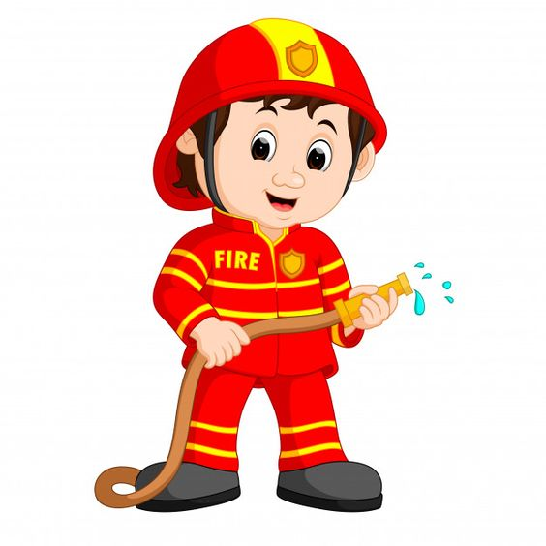
Reading Comprehension
წაკითხულის გააზრება
George

Slide 18
Reading Comprehension
წაკითხულის გააზრება
George
George has a very large family and his family members are famous. His mother is a doctor and his sister is a nurse, they work in the same hospital and they love their jobs very much. His father is an architect, he designs beautiful buildings all over Georgia and he likes his job very much too. His brother wants to become a fireman or a policeman. He is turning 25, so he needs to decide soon. His grandmother is a famous actress, but she loves to cook and wants to become a cook more, because being an actress is very difficult. That was George’s family, now let’s talk about George. George is a student and he wants to become an actor. Now he works as a postman, he brings letters to many people and makes their lives happy.

Slide 19
Reading Comprehension
წაკითხულის გააზრება
Are the sentences true or false?
სწორია თუ არა წინადადებები?
George’s family members are famous; TRUE
His mother and sister work in a café; FALSE
George’s father is a fireman; FALSE
George’s father designs buildings in Georgia; TRUE
His brother is a doctor too; FALSE
His grandmother is a famous actress; TRUE
George wants to become a postman; FALSE
George is a student. TRUE

Slide 20
Grammar- გრამატიკა
Articles (არტიკლები): a / an / the

Slide 21
Grammar- გრამატიკა
a / an - articles
a / an - განუსაზღვრელი არტიკლები
George’s mother is a doctor and his father is an architect.

Slide 22
Grammar- გრამატიკა
a / an - articles
a / an - განუსაზღვრელი არტიკლები
To talk about something non-specific
e.g. My grandmother is a cook.
e.g. My aunt is an actress.

Slide 23
Grammar - გრამატიკა
a / an- articles
a / an - განუსაზღვრელი არტიკლები
a and an
Use a before a consonant sound
e.g. a doctor; a nurse.
use an before a vowel sound
e.g. an actress; an architect.
a, e, i, o, u

Slide 24
Grammar- გრამატიკა
Choose ‘a’ or ‘an’ article
აირჩიეთ სწორი არტიკლი ‘a’ ან ‘an’
My friend’s father is a/an architect.
An/A notebook is on the table.
This is a/an beautiful picture.
My mother is a/an nurse and my sister is an/a actress.

Slide 25
Grammar - გრამატიკა
Article ‘the’- განსაზღვრული არტიკლი
To talk about something specific.
e.g. The hospital is very big.
To talk about something for the second time.
e.g. George has a bag. The bag is blue.

Slide 26
Grammar - გრამატიკა
Put ‘the’ article in the correct place
ჩასვით ‘the’ არტიკლი შესაბამის ადგილას
√ The
My mother has a computer. computer is black.
My bag is beautiful. bag is small.
house next to my garden is very big.
I have a new car. car is yellow.
√ The
√ The
√ The

Slide 27
Grammar- გრამატიკა
Choose the correct article: a/ an/ the
აირჩიეთ სწორი არტიკლი: a/an/the
His sister is a/an/the nurse and his mother is a/an/the doctor.
George’s mother and sister work in a hospital. A/An/The hospital is designed by his father.
There is a beautiful building near my house. The/A/An building is very tall.
I work at the/a/an office next to my house.

Slide 28
Summing up - შეჯამება
Vocabulary - ლექსიკა
Vocabulary ლექსიკა
policeman (n.)
doctor (n.)
postman (n.)
architect (n.)
cook (n.)
fireman (n.)
nurse (n.)
actor/actress (n.)
პოლიციელი
ექიმი
მედდა
ფოსტალიონი
მზარეული
მეხანძრე
მსახიობი კაცი/ქალი
არქიტექტორი

Slide 29
Summing up - შეჯამება
Grammar - გრამატიკა
Articles: a/ an/ the

Slide 30
Homework
საშინაო დავალება
Write about professions in your family as it is in the example:
მაგალითის მიხედვით, დაწერეთ თქვენი ოჯახის წევრების პროფესიებზე:
All people in my family have different professions. My mom is a nurse. My dad is a postman. My brother is a fireman and my grandma is a famous architect.

