Slide 2
Economics|ეკონომიკა
English for Specific Purposes | Level B2

Slide 3
Agenda
გაკვეთილის გეგმა
Introduction - შესავალი
Vocabulary - ლექსიკა
Economics
ეკონომიკა
Reading Comprehension - წაკითხულის გააზრება
Grammar - გრამატიკა
Summary- შეჯამება
Homework- საშინაო დავალება

Slide 4
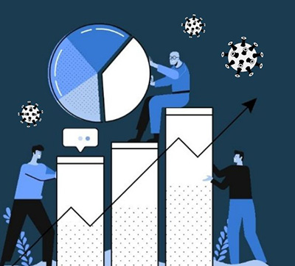
Introduction შესავალი
What are the different ways of building strong economy?

Slide 5
Vocabulary
ლექსიკა
trade
(n.)
ვაჭრობა
treasury
(n.)
სახელმწიფო ხაზინა
tax avoidance
(n.)
გადასახადებისგან
თავის არიდება
Vocabulary
ლექსიკა
poverty
(n.)
სიღარიბე
trade deficit
(n.)
საგარეო ვაჭრობის დეფიციტი

Slide 6
Vocabulary
ლექსიკა
treasury
(n.)
სახელმწიფო ხაზინა
The treasury estimates that the top 1% of earners will pay about 32.3% of all taxes this year.

Slide 7
Vocabulary
ლექსიკა
trade
(n.)
ვაჭრობა
The country's trade in manufactured goods has expanded in the last ten years.

Slide 8
Vocabulary
ლექსიკა
tax avoidance
(n.)
გადასახადებისგან თავის არიდება
The Inland Revenue estimates that it is losing at least £10 billion a year because of tax avoidance.

Slide 9
Vocabulary
ლექსიკა
trade deficit
(n.)
საგარეო ვაჭრობის დეფიციტი
Brazil has run a $14 billion trade deficit with the US.

Slide 10
Vocabulary
ლექსიკა
poverty
(n.)
სიღარიბე
Helping to alleviate poverty in developing countries also helps to reduce environmental destruction.

Slide 11
Vocabulary
ლექსიკა
treasury
trade
tax avoidance
trade deficit
poverty
The war interrupted the …………………between the two countries.

Slide 12
Vocabulary
ლექსიკა
treasury
tax avoidance
trade deficit
poverty
The problem of ……………….. is particularly acute in rural areas.

Slide 13
Vocabulary
ლექსიკა
treasury
tax avoidance
trade deficit
The ………………….is the part of the government which collects and pays out the government money.

Slide 14
Vocabulary
ლექსიკა
tax avoidance
trade deficit
Some companies use …………………………..strategies to avoid tax payments.

Slide 15
Vocabulary
ლექსიკა
trade deficit
The ……………………….with China remains high.

Slide 16
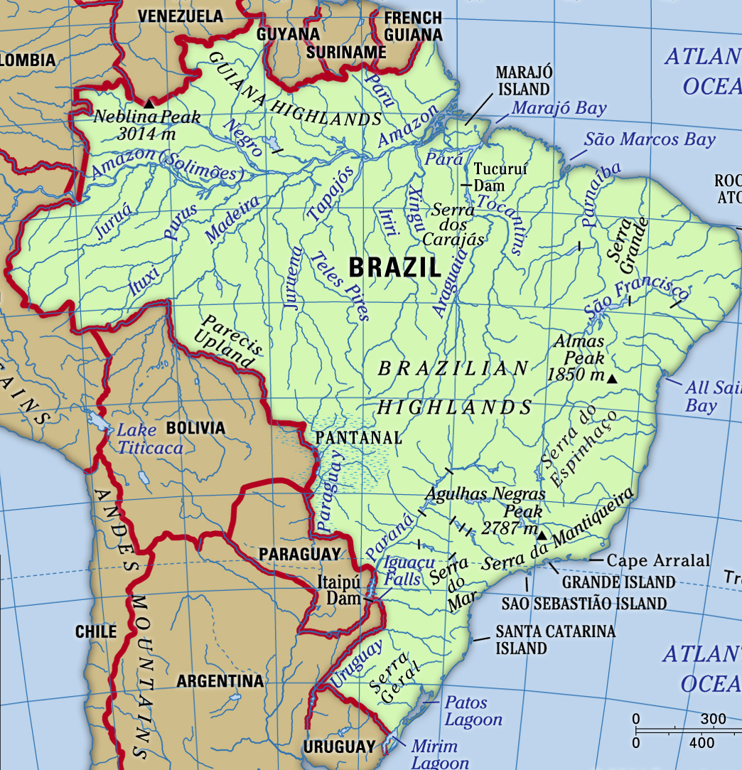
Do you know anything about Brazil’s economy?

Slide 17
Vocabulary
ლექსიკა
consumer
(n.)
მომხმარებელი
inflation
(n.)
ინფლაცია
GDP
Gross Domestic Product
(n.)
მთლიანი შიდა პროდუქტი
Vocabulary
ლექსიკა
consumer goods
(n.)
სამომხმარებლო საქონელი
interest rate
(n.)
საპროცენტო განაკვეთი
financial obligation
(n.)
ფინანსური ვალდებულება

Slide 18
Vocabulary
ლექსიკა
GDP
Gross Domestic Product
(n.)
მთლიანი შიდა პროდუქტი
If the GDP continues to shrink, the country will be in a recession.

Slide 19
Vocabulary
ლექსიკა
consumer
(n.)
მომხმარებელი
Shops were lowering prices to attract more customers.

Slide 20
Vocabulary
ლექსიკა
inflation
(n.)
ინფლაცია
The control of inflation is a key component of the government's economic policy.

Slide 21
Vocabulary
ლექსიკა
consumer goods
(n.)
სამომხმარებლო საქონელი
Prices of consumer goods rose by 2.5% last year.

Slide 22
Vocabulary
ლექსიკა
financial obligation
(n.)
ფინანსური ვალდებულება
The company may be unable to meet its financial obligations as they fall due.

Slide 23
Vocabulary
ლექსიკა
interest rate
(n.)
საპროცენტო განაკვეთი
The bank has plans to cut interest rates.

Slide 24
Reading Comprehension
წაკითხულის გააზრება
Brazil is the richest South American country in terms of GDP and it is currently one of the fastest growing economies in the world. However, there is a huge gap between the rich and the poor, and the financial situation is not easy even for ordinary Brazilians. In particular, they have problems related to consumer spending, bank interest rates and debt.
Until very recently, the inflation rate in Brazil was extremely high (sometimes 80% per month). As a result, Brazilians stopped saving money under their mattresses and started investing in consumer goods. Now, inflation is under control and the cost of living is generally not too high, but they have acquired a habit of spending and a desire for a higher standard of living.

Slide 25
Reading Comprehension
წაკითხულის გააზრება
Brazil is the fifth largest country in the world in terms of area, and so their food production is plentiful. Consequently, the cost of food is very low and most people can afford to buy enough to eat. However, the cost of consumer goods is extremely high. New cars, in particular, are very expensive and it is not easy to find cheap second-hand cars.
As the majority of Brazilians do not have high income, they usually need help from bank in order to fulfil their consumerist dreams. From then on, for people who take out a loan, it is the start of a long and complicated journey to meet their financial obligations. To take one example, the interest on loan to buy a car could be, on average, about 1.5% per month. And it is even worse when people take out a $1,000 loan to buy an item. In some cases, they end up paying three times the original price of the goods.

Slide 26
Reading Comprehension
წაკითხულის გააზრება
Bank interest rates are extremely high for borrowers, but very low for savers. Since most Brazilians are not used to saving money, many of them end up in debt. Moreover, credit card charges are about 12% each month, so once you are in debt it is hard to get out. However, if you take care of your finances and spend prudently, you can generally live very well in Brazil.

Slide 27
Reading Comprehension
წაკითხულის გააზრება
All Brazilians are very rich.
False
There is a huge gap between the rich and the poor.

Slide 28
Reading Comprehension
წაკითხულის გააზრება
High inflation caused an increase in consumer spending.
True
Until very recently, the inflation rate in Brazil was extremely high (sometimes 80% per month). As a result, Brazilians stopped saving money under their mattresses and started investing in consumer goods.

Slide 29
Reading Comprehension
წაკითხულის გააზრება
Food is very expensive and most people cannot afford to buy it.
False
The cost of food is very low and most people can afford to buy enough to eat.

Slide 30
Reading Comprehension
წაკითხულის გააზრება
It can be extremely expensive to buy goods on credit.
True
As the majority of Brazilians do not have high income, they usually need help from bank in order to fulfil their consumerist dreams. From then on, for people who take out a loan, it is the start of a long and complicated journey to meet their financial obligations.

Slide 31
Grammar
გრამატიკა
USING MODAL AUXILIARIES IN PAST PASSIVE SENTENCES

Slide 32
Grammar
გრამატიკა
Passive sentences are used when we want to put more emphasis on an action than on who or what did it. To speculate about who or what did the action, the passive voice with modal auxiliaries can be used.

Slide 33
Grammar
გრამატიკა
May/ Might/Could indicate possibility based on some evidence.
Example:
The inflation may/might/could have been caused by unstable political situations (we don’t know for sure).

Slide 34
Grammar
გრამატიკა
Must and have to indicate a stronger possibility based on stronger evidence.
Example:
The banks must have increased the interest rate on loans. The borrowers are dissatisfied (we know that bank consumers have been complaining about it).
They had to have taken measures to improve the economic situation (we can see the results of the measures taken).

Slide 35
Grammar
გრამატიკა
Can’t is used to talk about certainty in a negative sentence.
Example:
They can’t have missed the meeting. It was obligatory to attend (I’m pretty sure about it).

Slide 36
Grammar Activity
გრამატიკის დავალება
He ……………….. attended the conference, but we aren’t sure.
a. must have
b. can’t have
c. may have

Slide 37
Grammar Activity
გრამატიკის დავალება
I think they……………. got lost- surely they’d be here by now!
a. can’t have
b. must have
c. might have

Slide 38
Grammar Activity
გრამატიკის დავალება
I though I saw the manager this morning but it ………………… been him – he is in Greece on a business trip.
a. must have
b. couldn’t have
c. might have

Slide 39
Grammar Activity
გრამატიკის დავალება
Who told the newspapers about the prime minister’s plans? It …………………been someone close to him.
a. can’t have
b. must have
c. should have

Slide 40
Summary
გაკვეთილის შეჯამება
Vocabulary
Economics
ეკონომიკა
Reading about financial situation in Brazil
Grammar:
Using modal auxiliaries in the passive sentences

Slide 41
Homework Activity
საშინაო დავალება
Write a paragraph discussing the ways people can save their money more effectively.

Slide 42
Homework Activity
საშინაო დავალება
You’ll only start saving money when you learn healthy money habits and let your future needs be more important than your current wants—aka when you make saving money a priority. You can stop the cycle of living paycheck to paycheck with a simple secret: Make a strict budget before the month begins. A budget is all about being intentional. It helps you create a plan so you can see where your money is going and find out how much you can actually save each month. When you make a zero-based budget, you’re giving every single dollar a name—or assigning it a job to do—before you save or spend it. Remember: It really doesn’t matter how much money you make—what matters is how you spend and save the money you make.

