Slide 1


Slide 2


Landmarks
ღირსშესანიშნაობები
ზოგადი ინგლისური დონე: A2

Slide 3
Agenda
გაკვეთილის განრიგი
Vocabulary - ლექსიკა
Summing up - შეჯამება
Homework - დავალება
Grammar - გრამატიკა
Reading Comprehension - წაკითხულის გააზრება

Slide 4
Vocabulary - ლექსიკა
Vocabulary ლექსიკა
architectural
(adj.)
landmarks
(n.)
recognisable
(adj.)
bridge
(n.)
tower
(n.)
landscape
(n.)
statue
(n.)
to attract
(v.)
არქიტექტურული
მოხიბვლა
ღირსშესანიშნაობები
ქანდაკება
პეიზაჟი
კოშკი
ხიდი
ადვილად საცნობი

Slide 5
Vocabulary - ლექსიკა
landmarks
(n.)
ღირსშესანიშნაობები

Slide 6
Vocabulary - ლექსიკა
to attract
(v.)
მოხიბვლა

Slide 7
Vocabulary - ლექსიკა
landscape
(n.)
პეიზაჟი

Slide 8
Vocabulary - ლექსიკა
recognisable
(adj.)
ადვილად საცნობი

Slide 9
Vocabulary - ლექსიკა
bridge
(n.)
ხიდი

Slide 10
Vocabulary - ლექსიკა
tower
(n.)
კოშკი

Slide 11
Vocabulary - ლექსიკა
statue
(n.)
ქანდაკება

Slide 12
Vocabulary - ლექსიკა
architectural
(adj.)
არქიტექტურული

Slide 13
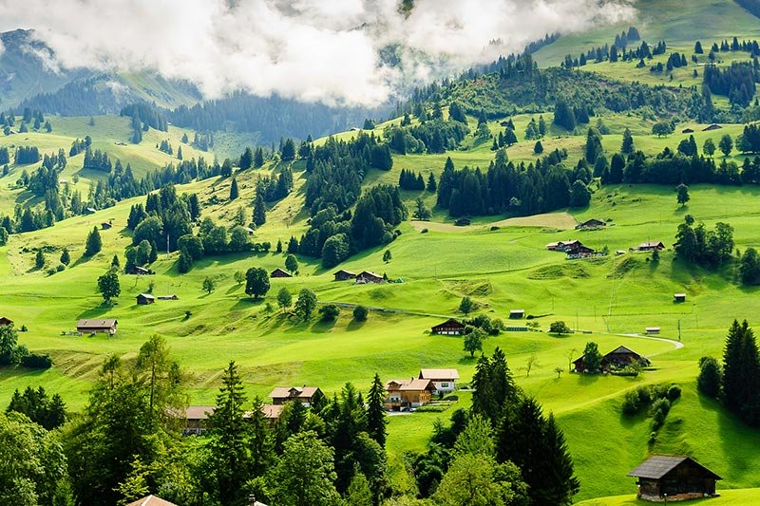
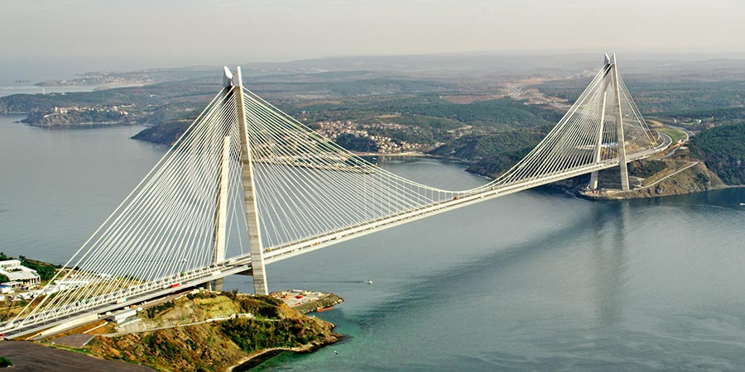
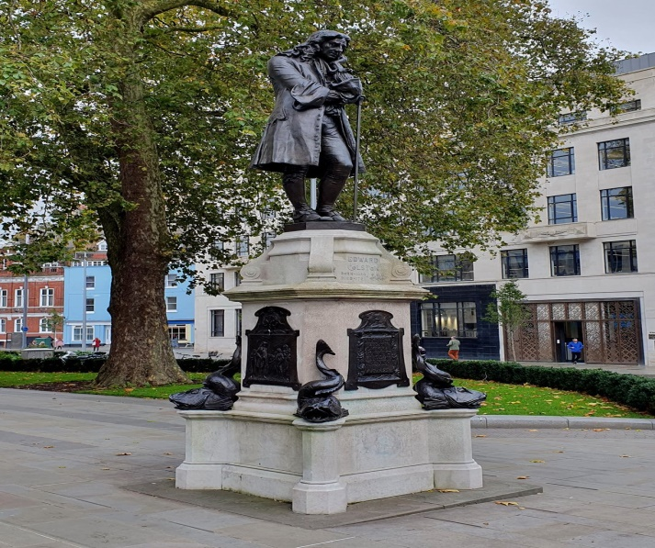
Vocabulary - ლექსიკა
Match the words with the pictures
დააკავშირეთ სიტყვები შესაბამის სურათებთან
landmarks
statue
landscape
tower
bridge
landscape
bridge
statue

Slide 14
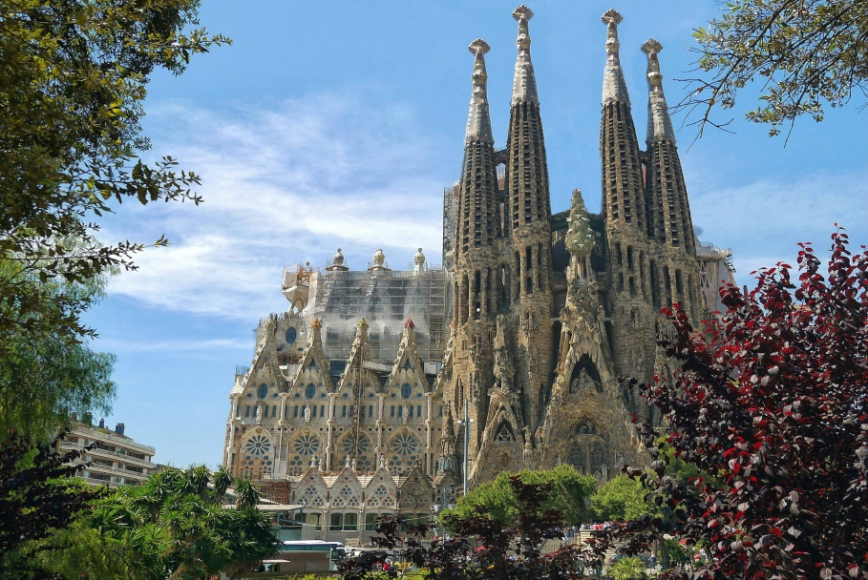
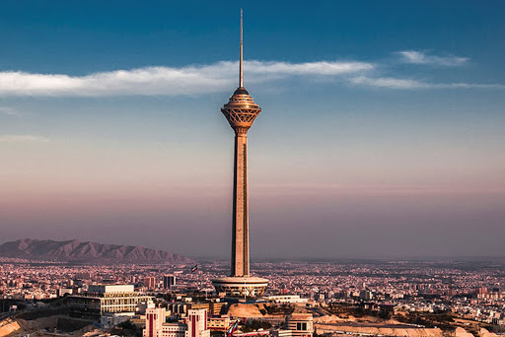
Vocabulary - ლექსიკა
Match the words with the pictures
დააკავშირეთ სიტყვები შესაბამის სურათებთან
landmark
statue
landscape
tower
bridge
landmark
tower

Slide 15
Vocabulary - ლექსიკა
Complete the sentences with the new words
დაასრულეთ წინადადებები ახალი სიტყვებით
recognisable, architectural, landmarks, attract.
This new building will ………………… a lot of tourists to the city.
The Eiffel Tower is the one of the most famous ………………………… in Paris.
Big Ben in London is an easily ………………………… landmark.
4. Some buildings in Old Tbilisi represent Asian and Georgian ……………………….. styles.
attract
landmarks
recognisable
architectural

Slide 16
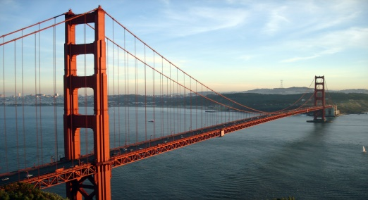
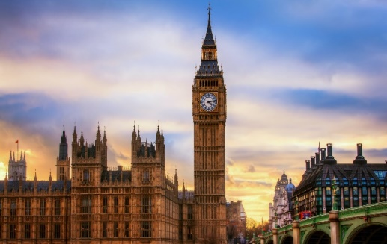
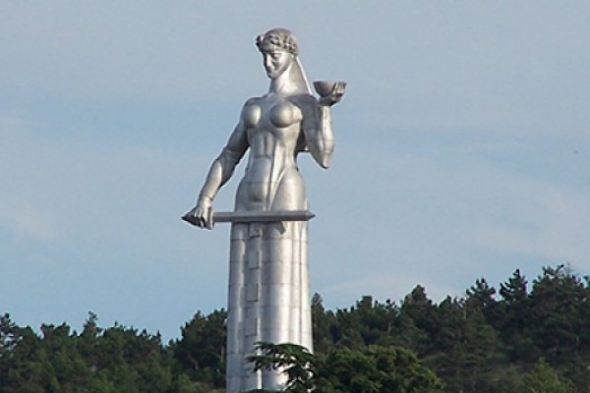
Reading Comprehension
წაკითხულის გააზრება
There are a lot of landmarks in different countries that make places easily recognisable. Landmarks can be architectural buildings, statues, landscapes and even bridges that are the symbols of particular places and attract a lot of tourists. We all know many landmarks; for example, the Eiffel Tower in France, the Leaning Tower of Pisa in Italy and the Great Pyramids of Egypt.
The Golden Gate Bridge is one of the most popular bridges in the world. This landmark was first opened in 1937, and it connected San Francisco Bay to the Pacific Ocean. It has a length of 2,737 meters. The colour of this bridge is known as 'international orange’.
Big Ben is one of the most famous symbols of the UK. Big Ben’s home is the palace of Westminster. It started ticking in 1859. The official name of the tower is the Elizabeth Tower.
The Mother of Georgia is a monument in Tbilisi. It was created by a Georgian sculptor Elguja Amashukeli in 1956. The statue is located on the top of Sololaki Hill. It is a twenty meter figure of a woman in a Georgian national dress with a bowl of wine and a sword in her hand.

Slide 17
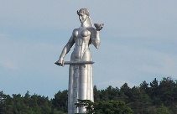
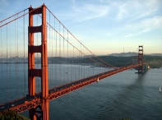

Reading Comprehension
წაკითხულის გააზრება
Put the sentences in the correct columns
ჩასვით წინადადებები შესაბამის სვეტში
It has a length of 2,737 meters.
It started ticking in 1859.
It has a bowl of wine and a sword in her hands.
Its official name is the Elizabeth Tower.
Its colour is known as 'international orange’.
It was created by a Georgian sculptor Elguja Amashukeli in 1956.
The Mother of Georgia | The Golden Gate Bridge | Big Ben
It has a bowl of wine and a sword in her hands.
It has a length of 2,737 meters.
It started ticking in 1859.
It was created by a Georgian sculptor Elguja Amashukeli in 1956.
Its colour is known as 'international orange’.
Its official name is the Elizabeth Tower.

Slide 18
Reading Comprehension
წაკითხულის გააზრება
Decide if the sentences are true or false
გადაწყვიტეთ სწორია თუ არა წინადადებები
Landmarks can be only architectural buildings. False
2. The Golden Gate Bridge connects San Francisco Bay to the Pacific Ocean. True
3. The Mother of Georgia isn’t located on the top of Sololaki Hill. False
4. Big Ben’s home is the Palace of Westminster. True

Slide 19

Grammar- გრამატიკა
Big Ben is one of the symbols of the UK. It is located in Westminster, next to the Thames.

Slide 20
Grammar - გრამატიკა
Prepositions of Place - in, on, at, under, next to, near, in front of, behind
A preposition of place refers to a place where something or someone is located.

Slide 21
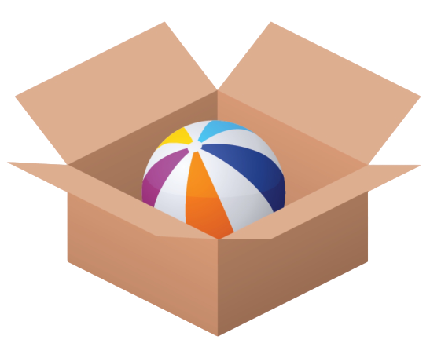
Grammar - გრამატიკა
Prepositions of Place - in, on, at, under, next to, near, in front of, behind
The ball is in the box.
The Pyramids are in Egypt.
in a car, in a building, in bed, in the newspaper

Slide 22
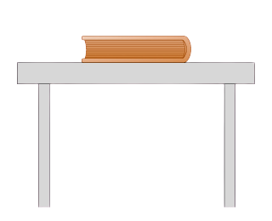
Grammar - გრამატიკა
Prepositions of Place - in, on, at, under, next to, near, in front of, behind
The book is on the table.
The White House is on Pennsylvania Avenue.
on a plane, on a horse, on TV, on the menu, on the beach

Slide 23
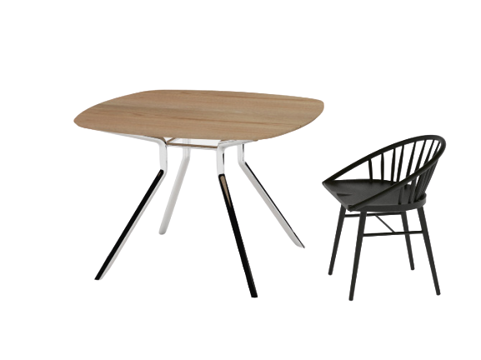
Grammar - გრამატიკა
Prepositions of Place - in, on, at, under, next to, near, in front of, behind
The chair is at the table.
This girl is standing at the Sydney Opera House.
at work, at home, at school, at university

Slide 24
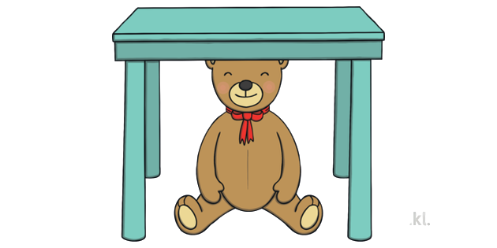
Grammar - გრამატიკა
Prepositions of Place - in, on, at, under, next to, near, in front of, behind
The teddy bear is under the table.

Slide 25
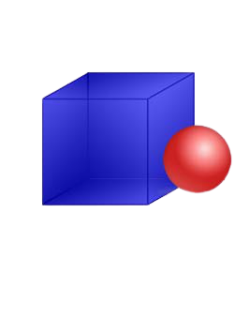
Grammar - გრამატიკა
Prepositions of Place - in, on, at, under, next to, near, in front of, behind
The ball is next to the box.

Slide 26

Grammar - გრამატიკა
Prepositions of Place - in, on, at, under, next to, near, in front of, behind
The ball is behind the box.

Slide 27
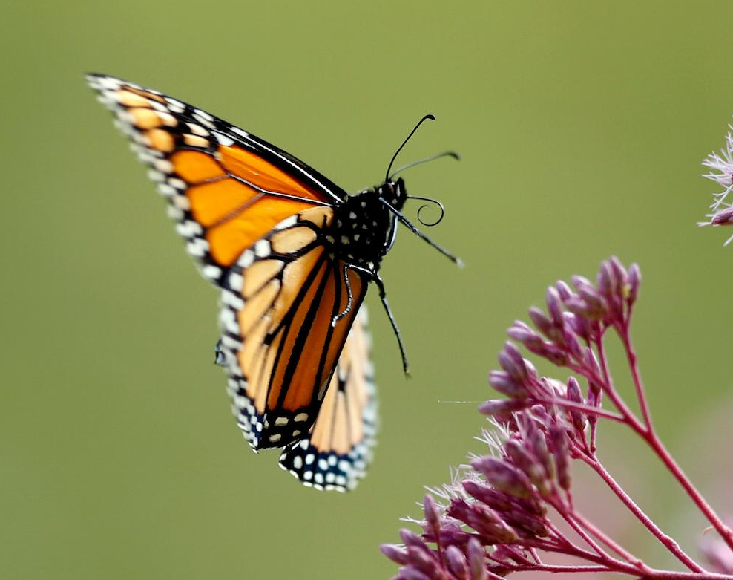
Grammar - გრამატიკა
Prepositions of Place - in, on, at, under, next to, near, in front of, behind
The butterfly is near the flower.

Slide 28

Grammar - გრამატიკა
Prepositions of Place - in, on, at, under, next to, near, in front of, behind
The elephant is in front of the chair.

Slide 29
Grammar- გრამატიკა
Prepositions of Place - in, on, at, under, next to, near, in front of, behind
The Brandenburg Gate is near the Reichstag building in Berlin.
The Pisa Cathedral is in front of the Leaning Tower of Pisa.
Big Ben is next to the river Thames.
The river Mtkvari flows under the Bridge of Peace in Tbilisi.

Slide 30
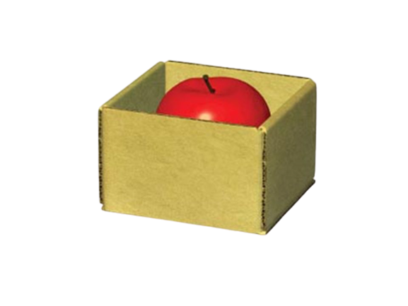

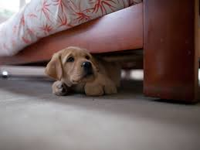
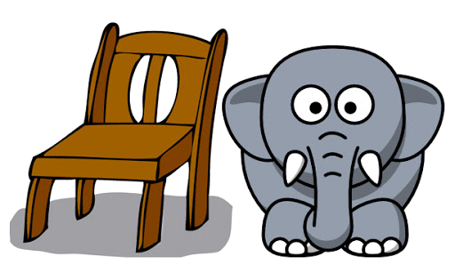
Grammar Activity
გრამატიკის დავალება
Complete the sentences according to the pictures with
დაასრულეთ წინადადებები ფოტოების გამოყენებით შემდეგი წინდებულებით:
next to, on, under, in
The apple is …
The computer is …
in the box.
on the table.
The dog is …
The elephant is …
under the bed.
next to the chair.

Slide 31
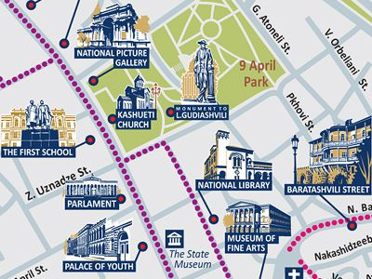
Grammar Activity გრამატიკის დავალება
Complete the sentences using the following prepositions: next to, in front of, near, behind
დაასრულეთ წინადადებები შემდეგი წინდებულების გამოყენებით:
1. There is Kashueti Church ………………... me.
2. The National Picture Gallery is …………… Kashueti Church.
3. Baratashvili street is ………………. the
National Library.
4. The First School is ………………. the
Parliament Building.
in front of
2
near
2
behind
3
1
3
1
4
4
next to

Slide 32
Summing up - შეჯამება
Vocabulary - ლექსიკა
Vocabulary ლექსიკა
architectural
(adj.)
landmarks
(n.)
recognisable
(adj.)
bridge
(n.)
tower
(n.)
landscape
(n.)
statue
(n.)
to attract
(v.)
არქიტექტურული
მოხიბვლა
ღირსშესანიშნაობები
ქანდაკება
პეიზაჟი
კოშკი
ადვილად საცნობი
ხიდი

Slide 33
Summing up - შეჯამება
Grammar - გრამატიკა
Prepositions of Place - in, on, at, under, next to, near, in front of, behind
We are in the TV studio and you are in front of the TV at home.

Slide 34
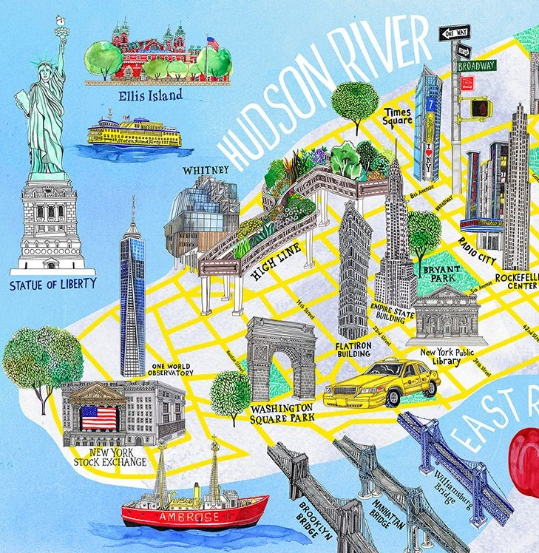
Homework
საშინაო დავალება
Write about one of your favourite landmark's location
დაწერეთ თქვენი საყვარელი ღირსშესანიშნაობის მდებარეობის შესახებ
I’m from New York. The most recognisable landmark for this city is the Statue of Liberty. But now I’d like to describe Manhattan island. The Empire State Building is one of the most famous places that attracts tourists from all over the world. There is Washington Square Park near it. I’d like to meet my friends there and walk across the Brooklyn Bridge. The bridge is behind the park. There are two other bridges next to the Brooklyn Bridge. The East River flows under these bridges. It’s my favourite place in New York.

