Slide 2
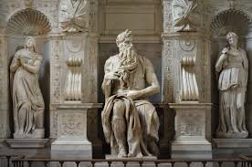
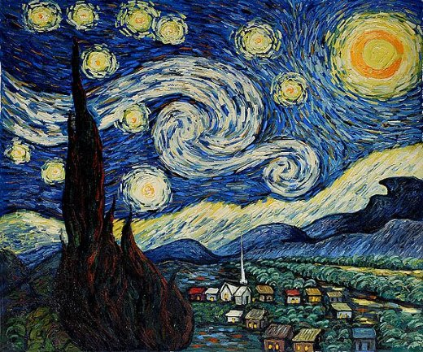
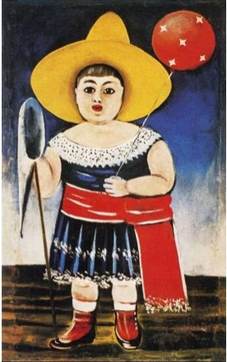
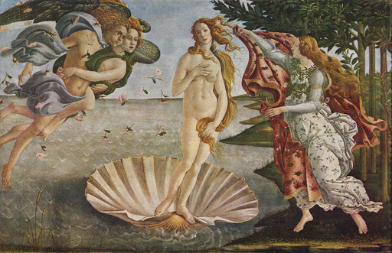

Slide 3
Art
ხელოვნება
ზოგადი ინგლისური დონე: A2

Slide 4
Agenda
გაკვეთილის განრიგი
Vocabulary - ლექსიკა
Summing up - შეჯამება
Homework - დავალება
Grammar - გრამატიკა
Reading Comprehension - წაკითხულის გააზრება

Slide 5
Vocabulary
ლექსიკა
Vocabulary ლექსიკა
creative
(adj.)
performing
(adj.)
painting
(n.)
portrait
(n.)
sculpture
(n.)
artist
(n.)
pottery
(n.)
visual
(adj.)
შემოქმედებითი
გარეგნული,
ვიზუალური
თიხის ჭურჭელი
საშემსრულებლო
ქანდაკება
მხატვარი
პორტრეტი
ნახატი

Slide 6
Vocabulary
ლექსიკა
artist
(n.)
მხატვარი

Slide 7
Vocabulary
ლექსიკა
painting
(n.)
ნახატი

Slide 8
Vocabulary
ლექსიკა
portrait
(n.)
პორტრეტი

Slide 9
Vocabulary
ლექსიკა
sculpture
(n.)
ქანდაკება

Slide 10
Vocabulary
ლექსიკა
pottery
(n.)
თიხის ჭურჭელი

Slide 11
Vocabulary
ლექსიკა
creative
(adj.)
შემოქმედებითი

Slide 12
Vocabulary
ლექსიკა
performing
(adj.)
საშემსრულებლო

Slide 13
Vocabulary
ლექსიკა
visual
(adj.)
გარეგნული, ვიზუალური

Slide 14
Vocabulary
ლექსიკა
Choose the correct answer
აირჩიეთ სწორი პასუხი
Van Gogh was a very ………………….painter.
2. ……………….. arts are those forms of art in which individual people participate separately or together.
3. The artists finally completed their last …………………. .
I have a good ……………..memory.
a. creative
b. visual
a. portrait
b. performing
a. visual
b. paintings
a. artist
b. visual

Slide 15
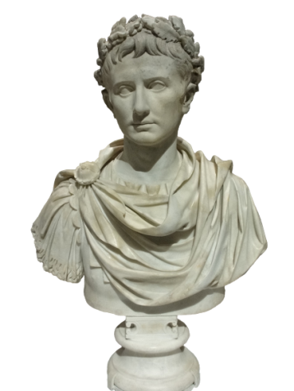
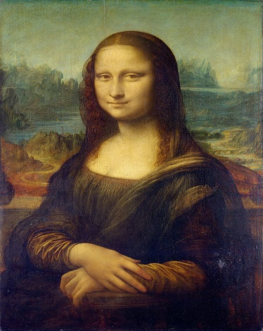
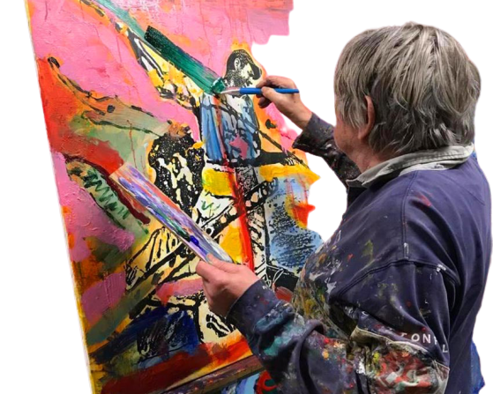
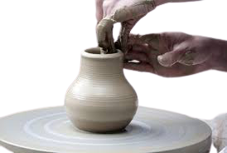
Vocabulary
ლექსიკა
Match the pictures with the following words:
დააკავშირეთ სურათები მოცემულ სიტყვებთან:
sculpture, pottery, artist, portrait
pottery
sculpture
portrait
artist

Slide 16
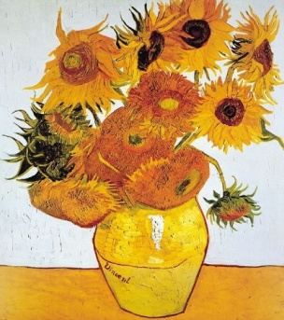
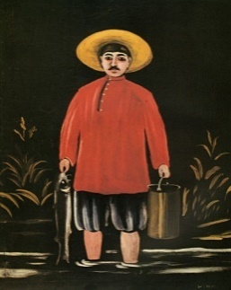
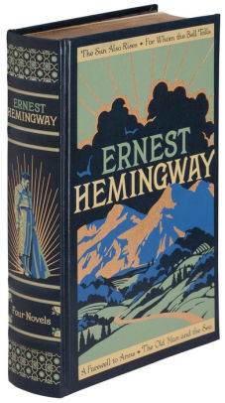
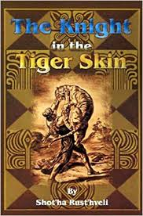
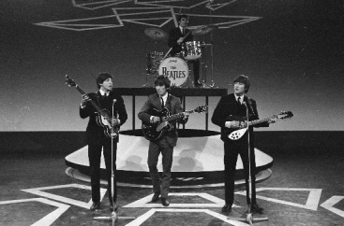
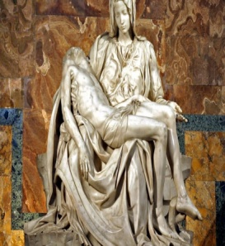
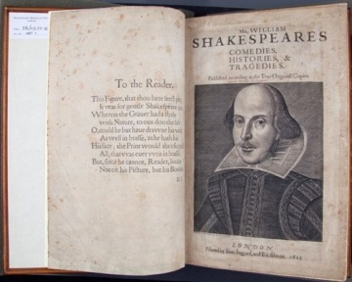
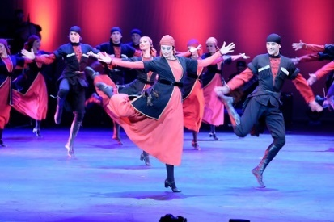
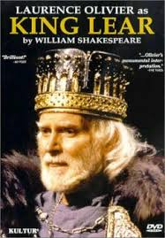
Reading Comprehension
წაკითხულის გააზრება
ART
Visual Arts paintings, sculptures | Literary Arts books | Performing Arts music, theatre, dance

Slide 17
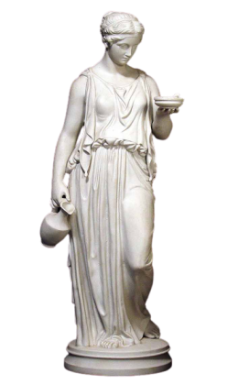
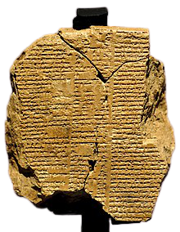
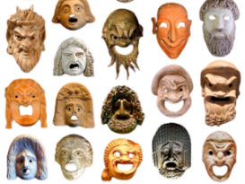
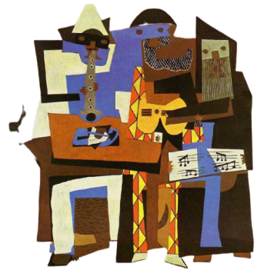
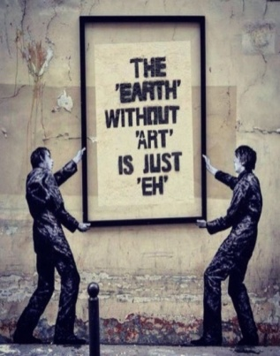
Reading Comprehension
წაკითხულის გააზრება
There are three main fields of art: visual arts including paintings and sculptures; literary arts connected to literature; performing arts - music, theater and dance. Each field has a very long and interesting history.
For example, ancient (old) Greeks were very famous for their sculptures. They also enjoyed painting on pottery and ceramics. Roman paintings were also very interesting as they were done directly on the walls of rich Romans.
The Epic of Gilgamesh is the first written story about the historical figure who lived between 2700-2500 BC.
Performing arts were also part of the ancient world sometimes connected to religious ceremonies. Actors in Greece used masks to perform different heroes.
Visual arts have different periods of its development from ancient time to modern. The world famous painters of Renaissance were Michelangelo and Leonardo Da Vinci. Vincent Van Gogh was a post-impressionist painter. His portraits of himself (self-portraits) are his well-known paintings. Pablo Picasso’s work Three Musicians is a classic example of Cubism.
Graffiti is one of the parts of modern visual arts. It helps people express their creative ideas on walls of different public places.

Slide 18
Reading Activity
კითხვის დავალება
Answer the questions
უპასუხეთ შეკითხვებს
How many main types of art are there? Name them.
There are three main types of art: performing arts, visual arts and literary arts.
There are three main types of arts: visual arts including paintings and sculptures; literary arts connected to literature; performing arts - music, theater and dance. Each type has a very long and an interesting history.

Slide 19
Reading Activity
კითხვის დავალება
Answer the questions
უპასუხეთ შეკითხვებს
2. Name the first written story about a historical figure.
The Epic of Gilgamesh.
The Epic of Gilgamesh is the first written story about the historical figure who lived between 2700-2500 BC.

Slide 20
Reading Activity
კითხვის დავალება
Answer the questions
უპასუხეთ შეკითხვებს
3. Who were the two famous painters of the Renaissance?
Michelangelo and Leonardo da Vinci.
The world famous painters of Renaissance were Michelangelo and Leonardo Da Vinci.

Slide 21
Reading Activity
კითხვის დავალება
Answer the questions
უპასუხეთ შეკითხვებს
Who painted “Three Musicians’’?
Pablo Picasso painted “Three Musicians’’.
Pablo Picasso’s work ”Three Musicians” is a classic example of Cubism.

Slide 22
Reading Activity
კითხვის დავალება
Complete the sentences from the text
დაასრულეთ წინადადებები ტექსტის მიხედვით
Ancient Greeks were famous for their ……………………. .
The epic of Gilgamesh is about the historical figure, who lived between ………………. .
Performing art was related to the ……………………………… .
Actors in Greece used …………… for performing the different heroes.
………………. helps people to express their creative ideas on the walls of public places.
sculptures
2700-2500 BC
religious ceremonies
masks
Graffiti

Slide 23
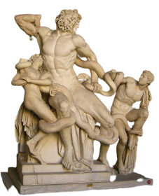
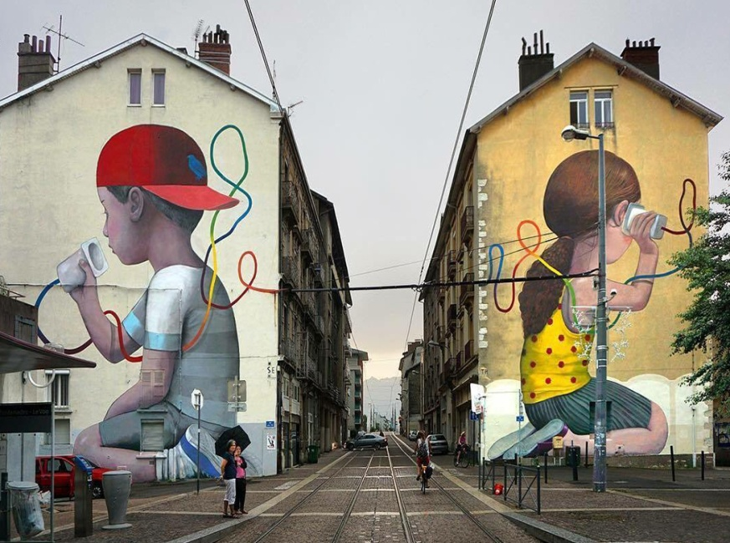
Grammar
გრამატიკა
PRESENT
PAST
A wall painting is a modern
visual art.
The Greeks were famous for their sculptures.

Slide 24
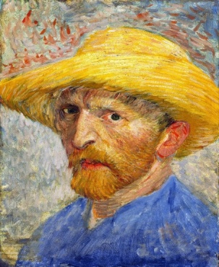
Grammar
გრამატიკა
Past Simple Tense - წარსული მარტივი დრო
We use Past Simple Tense to talk about the things that happened and finished in the past.
Van Gogh painted over 30 self-portraits between the years 1886 and 1889.
1. Is the action in the past?
2. Is the action finished?
3. Do we know when it happened?
Yes
Yes
Yes

Slide 25
Grammar
გრამატიკა
Past Simple Tense - წარსული მარტივი დრო
To Be
Affirmative | Interrogative | Negative
I was
You were
He/She/It was
We were
They were
Was he a painter?
They were not /weren’t sculptors.
Yes, he was.
No, he wasn’t.

Slide 26
Grammar
გრამატიკა
Past Simple Tense - წარსული მარტივი დრო
Regular verbs add – ed, –d or –ied
paint-painted
live-lived
study-studied
Affirmative | Interrogative | Negative
They did not/didn’t paint.
I, you, he/she/it, we, they painted
Did we painted?
Yes, we did.
No, we didn’t.

Slide 27
Grammar
გრამატიკა
Past Simple Tense - წარსული მარტივი დრო
Time expressions with the Past Simple Tense
Examples: in ancient times, in 2700 BC, in the 16th century, last year,
three weeks ago, yesterday
A Georgian painter Pirosmani was born in 1862 and died in 1918.

Slide 28
Grammar Practice
გრამატიკის დავალება
Put the sentences into Past Simple Tense
ჩასვით წინადადებები წარსულ მარტივ დროში
1. The artist /paint/ in 1909/the portrait.
The artist painted the portrait in 1909.
2. they /last week /like/ these creative paintings?
Did they like these creative paintings last week?
3. I/last month/study/ how to make sculptures.
I studied how to make sculptures last month.

Slide 29
Grammar Practice
გრამატიკის დავალება
Put the sentences into Past Simple Tense
ჩასვით წინადადებები წარსულ მარტივ დროში
4. you/like/ the visual effects/ last Sunday?
Did you like the visual effects last Sunday?
5. Yesterday / I not go/ to see new paintings.
Yesterday I didn’t go to see new paintings.
6. Last year/he not paint/ any paintings.
Last year he didn’t paint any paintings.

Slide 30
Grammar Practice
გრამატიკის დავალება
Find and correct the mistakes
იპოვეთ და გაასწორეთ შეცდომები
I enjoy painting yesterday.
I enjoyed painting yesterday.
Last year I live in a small town.
Last year I lived in a small town.
When my grandparents are younger, they want to become artists.
When my grandparents were younger, they wanted to become artists.

Slide 31
Grammar Practice
გრამატიკის დავალება
Find and correct mistakes
იპოვეთ და გაასწორეთ შეცდომები
4. In old times, the Greeks are famous for their sculptures.
In old times, the Greeks were famous for their sculptures.
5. In ancient times, people use mask for performing.
In ancient times, people used masks for performing.
6. I paint a portrait of my friend when I am 10.
I painted a portrait of my friend when I was 10.

Slide 32
Summing up - შეჯამება
Vocabulary - ლექსიკა
Vocabulary ლექსიკა
creative
(adj.)
performing
(adj.)
painting
(n.)
portrait
(n.)
sculpture
(n.)
artist
(n.)
pottery
(n.)
visual
(adj.)
შემოქმედებითი
გარეგნული,
ვიზუალური
თიხის ჭურჭელი
საშემსრულებლო
ქანდაკება
მხატვარი
პორტრეტი
ნახატი

Slide 33
Summing up - შეჯამება
Grammar - გრამატიკა
We visited a museum of art last week.
Past Simple Tense - წარსული მარტივი დრო

Slide 34
Homework
საშინაო დავალება
Write a short paragraph about your favourite artist and one of his/her paintings.
დაწერეთ მოკლე აბზაცი თქვენი საყვარელი მხატვრის და მისი ერთ-ერთი ნახატის შესახებ.

Slide 35
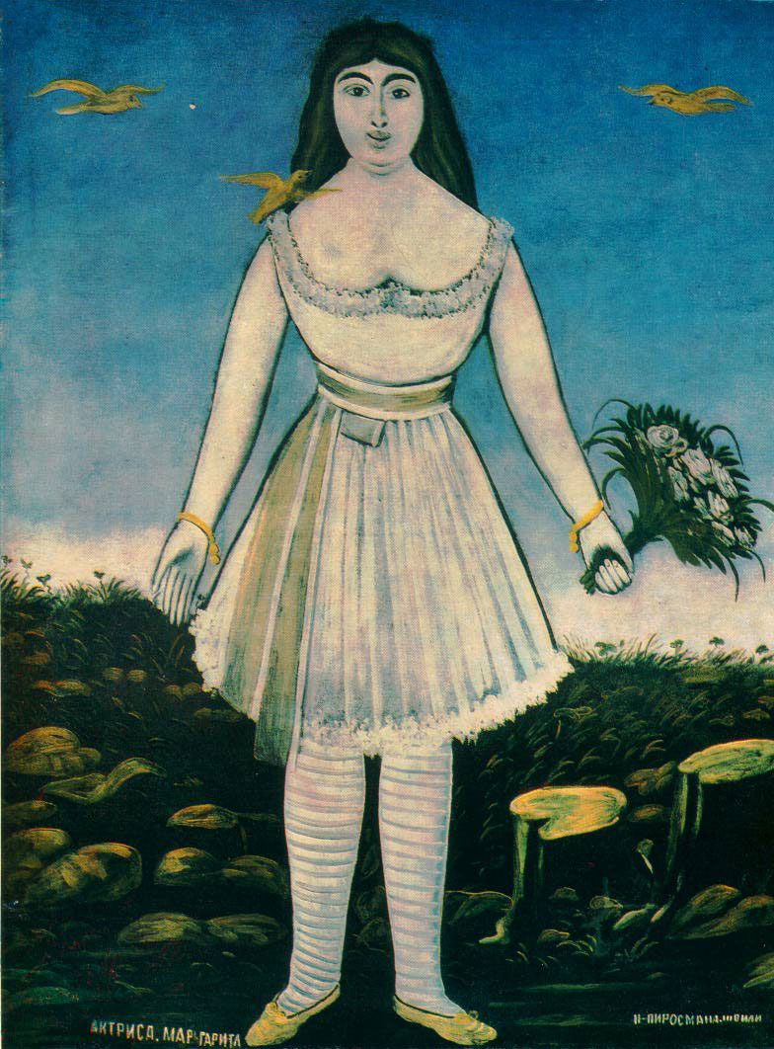
Homework
საშინაო დავალება
Niko Pirosmani is my favourite painter. He created lots of paintings about Georgian people and culture. He lived more than 100 years ago and worked hard to survive. Here is one of his favourite paintings, Actress Margarita. As we know, Pirosmani loved the actress very much. She worked as a singer and the painter delivered flowers to her. The painting was created in 1909.

