Slide 2
Nursing |პაციენტის მოვლა
English for Specific Purposes | Level B2

Slide 3
Agenda
გაკვეთილის გეგმა
Introduction - შესავალი
Vocabulary - ლექსიკა
Nursing
პაციენტის მოვლა
Reading Comprehension - წაკითხულის გააზრება
Grammar - გრამატიკა
Summary- შეჯამება
Homework- საშინაო დავალება

Slide 4
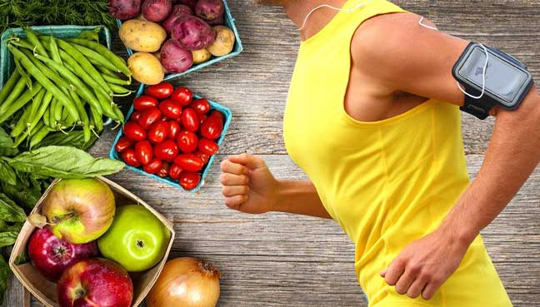
Introduction
შესავალი
What do you do to be healthy?

Slide 5
Vocabulary
ლექსიკა
carbohydrates
(n.)
ნახშირწყლები
protein
(n.)
ცილა
fiber
(n.)
ბოჭკო
Vocabulary
ლექსიკა
additives
(n.)
საკვები დანამატი
nutrient
(n.)
მკვებავი ნივთიერება

Slide 6
Vocabulary
ლექსიკა
protein
(n.)
ცილა
Meat and fish are a vital source of protein.

Slide 7
Vocabulary
ლექსიკა
carbohydrates
(n.)
ნახშირწყლები
Eat your carbohydrates within two hours after your workout.

Slide 8
Vocabulary
ლექსიკა
fiber
(n.)
ბოჭკო
Doctors recommend a diet of fruits, vegetables, and grains that are high in fiber.

Slide 9
Vocabulary
ლექსიკა
nutrient
(n.)
მკვებავი ნივთიერება
A healthy diet should provide all your essential nutrients.

Slide 10
Vocabulary
ლექსიკა
additives
(n.)
საკვები დანამატი
This margarine is full of additives - just look at the label!

Slide 11
Vocabulary
ლექსიკა
protein
carbohydrate
fiber
nutrients
additives
A vegetarian gets …………………..not from meat but from its analogues.

Slide 12
Vocabulary
ლექსიკა
fiber
carbohydrate
nutrient
additives
Analysis of the wine showed that it contained dangerous…………………. .

Slide 13
Vocabulary
ლექსიკა
fiber
carbohydrates
nutrient
A poor diet, with low …………………snacks can lead to nutritional deficiencies.

Slide 14
Vocabulary
ლექსიკა
fiber
carbohydrates
Eating cereals and fruit will give you plenty of ……..………….in your diet.

Slide 15
Vocabulary
ლექსიკა
carbohydrates
Both ………………………and fats provide plentiful sources of energy.

Slide 16
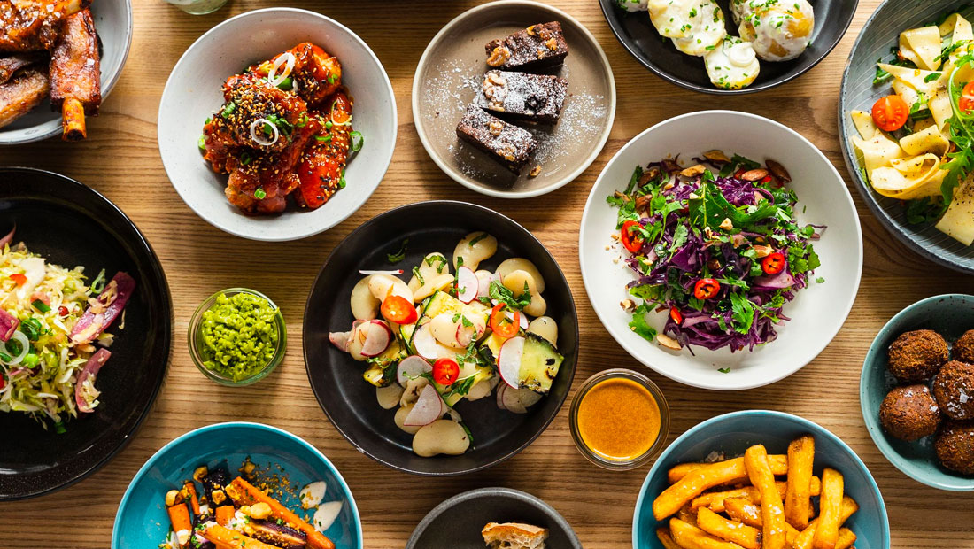
What’s your favourite food?
What are the best ways to fight against obesity?

Slide 17
Vocabulary
ლექსიკა
life expectancy
(n.)
სიცოცხლის საშუალო ხანგრძლივობა
intake
(n.)
მიღება პერორალურად
obesity
(n.)
ჭარბწონიანობა
Vocabulary
ლექსიკა
weight gain
(n.)
წონის მომატება
consistent
(adj.)
მდგრადი
weight loss
(n.)
წონის კლება

Slide 18
Vocabulary
ლექსიკა
obesity
(n.)
ჭარბწონიანობა
A diet that is high in fat and sugar can lead to obesity.

Slide 19
Vocabulary
ლექსიკა
life expectancy
(n.)
სიცოცხლის საშუალო ხანგრძლივობა
Life expectancy in Europe increased greatly in the 20th century.

Slide 20
Vocabulary
ლექსიკა
intake
(n.)
მიღება პერორალურად
It says on the packet that four slices of this bread contains one half of your recommended daily intake of fiber.

Slide 21
Vocabulary
ლექსიკა
weigh gain
(n.)
წონის მომატება
She was very upset by her recent weight gain.

Slide 22
Vocabulary
ლექსიკა
weight loss
(n.)
წონის კლება
Common symptoms of diabetes are weight loss and fatigue.

Slide 23
Vocabulary
ლექსიკა
consistent
(adj.)
მდგრადი
There has been a consistent improvement in her attitude.

Slide 24
Reading Comprehension
წაკითხულის გააზრება
Concepts of a ‘healthy diet’ have steadily altered across time in response to beliefs and research, and at no other time in history have we had access to so much evidence of the impact of food on the human body. Despite considerable ‘hype’ from those with vested interests and frivolous speculation from irresponsible journalism, there is now a clear consensus about what a ‘healthy diet’ consists of, which has remained relatively consistent over the past few years. The UK Department of Health’s guidelines for a healthy diet are represented in the health promotion tool, the ‘plate model’, which shows the five major food groups and the proportion each should contribute to the dietary intake. Additionally, it is recommended that each individual should eat five or more portions of a variety of fruit and vegetables a day.

Slide 25
Reading Comprehension
წაკითხულის გააზრება
Appetite and Choices
There are many factors regarding food choices. For example, we consume food because of its perceived benefits or for its own sake, because it tastes good or for comfort. By the same token we avoid foods because of their dangerous properties, because of our intolerance or allergy to them, or because of dislike or unfamiliarity. Social factors are important in determining how we come to like or dislike certain foods. Parental choice can, for example, influence children one way or another. People can develop long-term food preferences that are stable over long periods of time and unaffected by changes in their mood or environment; these can be highly resistant to change if a more healthy diet is advised. Some food preferences change from day to day and are more likely to be affected by mood. For example, we may choose to eat a bar of chocolate to ‘cheer ourselves up’, or have a glass of champagne to celebrate an event.

Slide 26
Reading Comprehension
წაკითხულის გააზრება
Obesity
Nearly half of Britain’s population is overweight and one in five is clinically obese. The equation is deceptively simple: the energy expended must be balanced by the energy gained. The body’s metabolism slows over time, so as people become less active because of age, they need to adjust their intake downwards and try to keep their activity level up. Obesity can reduce a person’s life expectancy. The client with obesity may well experience psychological and social penalties too. The treatment of obesity should be individualised and include assessment and goal-setting. It should be based on diet, activity and behavioural change. The initial aim of obesity management is to stabilise weight and prevent further weight gain. Following this, a moderate weight loss can be attempted, followed by further weight loss and weight maintenance. If diet, activity and behavioural change are successful in isolation, surgery or drug therapy may be offered. Prevention is, however, better than cure and currently there are lots of national and local initiatives to try and address the significant public health problem of obesity in this country.

Slide 27
Reading Comprehension
წაკითხულის გააზრება
Liking or disliking particular foods depends completely on the individual.
False
Social factors are important in determining how we come to like or dislike certain foods.

Slide 28
Reading Comprehension
წაკითხულის გააზრება
Mood can affect food choices.
True
Some food preferences change from day to day and are more likely to be affected by mood.

Slide 29
Reading Comprehension
წაკითხულის გააზრება
Less than 50% of Britain’s population is overweight.
True
Nearly half of Britain’s population is overweight and one in five is clinically obese.

Slide 30
Reading Comprehension
წაკითხულის გააზრება
Obesity management should encourage patients to aim for immediate
rapid weight loss.
False
The initial aim of obesity management is to stabilise weight and prevent further weight gain.

Slide 31
Grammar
გრამატიკა
Making comparisons: the + comparative + the+ comparative;
Comparatives of compound adjectives

Slide 32
Grammar
გრამატიკა
Making Comparisons
In spoken and written English, people often use the + comparative + the + comparative to mean “If it is more X, it will be more Y.”
For example:
Going on a healthy diet is good. The sooner, the better (It is best to start right away).
The longer I waited, the harder it was to change (As time passed, it became harder to change).

Slide 33
Grammar
გრამატიკა
Comparative Forms of Compound Adjectives
If the first word of the compound is an adjective (open minded, long lasting), use -er or more to make the comparative form. If the first word is not an adjective (badly behaved), use more.
For example:
First, at the bottom, there are the lower-level physiological needs.
I’d like a more expensive-looking car.
A more culturally-sensitive theory would include ideas like these.

Slide 34
Grammar Activity
გრამატიკული დავალება
highly-motivated/The/more/are/you/the/better/you/have/results
The more highly-motivated you are, the better results you have.

Slide 35
Grammar Activity
გრამატიკული დავალება
you/more/The/practice,/the/you/get/better
The more you practice, the better you get.

Slide 36
Grammar Activity
გრამატიკული დავალება
happier/with/lasting/their/relationships/with/others/longer/is/be/someone/themselves/the/The/can.
The happier someone is with themselves, the longer lasting their relationships with others can be.

Slide 37
Grammar Activity
გრამატიკული დავალება
The/you/of winning/better/better/attitude/The/are/your chances.
The better your attitude, the better your chances are of winning.

Slide 38
Summary
გაკვეთილის შეჯამება
Vocabulary
Nursing
პაციენტის მოვლა
Reading about a healthy diet
Grammar: Making comparisons: the + comparative + the+ comparative;
Comparatives of compound adjectives

Slide 39
Homework Activity
საშინაო დავალება
Write a paragraph recommending a healthy diet.

Slide 40
Homework Activity
საშინაო დავალება
Eating a healthy diet is not about strict limitations, staying unrealistically thin, or depriving yourself of the foods you love. Rather, it’s about feeling great, having more energy, improving your health, and boosting your mood. Healthy eating doesn’t have to be overly complicated. If you feel overwhelmed by all the conflicting nutrition and diet advice out there, you’re not alone. It seems that for every expert who tells you a certain food is good for you, you’ll find another saying exactly the opposite. The truth is that while some specific foods or nutrients have been shown to have a beneficial effect on mood, it’s your overall dietary pattern that is most important. The cornerstone of a healthy diet should be to replace processed food with real food whenever possible. Eating food that is as close as possible to the way nature made it can make a huge difference to the way you think, look, and feel.

