Slide 2
Family ოჯახი
Young Learners
დაწყებითი კლასები

Slide 3
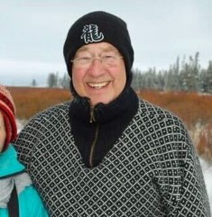
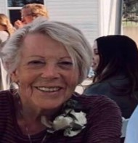
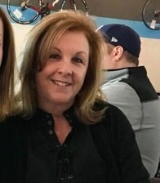
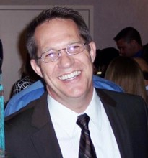
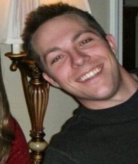
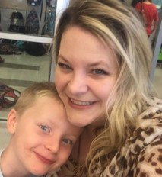
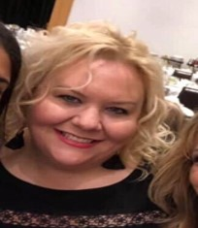
grandfather
ბაბუა
grandmother
ბებია
father
მამა
mother
დედა
Amanda
brother
ძმა
sisters
დები

Slide 4
I have got a big family. She has got a big family. I have got a mother and a father. She has got a mother and a father. I have got two sisters and a brother. She has got two sisters and a brother. I have got a grandmother and a grandfather. She has got a grandmother and a grandfather.
Have got ქონა/ყოლა

Slide 5
I
მე
We
ჩვენ
They
ისინი/ მათ
You
შენ / თქვენ
Have got

Slide 6
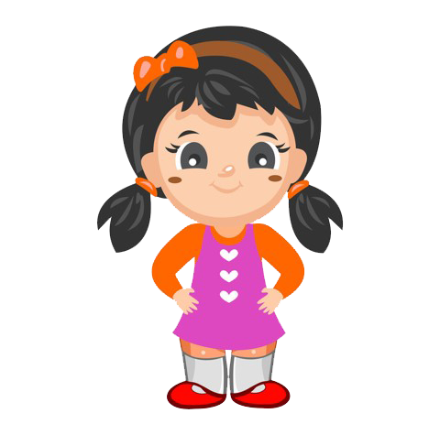
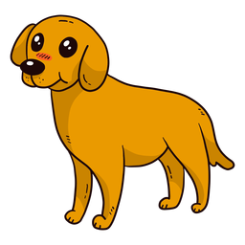
He
ის / მას
She
ის /მას
It
ის / მას
It
ის / მას
Has got

Slide 7
I have got
You have got
He has got
She has got
It has got
We have got
You have got
They have got

Slide 8
I have got a ball. Have I got a ball? I have not got a ball. She has got a ball. Has she got a ball? She has not got a ball.

Slide 9
Write five sentences of five things that you have got and you like and five things that you have not got, but you want to have. დაწერეთ ხუთი წინადადება იმ ხუთი ნივთის შესახებ, რომელიც გაქვთ და მოგწონთ და ხუთი, რომელიც არ გაქვთ და გსურთ რომ გქონდეთ. Example:
Homework N1
საშინაო დავალება

Slide 10
Create your family tree. შექმენით თქვენი საგვარეულო ხე.
Homework N2
საშინაო დავალება

Slide 11
Example
მაგალითი
grandfather
ბაბუა
grandmother
ბებია
father
მამა
mother
დედა
Amanda
brother
ძმა
sisters
დები

