Slide 2
Medicine | მედიცინა
English for Specific Purposes | Level B2

Slide 3
Agenda
გაკვეთილის გეგმა
Introduction - შესავალი
Medicine
მედიცინა
Vocabulary - ლექსიკა
Reading Comprehension- წაკითხულის გააზრება
Grammar - გრამატიკა
Summary - შეჯამება
Homework - საშინაო დავალება

Slide 4
Introduction
შესავალი
How often do you visit your doctor for a check-up?

Slide 5
to cure
(v.)
განკურნება
ointment
(n.)
მალამო
remedy
(n.)
მედიკამენტი, სამკურნალო საშუალება
Vocabulary
ლექსიკა
transfusion
(n.)
გადასხმა (სისხლის, მედიკამენტის)
painkiller
(n.)
ტკივილგამაყუჩებელი

Slide 6
Vocabulary
ლექსიკა
remedy
(n.)
მედიკამენტი, სამკურნალო საშუალება
This is an effective herbal remedy for headaches.

Slide 7
Vocabulary
ლექსიკა
to cure
(v.)
განკურნება
At one time doctors couldn't cure people of TB.

Slide 8
Vocabulary
ლექსიკა
ointment
(n.)
მალამო
We put some ointment and a bandage on his knee.

Slide 9
Vocabulary
ლექსიკა
painkiller
(n.)
ტკივილგამაყუჩებელი
If you have a headache you should take some painkillers.

Slide 10
Vocabulary
ლექსიკა
transfusion
(n.)
გადასხმა (სისხლის, მედიკამენტის)
He suffered kidney failure and needed a blood transfusion.

Slide 11
Vocabulary
ლექსიკა
remedy
cure
ointment
painkiller
transfusion
The process of adding an amount of blood to the body of a person or animal, or the amount of blood itself

Slide 12
Vocabulary
ლექსიკა
remedy
cure
painkiller
ointment
A successful way of curing an illness or dealing with a problem or difficulty

Slide 13
Vocabulary
ლექსიკა
cure
painkiller
ointment
To make someone with an illness healthy again

Slide 14
Vocabulary
ლექსიკა
painkiller
ointment
A thick substance, usually containing medicine, that is put on the skin where it is sore or where there is an injury, in order to cure it

Slide 15
Vocabulary
ლექსიკა
painkiller
A drug that is used to reduce physical pain
or remove it

Slide 16
prescription
(n.)
ექიმის მიერ გამოწერილი რეცეპტი
double-blind
(adj.)
ორმხრივად ბრმა
treatment
(n.)
მკურნალობა
Vocabulary
ლექსიკა
healing
(adj.)
სამკურნალო
recovery
(n.)
გამოჯანმრთელება
trial
(n.)
გამოცდა
,

Slide 17
Vocabulary
ლექსიკა
prescription
(n.)
ექიმის მიერ გამოწერილი რეცეპტი
You need doctor’s prescription to get some medicine in the pharmacy.

Slide 18
Vocabulary
ლექსიკა
double-blind
(adj.)
ორმხრივად ბრმა
This is a double-blind trial with 400 patients where 60% will get the drug and 40% will get a placebo.

Slide 19
Vocabulary
ლექსიკა
trial
(n.)
გამოცდა
The drug trial lasted for two years.

Slide 20
Vocabulary
ლექსიკა
recovery
(n.)
გამოჯანმრთელება
I wish you a quick recovery.

Slide 21
Vocabulary
ლექსიკა
treatment
(n.)
მკურნალობა
The best treatment for colds is more vitamin C.

Slide 22
Vocabulary
ლექსიკა
healing
(adj.)
სამკურნალო
Sleep has a healing power.

Slide 23
Reading Comprehension
წაკითხულის გააზრება

Slide 24
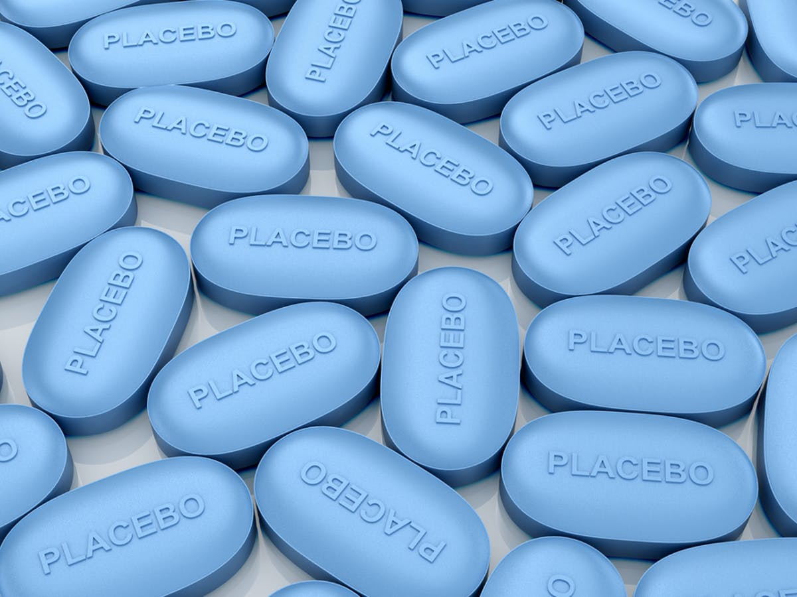
What does placebo mean?
Would prescribing a placebo be a good strategy for the following problems?
A life-threatening injury
A mild headache

Slide 25
Many people go to the doctor’s office when they are sick, and often they leave with a prescription. Most people do not ask questions about what’s in the medicine the doctor has prescribed. Instead they trust the doctors know what they’re doing – they know about the rigorous medical training doctors must complete and the through examination process they have to go through. But how much does that help the healing process? What if, after filling their prescription and taking it as prescribed, patients found out that the medicine the doctor had given them was not a real drug. Yet they get better. They trusted that they would get well after taking the medicine, so they did.

Slide 26
How can fake medicine help someone to get better? Sensory experience and thoughts can affect the brain, and the brain can affect other systems. Therefore, a person’s optimism and hopefulness may be important to his physical recovery from an injury or sickness. Some experts believe that placebo, or fake medicines, simply cause a psychological response. In other words, taking them only enhances your sense of well-being.
Today, before a drug can be approved, it must be tested and proven more effective than a placebo. Because both a patient’s belief in the value of a treatment can affect its outcome, most drug trials are usually double-blind, but also the doctors are unaware of who is receiving a placebo and who is receiving the real drug.

Slide 27
Almost all double-blind studies show some benefit to the people taking a placebo, but in actual clinical practice, there is evidence that for some conditions, positive responses to a placebo may be as high as 80% to 90%. The reason is that in a real treatment, the placebo effect is enhanced by the doctor’s and the patient’s expectations that the treatment will work.
But the placebo effect does not happen only with fake medicines. Experts say the placebo effect is responsible for about a third of the benefits of any treatment – even carefully tested drugs. This means that even effective one as are enhanced by the power of positive thinking. As a result doctors think they should prescribe placebo when it is appropriate and when the patient’s health is not in danger.

Slide 28
False
Reading Activity
კითხვის დავალება
A positive thinking about the treatment can not have an influence on physical response.
Almost all double-blind studies show some benefit to the people taking a placebo, but in actual clinical practice, there is evidence that for some conditions, positive responses to a placebo may be as high as 80 % to 90%.

Slide 29
False
Reading Activity
კითხვის დავალება
Placebo is more effective than the real drug.
Today, before a drug can be approved, it must be tested and proven more effective than a placebo.

Slide 30
False
Reading Activity
კითხვის დავალება
Doctors should have right to prescribe placebo for any health problem.
As a result, doctors think they should prescribe placebo when it is appropriate and when the patient’s health is not in danger.

Slide 31
True
Reading Activity
კითხვის დავალება
Placebo only works because of the doctor’s and patient’s expectations.
The reason is that in a real treatment, the placebo effect is enhanced by the doctor’s and the patient’s expectations that the treatment will work.

Slide 32
Grammar
გრამატიკა
Adverb Clauses of Concession: Reduced Adverb Clauses of Time
Adverb Clauses of Concession
Adverb clauses of concession use words such as although, even though, whereas, and while to add contrasting information to a sentence. An adverb clause is a dependent clause and must go with a main clause with a subject and verb.

Slide 33
Grammar
გრამატიკა
We use though, although and even though to show ideas that are contrasting but related.
Although he drank the painkiller, he doesn’t feel good.
We use whereas and while to compare two different people, things, or situations.
While polygraph measures stress, this new technology actually looks inside your brain.

Slide 34
Grammar
გრამატიკა
Reduced adverb clauses of time
If an adverb clause of time (after, before, when ) has the same subject as the main clause, you can reduce the adverb clause by removing the subject and putting the verb in -ing form.
While visiting the doctor, the patient got a lot of useful information. (reduced form)
After the patient returned home, the doctor phoned him to find out how he felt. ( can’t be reduced)

Slide 35
Grammar Activity
გრამატიკის დავალება
He couldn’t recover while/even though the doctors did everything they could.

Slide 36
Grammar Activity
გრამატიკის დავალება
Some people can look you right in the eyes though/while lying to you.

Slide 37
Grammar Activity
გრამატიკის დავალება
After/ though failing the first test, the researchers started a new trial.

Slide 38
Grammar Activity
გრამატიკის დავალება
Some of the studies show positive results, whereas/though others do not.

Slide 39
Summary
გაკვეთილის შეჯამება
Medicine
მედიცინა
Vocabulary
Reading
Grammar: Adverb Clauses of Concession and Time

Slide 40
Homework
საშინაო დავალება
Write a report about patient care.

Slide 41
Homework
საშინაო დავალება
A 35 year-old woman, Mrs. Bentley telephoned at 3 a.m. complaining of severe vomiting. She had very loose motions several times and she had some cramping pains in the central and lower abdomen. These started about six hours. She did not smoke and was teetotal. She had some egg mayonnaise sandwiches on the way home from work. There was no dysuria. Her periods were regular and her last menstrual period was. She had an appendicectomy before. She had a temperature of 38.1 degrees Centigrade. She did not look anemic. Her was 101/min and regular. The blood pressure was 110/70. Hers was 19/min. Her tongue was dry. She had some tenderness in the centre of her abdomen and in the left there was no of her abdomen, her bowel sounds were prominent. There was no lymphadenopathy.

