Slide 2
HR Management|ადამიანური რესურსების მართვა
English for Specific Purposes | Level B2

Slide 3
Agenda
გაკვეთილის გეგმა
Introduction - შესავალი
Vocabulary - ლექსიკა
Reading Comprehension - წაკითხულის გააზრება
Grammar - გრამატიკა
Summary- შეჯამება
Homework- საშინაო დავალება

Slide 4
Introduction შესავალი
How do people usually find jobs?
Have you ever applied for a job?
Were you successful?

Slide 5
recruitment
(n.)
სამსახურში აყვანა, დაქირავება
to headhunt
(v.)
კადრების მოზიდვა, გადმობირება
applicant
(n.)
კანდიდატი, განმცხადებელი
Vocabulary
ლექსიკა
to resign
(v.)
თანამდებობიდან გადადგომა, წასვლა
LeavelllLlllL
leave
(n.)
შვებულება
appraisal
(n.)
შეფასება
(თანამშრომლის საქმიანობის)

Slide 6
Vocabulary
ლექსიკა
recruitment
(n.)
სამსახურში აყვანა, დაქირავება
A survey in January highlighted the recruitment of people with leadership skills as one of HR directors' biggest worries.

Slide 7
Vocabulary
ლექსიკა
to headhunt
(v.)
კადრების მოზიდვა, გადმობირება
She was headhunted by a rival firm.

Slide 8
Vocabulary
ლექსიკა
Vocabulary
ლექსიკა
leave
(n.)
შვებულება
I've asked if I can take a week's unpaid leave.

Slide 9
Vocabulary
ლექსიკა
appraisal
(n.)
შეფასება (თანამშრომლის საქმიანობის)
Many companies operate regular job appraisals, often on an annual basis.

Slide 10
Vocabulary
ლექსიკა
to resign
(v.)
თანამდებობიდან გადადგომა, წასვლა
She resigned as director.

Slide 11
c
Vocabulary
ლექსიკა
Vocabulary
ლექსიკა
applicant
(n.)
კანდიდატი, განმცხადებელი
How many applicants did you have for the job?

Slide 12
Vocabulary
ლექსიკა
recruitment
headhunt
leave
appraisal
resign
applicant
The process of finding people to work for a company or become a new member of an organisation

Slide 13
Vocabulary
ლექსიკა
headhunt
leave
appraisal
resign
applicant
To give up a job or position by telling your employer that you are leaving

Slide 14
Vocabulary
ლექსიკა
headhunt
leave
appraisal
applicant
To persuade someone to leave their job by offering that person another job with more pay and a higher position

Slide 15
Vocabulary
ლექსიკა
leave
appraisal
applicant
Time allowed away from work for a holiday or illness

Slide 16
Vocabulary
ლექსიკა
Vocabulary
ლექსიკა
appraisal
applicant
A meeting in which an employee discusses his or her progress, aims, and needs at work with his or her manager or employer

Slide 17
Vocabulary
ლექსიკა
applicant
A person who formally requests something, especially a job, or to study at a college or university

Slide 18
to nurture
(v.)
ზრუნვა
cognitive ability
(n.phr.)
შემეცნების უნარი
Vocabulary
ლექსიკა
ambiguity
(n.)
გაურკვევლობა
personality trait
(n.phr.)
პიროვნული თვისება
compensation package
(n.)
ანაზღაურება

Slide 19
Vocabulary
ლექსიკა
to nurture
(v.)
ზრუნვა, განვითარებაში ხელშეწყობა
As a record company executive, his job is to nurture young talent.

Slide 20
Vocabulary
ლექსიკა
cognitive ability
(n.phr.)
შემეცნების უნარი
However, it is not just brain size that determines cognitive ability.

Slide 21
Vocabulary
ლექსიკა
personality trait
(n.phr.)
პიროვნული თვისება
Arrogance is a very unattractive personality trait.

Slide 22
Vocabulary
ლექსიკა
compensation package
(n.)
ანაზღაურება
Health and dental insurance might be considered a vital part of the compensation package.

Slide 23
Vocabulary
ლექსიკა
ambiguity
(n.)
გაურკვევლობა, ბუნდოვანება
Be as precise as possible in your answer, so that there is no ambiguity.

Slide 24
Reading Comprehension
წაკითხულის გააზრება

Slide 25
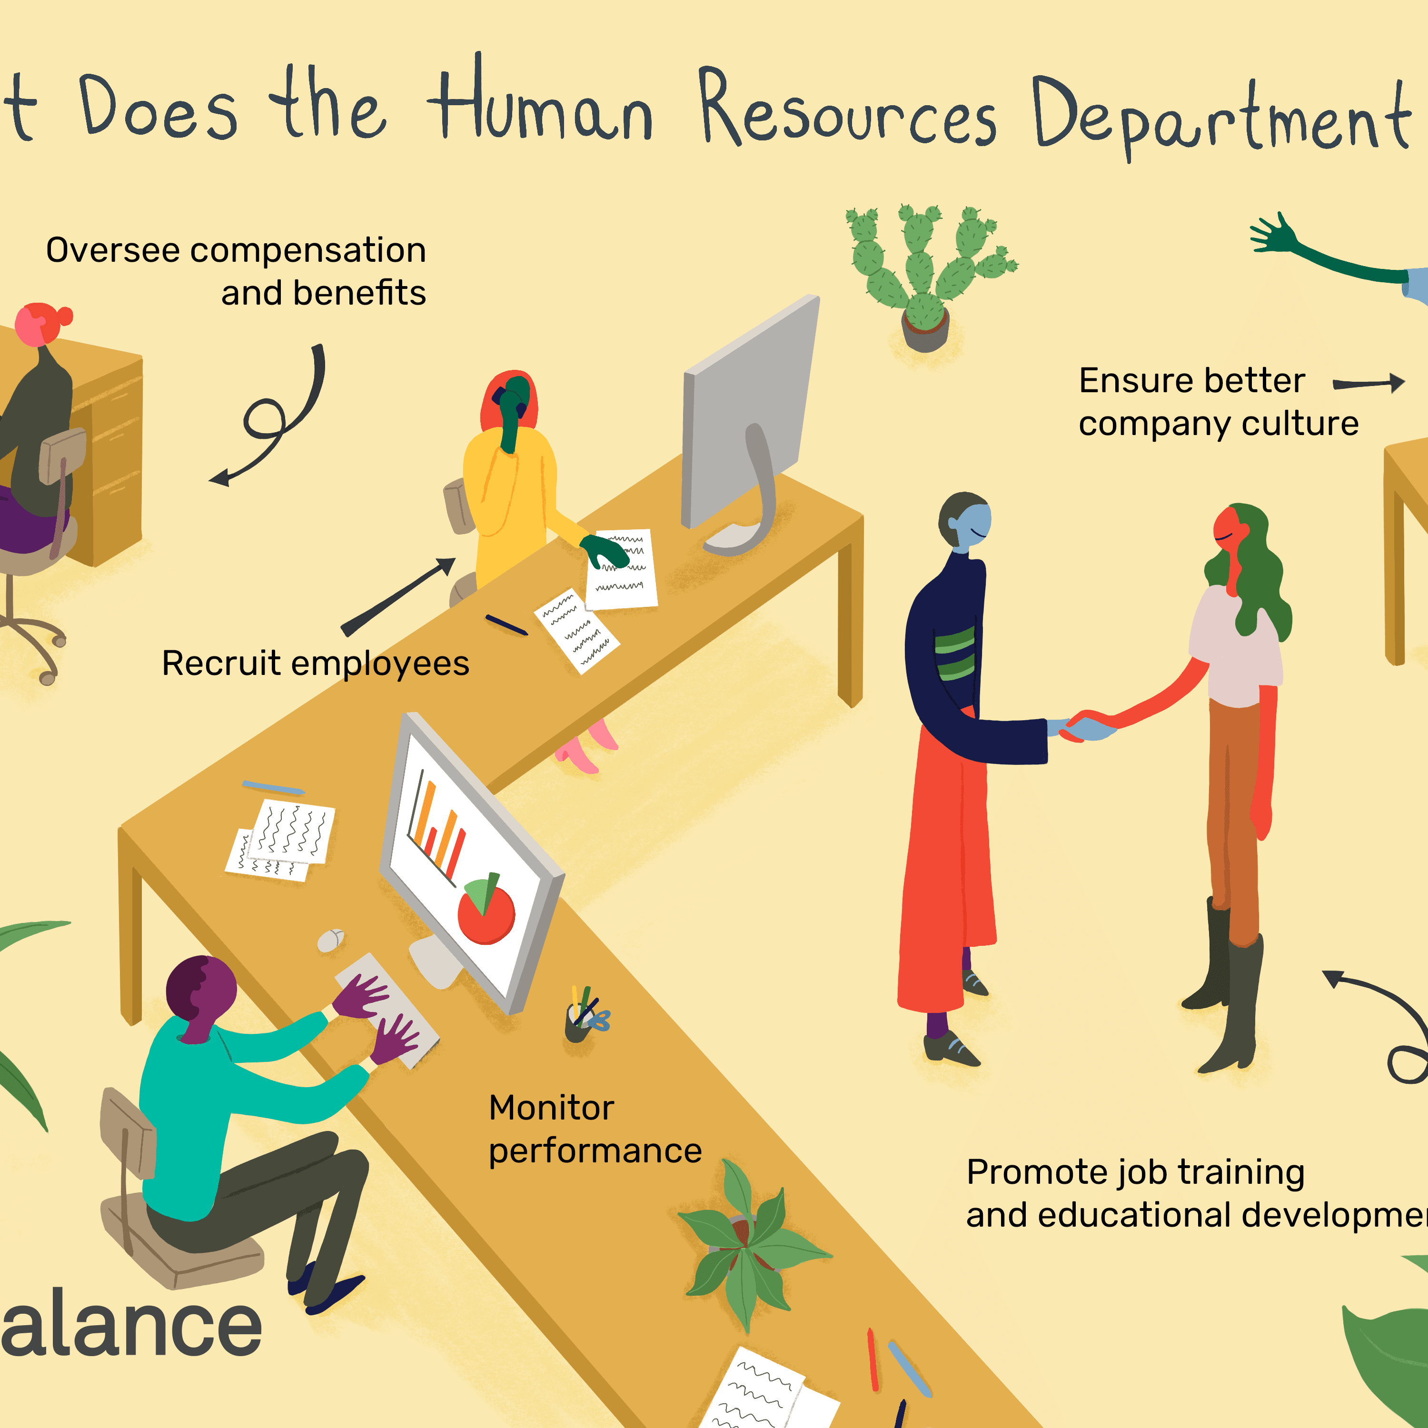
Reading Comprehension
წაკითხულის გააზრება
What does the human resources department do?
What do you think is the most important human resource function?

Slide 26
When one looks at the size of the recruitment industry around the world, it seems that practitioners act as if recruitment and selection is the most important human resource function.
The research on the critical role of ability in explaining performance suggests that they are right to do so. Failure to recruit workers with appropriate competencies will doom the firm to failure or, at the very least, to stunted growth. Firms need to attract and nurture people with the kind of abilities that will make the organisation productive in its chosen industry.

Slide 27
While firms should aim to recruit effectively at all levels of ability, the need to recruit astutely is particularly important where higher levels of discretion or specialised blends of skills are required in the work.
As job complexity increases, so does the range of human performance. Thus, as we move up from low complexity work to jobs where greater ambiguity is involved in decision making, differences in skills and judgement become more pronounced and are more consequential for the organisation.

Slide 28
It is quite possible for one professional, such as a lawyer or an IT consultant, to be several times better than another at the same task. The phenomenon of large performance variation is also commonly recognised in sales work, such as insurance sales. Some people simply lack the blend of cognitive abilities and personality traits needed and should not be recruited at all. Among those who do have the threshold abilities, the performance range will still be enormous. In Anglo-American countries, at least, firms commonly find they need ‘sales compensation packages’ which allow high achievers to earn a higher pay pack better linked to their personal productivity.

Slide 29
Recognising the crucial role of ability in performance, the literature on recruitment and selection is vast. It is important to make a distinction between selection practices and recruitment strategies. Selection is about choosing among job candidates. It is about how to make fair and relevant assessments of the strengths and weaknesses of applicants. However, recruitment strategy is best understood as the way in which a firm tries to source or attract people among whom it will ultimately make selections. Recruitment strategies include attempts to make the organization an attractive place to work and attempts to reach better pools of candidates.

Slide 30
True
Reading Activity
კითხვის დავალება
People working in HR believe that recruitment and selection are the most important aspects of what they do, and this is borne out by research.
‘Practitioners act as if recruitment and selection is the most important human resource function. The research on the critical role of ability in explaining performance suggests that they are right to do so’.

Slide 31
False
Reading Activity
კითხვის დავალება
Candidates for ‘professional’ and specialised categories of jobs (e.g. lawyers and IT consultants) are generally better in interviews than candidates for less demanding jobs.
‘It is quite possible for one professional, such as a lawyer or an IT consultant, to be several times better than another at the same task.’

Slide 32
True
Reading Activity
კითხვის დავალება
Even if people do have all the necessary skills and qualities to do a job effectively, there will still be a wide variation in individual ability.
‘Among those who do have the threshold abilities, the performance range will still be enormous’.

Slide 33
False
Reading Activity
კითხვის დავალება
Only Anglo-American companies try to reflect individual differences in performance through pay policy.
‘In Anglo-American countries, at least, firms commonly find they need ‘sales compensation packages’ which allow high achievers to earn a higher pay pack better linked to their personal productivity.’

Slide 34
Grammar
გრამატიკა
Past Tenses

Slide 35
Grammar
გრამატიკა
Form
Statement: I/you/he/she/it/ewe/they worked
Negative: I/you/he/she/it/we/they didn’t work.
Question: Did/you/he/she/it/we/they work?
Note: irregular verbs do not take “ed” in the past simple
Past Simple
Use
Simple completed actions
Habits in the past
Permanent situation in the past
General truths and facts about past
The main events in the story
Examples
The team completed a project last month.
The company always employed qualified staff.
The company became successful in 1930s.
The company managed to anticipate the risks and developed a contingency plan.

Slide 36
Grammar
გრამატიკა
Past Continuous
Form
Statement: I/he/she/it was working
You/we/they were working
Negative: I/he/she/it wasn’t playing
You/we/they weren’t working
Question: Was I/he/she/it working?
Were you/we/they working?
Use
Actions happening at a particular moment in the past
Temporary situations in the past
Annoying past habits (usually with always)
Actions in progress over a period of time
Two actions in progress at the same time
Background information in a story
Example
At five o’clock, the CEO was having a meeting with the staff.
Greg was working for that company at that time.
He was always trying to avoid paying taxes.
We were negotiating with the customers, while he was preparing an action plan.

Slide 37
Grammar
გრამატიკა
Past Perfect Simple
Form
had + past participle
Use
Situations and states before the past
Completed actions before a moment in the past
Completed actions where the important thing is the result at the moment in the past
Example
He had worked for Forbes before he moved to our company.
He had already been made redundant before the company went bankrupt.
He had been fired so he couldn’t make any decisions for the company.

Slide 38
Grammar Activity
გრამატიკის დავალება
When the robbery happened, the security guard……………….
slept
was sleeping
had slept
was slept

Slide 39
Grammar Activity
გრამატიკის დავალება
I wasn’t sure how Belinda would react because I …………… her long.
didn’t know
wasn’t knowing
hadn’t been knowing
hadn’t known

Slide 40
Grammar Activity
გრამატიკის დავალება
I ……… to the manager, when he entered the room.
talked
had been talking
was talking
had talked

Slide 41
Grammar Activity
გრამატიკის დავალება
When we got to the airport, I realised I…………….my passport at home!
was left
had left
left
had been leaving

Slide 42
Summary
გაკვეთილის შეჯამება
Vocabulary
Reading
Grammar: Past tenses

Slide 43
Homework Activity
საშინაო დავალება
Write a paragraph about your experience applying for a job.

Slide 44
I worked for a year as a student in a local Pizza restaurant. That helped me to get confidence in talking to the public, and also showed me that this is a job where I will need to work hard. I then worked for a short while in a kitchen, helping the chef. That showed me the other side of working in a restaurant, so I can understand the importance of giving the chef accurate information with orders. I also worked for a while in a bank. That shows that I am confident with handling money, which will help when I take payment for meals. I also needed to develop a good understanding of the pizzas we sold so I could help customers. I learned to be polite and to keep smiling, even with some of the more challenging customers.

