Slide 2
Engineering|ინჟინერია
English for Specific Purposes | Level B2

Slide 3
Agenda
გაკვეთილის გეგმა
Introduction - შესავალი
Engineering
ინჟინერია
Vocabulary - ლექსიკა
Reading Comprehension - წაკითხულის გააზრება
Grammar - გრამატიკა
Summary- შეჯამება
Homework- საშინაო დავალება

Slide 4
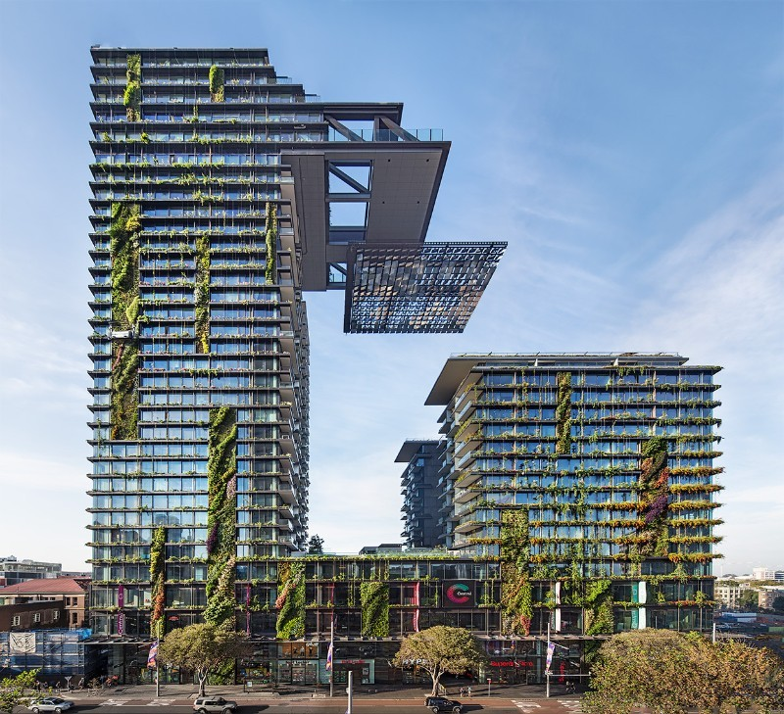
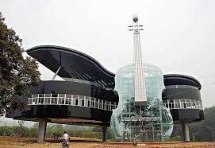
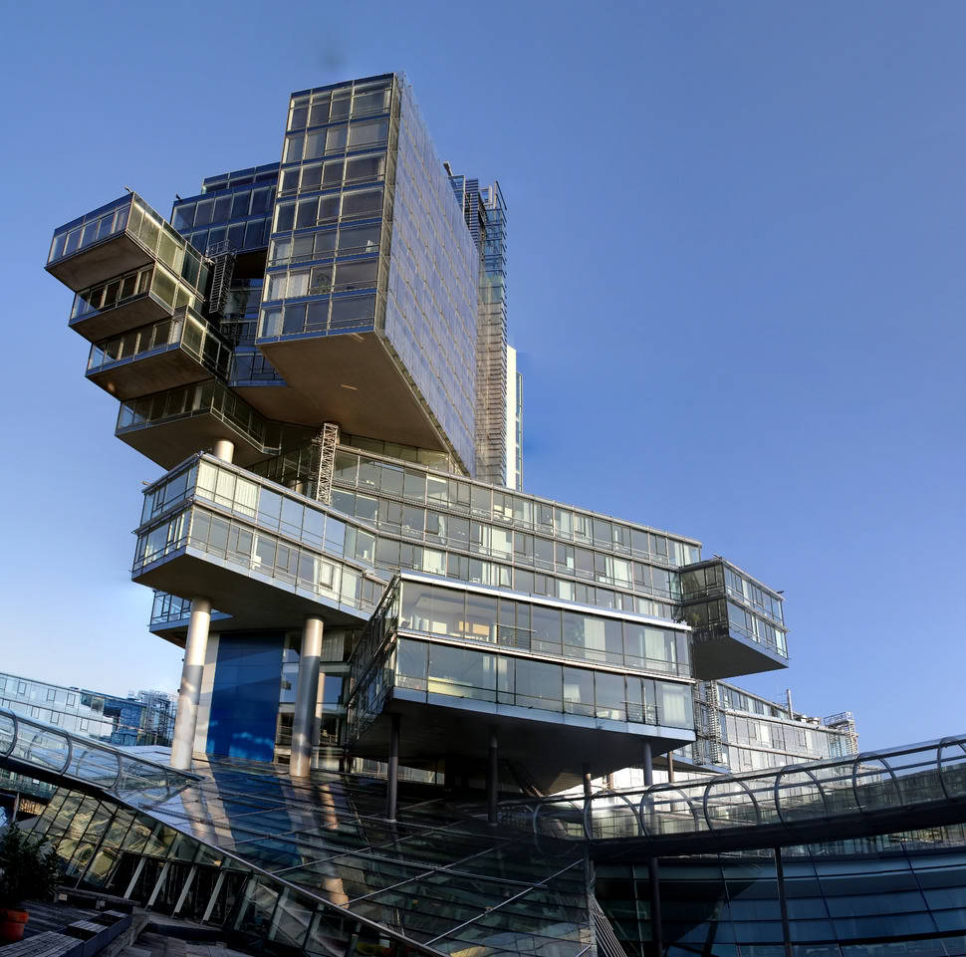
Introduction შესავალი
Which of the buildings is your favourite? Why?

Slide 5
eye-catching
(adj.)
მიმზიდველი, თვალშისაცემი
stunning
(adj.)
მომხიბვლელი
ornate
(adj.)
მორთული (მრავალი, ნატიფი ორნამენტით)
Vocabulary
ლექსიკა
unsightly
(adj.)
უშნო, შეუხედავი
iconic
(adj.)
საკულტო

Slide 6
Vocabulary
ლექსიკა
stunning
(adj.)
მომხიბვლელი
I've never seen a more stunning view in my life.

Slide 7
Vocabulary
ლექსიკა
eye-catching
(adj.)
მიმზიდველი, თვალშისაცემი
With your advice we now have an eye-catching and comfortable home.

Slide 8
Vocabulary
ლექსიკა
ornate
(adj.)
მორთული (მრავალი, ნატიფი ორნამენტით)
It was a room with an ornate ceiling and gold mirrors.

Slide 9
Vocabulary
ლექსიკა
iconic
(adj.)
საკულტო
These smoke-filled rooms are iconic images of Turkey.

Slide 10
Vocabulary
ლექსიკა
unsightly
(adj.)
უშნო, შეუხედავი
When open, the garage is an unsightly storeroom.

Slide 11
Vocabulary
ლექსიკა
stunning
eye-catching
ornate
iconic
unsightly
The frames on the pictures are ………………………with flowers and fruit painted in gold.

Slide 12
Vocabulary
ლექსიკა
stunning
eye-catching
iconic
unsightly
They took pictures not only of the wall but of the …………………..houses the government had wanted to hide.

Slide 13
Vocabulary
ლექსიკა
stunning
eye-catching
iconic
These were really beautiful homes and even more
……………………….gardens.

Slide 14
Vocabulary
ლექსიკა
stunning
iconic
A dust storm blankets Sydney’s ……………………Opera House at sunrise.

Slide 15
Vocabulary
ლექსიკა
stunning
Nepal is………………………., with its wild, untamed landscape.

Slide 16
masterpiece
(n.)
შედევრი
to overflow
(v.)
დატბორვა
shifting
(adj.)
მოძრავი
Vocabulary
ლექსიკა
to pump
(v.)
ამოტუმბვა
landscape
(n.)
ლანდშაფტი

Slide 17
Vocabulary
ლექსიკა
to overflow
(v.)
დატბორვა
Because of the heavy rains, the river overflowed its banks.

Slide 18
Vocabulary
ლექსიკა
shifting
(adj.)
მოძრავი
They lost their way in the shifting sands of the Sahara.

Slide 19
Vocabulary
ლექსიკა
landscape
(n.)
ლანდშაფტი
The cathedral dominates the landscape for miles around.

Slide 20
Vocabulary
ლექსიკა
masterpiece
(n.)
შედევრი
The new opera house was a real masterpiece.

Slide 21
Vocabulary
ლექსიკა
to pump
(v.)
ამოტუმბვა
Our latest machine can pump a hundred gallons a minute.

Slide 22
Reading Comprehension
წაკითხულის გააზრება

Slide 23
Reading Comprehension
წაკითხულის გააზრება
Since their earliest beginnings, humans have devised ways to improve their living conditions. Over time, we have developed incredibly clever solutions to overcome challenges of limited space and extreme climates and geography, creating stronger, more efficient buildings, and faster, more convenient forms of transportation. Today’s engineers and architects seem able to create the impossible – building higher, longer, more complex structures than ever before.
Population growth, climate change, and aging urban infrastructures are some of the dilemmas affecting the world today. In some places, these concerns have brought about some of the biggest, most daring engineering projects ever attempted- project that will redesign the course of nature.

Slide 24
Reading Comprehension
წაკითხულის გააზრება
The Italian city of Venice is known as one of the most beautiful, romantic places in the world. Venice is famous for its rich cultural heritage, beautiful architecture, and Renaissance art – and famous for floods. Since written records about Venice’s water levels began in 1872, floods have been a part of its history. The city is situated in a lagoon in the Adriatic Sea, and experts say it has sunk as much as 23 centimeters in the last century. As a result of the shifting landscape, the city currently endures flooding about 60 times a year according to some estimates. Since 1966, when record high flood waters caused the destruction of numerous historical landmarks and artistic masterpieces, Venetians have been debating what to do.

Slide 25
Reading Comprehension
წაკითხულის გააზრება
The Tide Barrier Project (also known as the MOSE project) was begun in 2003 by Silvio Berlusconi, who is Italy’s former Prime Minister. It consists of 78 underwater steel gates, each around 28 meters high, 20 meters wide, and weighing 300 tones. The gates are attached to the sea floor. When a dangerously high tide is predicted, compressed air is pumped underneath the gates, causing them to rise and stop the sea water from overflowing into the city. Many people believe the project is the only way to save Venice. Others argue that it will have negative effects on wildlife, and simply won’t stop the flooding.

Slide 26
Reading Comprehension
წაკითხულის გააზრება
If successful, this project might have amazing positive potential. It may be an example of today’s “where there’s a will, there’s a way” attitude. There will be many challenges and great obstacles to overcome along the way. Will it really be possible for humans to tame the sea? Perhaps. Only time will tell. But we can hope for the best while he still have the energy to dream big.

Slide 27
False
Reading Comprehension
წაკითხულის გააზრება
Flooding was not common for Venice in the past.
Since written records about Venice’s water levels began in 1872, floods have been a part of its history.

Slide 28
True
Reading Comprehension
წაკითხულის გააზრება
Venetians are concerned about the fact that the city continues to sink and want to solve the problem.
Since 1966, when record high flood waters caused the destruction of numerous historical landmarks and artistic masterpieces, Venetians have been debating what to do.

Slide 29
True
Reading Comprehension
წაკითხულის გააზრება
The gates attached to the sea bed will prevent the water from overflowing into the city.
The gates are attached to the sea floor. When a dangerously high tide is predicted, compressed air is pumped underneath the gates, causing them to rise and stop the sea water from overflowing into the city.

Slide 30
False
Reading Comprehension
წაკითხულის გააზრება
Everyone is sure that Tide Barrier project will save the city.
Many people believe the project is the only way to save Venice. Others argue that it will have negative effects on wildlife, and simply won’t stop the flooding.

Slide 31
Grammar
გრამატიკა
Relative clauses
They give us extra information about something/someone or identify which particular thing/ person we are talking about. They are often introduced by the following words.

Slide 32
Grammar
გრამატიკა
Which (for things and animals) | Did you see the film which was on TV last night?
Who (for people) | Tom Davis, who is appearing in concert in Reading this week, is with me in the studio.
When (for time) | Do you remember the day when we met?
Where (for places) | This is the place where they filmed Citizen Kane.
Why (for reasons) | That’s the reason why he’s so popular.
Whom (for people as the object of the relative clause) | Is that the man whom we saw at the cinema yesterday!
Whose (for possession) | My next guest on the show is John, whose career goes back to the early seventies.

Slide 33
Grammar
გრამატიკა
Non - Defining Relative Clauses
Non-defining relative clause simply gives us more information about something/someone. The sentence makes complete sense without the relative clause.

Slide 34
Grammar
გრამატიკა
Non – defining relative clauses are separated from the rest of the sentence by commas.
This building, which was built in the 19th century, is a masterpiece.
We cannot leave out the word which introduced the relative clause and we cannot use the word “that“ instead.
This building, was built in the 19th century, is a masterpiece.
This building, that was built in the 19th century, is a masterpiece.
Which can refer back to the whole of the sentence.
We finally finished the construction, which made us all happy.

Slide 35
Grammar Activity
გრამატიკის დავალება
Microsoft has a lot of power in the world of computers. That annoys some people.
Microsoft has a lot of power in the world of computers, which annoys some people.

Slide 36
Grammar Activity
გრამატიკის დავალება
The euro replaced a number of national currencies. It was introduced in January 2002.
The euro, which was introduced in January 2002, replaced a number of national currencies.

Slide 37
Grammar Activity
გრამატიკის დავალება
Prince Charles is heir to the throne of England. His wife was Princess Diana.
Prince Charles, whose wife was Princess Diana, is heir to the throne of England.

Slide 38
Grammar Activity
გრამატიკის დავალება
Parts of Buckingham Palace are open to the public. It is where the queen lives.
Parts of Buckingham Palace, where the queen lives, are open to the public.

Slide 39
Summary
გაკვეთილის შეჯამება
Engineering
ინჟინერია
Vocabulary
Reading
Grammar: Non-Defining Relative Clauses

Slide 40
Homework
საშინაო დავალება
Write a paragraph describing an innovative project.

Slide 41
Homework
საშინაო დავალება
Hywind Scotland is the world’s first floating wind farm. Five turbines bob in the nearly 400-foot-deep waters off the coast of Scotland, generating enough power to meet the needs of around 20,000 homes. This floating-wind-farm project is close to shore, but the design means that turbines could one day live farther out to sea, where the winds are stronger—and the farms are less visible from land. That’s a win-win for people who like clean energy but want to keep their sweet ocean view.

