Slide 2
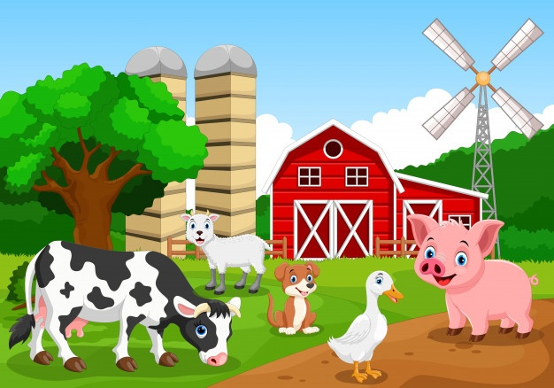
Farm
ფერმა
Young Learners დაწყებითი კლასები

Slide 3
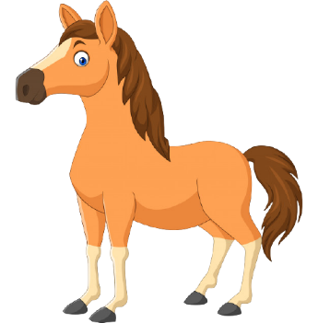
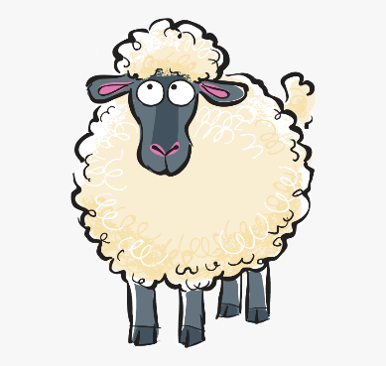
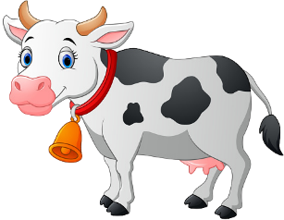
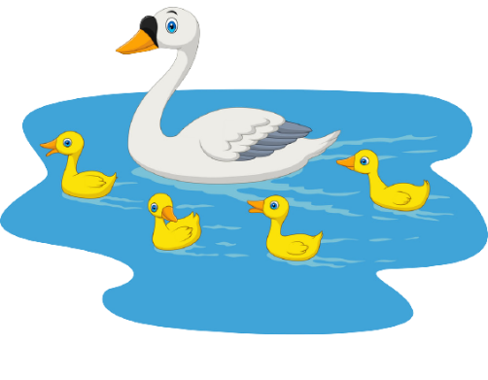
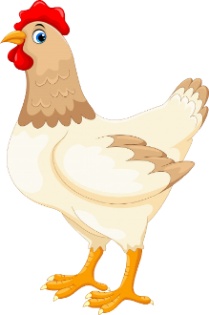
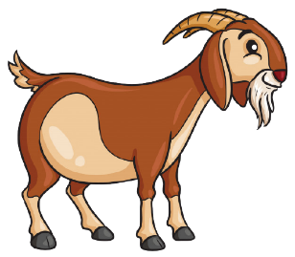
cows ძროხები
horses ცხენები
sheep ცხვრები
goats თხები
hens ქათმები
ducks / ducklings იხვები / იხვის ჭუკები

Slide 4
A cow has got four legs. It has got one tail. It has got two ears, two eyes, one nose and a mouth. A cow has got two horns. Some cows are black, some are white, some are brown and some have spots on their skin. Cows eat grass and give us milk.
A cow

Slide 5
A hen has got two legs. It has got two wings. A hen has got two eyes and one beak. Some hens are brown, some are white and some have spots on their feathers. Hens eat corn and give us eggs.
A hen

Slide 6
farm ფერმა
cow ძროხა
duck/ducklings იხვი/იხვის ჭუკები
sheep ცხვარი
goat თხა
hen ქათამი
horse ცხენი

Slide 7
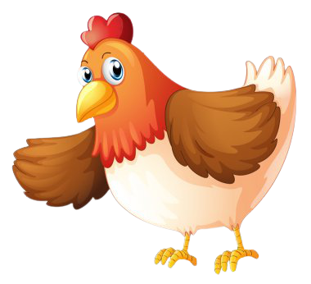
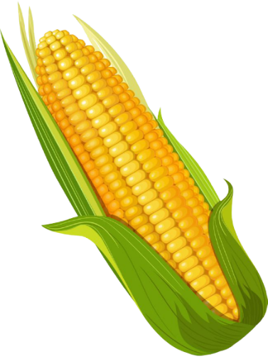
skin კანი
feather ბუმბული
horns რქები
tail კუდი
beak ნისკარტი
grass ბალახი
corn
სიმინდი

Slide 8
I was You were He was She was It was We were You were They were
am
was
be
be
is
were
are

Slide 9
1. Yesterday George _______ on the farm. 2. _______ there many animals? 3. I _______ happy to see a sheep. 4. Two hens _______ not on the fence. 5. ________ it a good day?
Complete the sentences with was/were.
შეავსეთ წინადადებებში გამოტოვებული ადგილები was/were-ის გამოყენებით.

Slide 10
Yesterday my mom and I ______ at the aquarium. There _______ many sea animals. There ______ one grey dolphin and there ______ a yellow snake, too. There _______ two blue whales. They ______ not big. I ______ happy.
Homework N1 საშინაო დავალება N1
Complete the text with was/ were. შეავსეთ ტექსტში გამოტოვებული ადგილები was/were - ის გამოყენებით.

Slide 11
__________ _______________________________ _______________________________ _______________________________ _______________________________
Homework N2 საშინაო დავალება N2
Describe one farm animal.
აღწერეთ ფერმის ერთ-ერთი ცხოველი.

Slide 12
Please send your homework to:
საშინაო დავალება გამოგვიგზავნეთ
შემდეგ მისამართზე:

