Slide 1
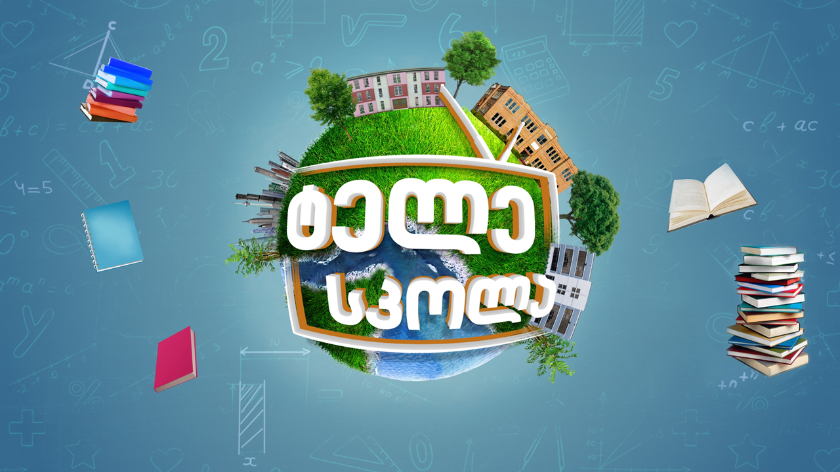

Slide 2
Engineering
ინჟინერია
English for Specific Purposes: Level A2

Slide 3
Agenda
გაკვეთილის გეგმა
Introduction - შესავალი
Superstructures
დიდი ნაგებობები
Vocabulary - ლექსიკა
Reading Comprehension - წაკითხულის გააზრება
Grammar - გრამატიკა
Summary- შეჯამება
Homework- საშინაო დავალება

Slide 4
Introduction შესავალი
What kind of problems do civil engineers try to solve?
What are the current problems in the world that can be solved by engineers?

Slide 5
Vocabulary ლექსიკა
depth
(n.)
სიღრმე
length
(n.)
სიგრძე
width
(n.)
სიგანე
Vocabulary
ლექსიკა
height
(n.)
სიმაღლე
construction
(n.)
მშენებლობა, ნაგებობა
measure
(v.)
გაზომვა
weigh
(v.)
აწონვა

Slide 6
Vocabulary
ლექსიკა
length
(n.)
სიგრძე
The length of the bridge is approximately 20 miles.

Slide 7
Vocabulary
ლექსიკა
depth
(n.)
სიღრმე
What’s the depth of this pool?

Slide 8
Vocabulary
ლექსიკა
width
(n.)
სიგანე
The width of the river at this point is quite amazing.

Slide 9
Vocabulary
ლექსიკა
height
(n.)
სიმაღლე
The height of New York's skyscrapers is so impressive.

Slide 10
Vocabulary
ლექსიკა
measure
(v.)
გაზომვა
Before you build a building, you should measure everything twice.

Slide 11
Vocabulary
ლექსიკა
weigh
(v.)
აწონვა
Yesterday a satellite weighing 15 tons was successfully placed in orbit.

Slide 12
Vocabulary
ლექსიკა
construction
(n.)
მშენებლობა, ნაგებობა
The construction of the bridge only took one month.

Slide 13
Vocabulary
ლექსიკა
length
weigh
measure
width
depth
height
construction
The measurement of something from end to end or along its longest side.

Slide 14
Vocabulary
ლექსიკა
width
height
depth
measure
weigh
construction
The distance across something from one side to the other.

Slide 15
Vocabulary
ლექსიკა
height
depth
measure
weigh
construction
The work of building or making something, especially buildings, bridges, etc.

Slide 16
Vocabulary
ლექსიკა
height
weigh
measure
depth
The distance from the top to the bottom of something, or the quality of being tall.

Slide 17
Vocabulary
ლექსიკა
depth
weigh
measure
The distance down either from the top of something to the bottom, or to a distance below the top surface of something.

Slide 18
Vocabulary
ლექსიკა
measure
weigh
To discover the exact size or amount of something.

Slide 19
Vocabulary
ლექსიკა
weigh
To have a heaviness of a stated amount, or to measure the heaviness of an object.

Slide 20
Vocabulary
ლექსიკა
dam
(n.)
კაშხალი
tunnel
(n.)
გვირაბი
flood
(v.)
დატბორვა
railway
(n.)
რკინიგზა
Vocabulary
ლექსიკა
destroy
(v.)
განადგურება
solar power
(n.)
მზის ენერგია
surface
(n.)
ზედაპირი

Slide 21
Vocabulary
ლექსიკა
dam
(n.)
კაშხალი
The Aswan High Dam is on the River Nile in Egypt.

Slide 22
Vocabulary
ლექსიკა
tunnel
(n.)
გვირაბი
The train went into the tunnel.

Slide 23
Vocabulary
ლექსიკა
railway
(n.)
რკინიგზა
She travelled across Siberia on the Trans-Siberian railway.

Slide 24
Vocabulary
ლექსიკა
surface
(n.)
ზედაპირი
There was very little wind, and the surface of the water was calm.

Slide 25
Vocabulary
ლექსიკა
flood
(v.)
დატბორვა
The whole town flooded when the dam burst.

Slide 26
Vocabulary
ლექსიკა
destroy
(v.)
განადგურება
In 1906 an earthquake destroyed much of San Francisco.

Slide 27
Vocabulary
ლექსიკა
solar power
(n.)
მზის ენერგია
The house is heated by solar power.

Slide 28
Reading Comprehension
წაკითხულის გააზრება

Slide 29
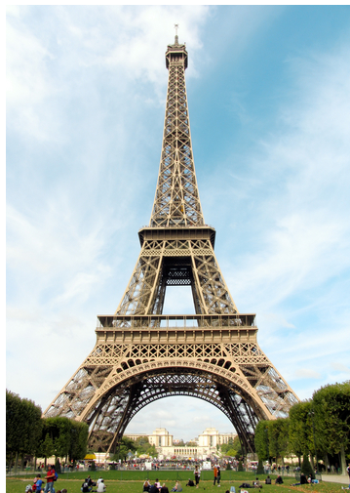
Reading Comprehension
წაკითხულის გააზრება
What is the largest man-made structure you have been in or on?
How would you feel if you were:
at the top of a very tall building?
in a tunnel deep in the ground?
in a building at the bottom of the sea?

Slide 30
Reading Comprehension
წაკითხულის გააზრება
The Transatlantic Tunnel
For those afraid to fly by planes across the ocean, engineers have designed a new way to travel. It is a magnetic railway tunnel which will be used to travel from New York to London and the journey will take only 45 minutes. This is an expensive project which will face great difficulties in construction. This railway tunnel across the ocean will not be above the sea level. It will actually be around 45 meters below the surface of the water, and it will take long time to fully finish. If it is built, it will be the largest and the most expensive engineering project in the history of the world.

Slide 31
Reading Comprehension
წაკითხულის გააზრება
Solar and Windfarm Project
Huge solar and wind farms are built in the Sahara Desert, from Morocco to Saudi Arabia. The aim is to provide electricity and to solve some of the world’s energy problems. There is a lot of intense sunlight in the Sahara Desert region, and this could provide a huge amount of solar power. In addition, the sandstorms of the area can create huge amounts of wind power which can be used to provide energy. There are some problems, however. Bad weather could destroy parts of the farms, and lots of water will be needed to clean them every day.

Slide 32
Reading Comprehension
წაკითხულის გააზრება
The Belo Monte Dam
The Brazilian government is planning to build a dam which will be the third largest in the world. The dam will provide 11,000 megawatts of energy, which the Brazilian government hopes will help Brazil’s economy to improve. However, it is a very expensive project. It will cost $18 billion to construct. There is more bad news. The dam will destroy much land by flooding large area, and 16,000 people that live there will have to find new homes. Despite all these, the dam could have great future benefits for the Brazilian people and its economy!

Slide 33
False
Reading Activity
კითხვის დავალება
The railway tunnel will be over the sea.
This railway tunnel across the ocean will not be above sea level. It will actually be around 45 metres below the surface of the water.

Slide 34
False
Reading Activity
კითხვის დავალება
It is cheap to build the Transatlantic tunnel.
This is an expensive project.

Slide 35
True
Reading Activity
კითხვის დავალება
The aim of the solar and wind farm project is to provide electricity.
The aim is to provide electricity and to solve some of the world’s energy problems.

Slide 36
False
Reading Activity
კითხვის დავალება
Construction of the dam won’t do any harm to the environment.
The dam will destroy much land by flooding large area, and 16,000 people that live there will have to find new homes.

Slide 37
Grammar
გრამატიკა
Huge solar and wind farms are built in the Sahara Desert, from Morocco to Saudi Arabia.

Slide 38
Grammar
გრამატიკა
We often use the passive:
when we prefer not to mention who or what does the action (for example, it's not known, we don't want to mention or it isn’t important)
New bridges are built in our city every year.

Slide 39
Grammar
გრამატიკა
We often use the passive:
so that we can start a sentence with the most important or most logical information.
The city is destroyed.

Slide 40
Grammar
გრამატიკა
We also use the passive voice:
in more formal or scientific writing.
New methods of construction are discovered by engineers.

Slide 41
Grammar
გრამატიკა
We can mention the doer of the action by using the preposition “by”
at the end of the sentence.
The bridge is built by engineers.

Slide 42
Grammar
გრამატიკა
Present Simple Passive
The passive voice is made with object + to be + past participle + by + subject.
I am informed about the updates.
The work is done by the engineers.

Slide 43
Grammar
გრამატიკა
Negative form
Object + negative of to be + past participle + by + subject.
The construction of the tunnel is not finished by engineers.

Slide 44
Grammar
გრამატიკა
Question form
to be + object + past participle + by + subject
Is the research done by scientists?

Slide 45
Grammar Activity
გრამატიკული დავალება
Every year, several prizes ……………..(GIVE) to the best students.
Every year, several prizes are given to the best students.

Slide 46
Grammar Activity
გრამატიკული დავალება
English ……………………. (SPEAK) in many countries all over the world.
English is spoken in many countries all over the world.

Slide 47
Grammar Activity
გრამატიკული დავალება
Houses ……………………..(NOT DESTROY) by the flood in this area.
Houses are not destroyed by the flood in this area.

Slide 48
Summary
შეჯამება
Vocabulary
Engineering
ინჟინერია
Reading Comprehension
Grammar

Slide 49
Homework
საშინაო დავალება
Write a paragraph about a superstructure you have ever seen.

Slide 50
Homework
საშინაო დავალება
Seikan Tunnel, Japan
The 53.85km Seikan tunnel in Japan is the longest and deepest rail tunnel in the world. It passes through Tsugaru Strait connecting the Hokkaido and Honshu islands.
It is built 100m below the seabed. It was officially opened in March 1988 and is used for the operation of express trains.
The tunnel was sponsored by Japan Railway Construction, Transport and Technology Agency and is operated by JR Hokkaido. The internal height and width of the tunnel is 7.85m and 9.7m respectively. Two stations, Tappi Kaitei and Yoshioka Kaitei, are located inside the tunnel.

