Slide 2
Technology ǀ ტექნოლოგია
English for Specific Purposes | Level B2

Slide 3
Agenda
გაკვეთილის გეგმა
Introduction - შესავალი
Technology
ტექნოლოგია
Vocabulary - ლექსიკა
Reading Comprehension - წაკითხულის გააზრება
Grammar - გრამატიკა
Summary- შეჯამება
Homework- საშინაო დავალება

Slide 4
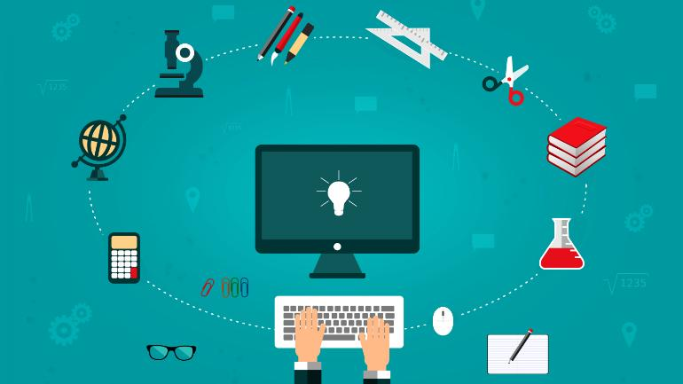
Introduction შესავალი
What are the positive effects of integrating technology in everyday life?

Slide 5
Vocabulary
ლექსიკა
to process
(v.)
დამუშავება
data
(n.)
მონაცემები, ინფორმაცია
protection
(n.)
დაცვა
Vocabulary
ლექსიკა
technophobe
(n.)
ტექნოფობი
resolution
(n.)
გადაჭრა (პრობლემის)

Slide 6
Vocabulary
ლექსიკა
data
(n.)
მონაცემები, ინფორმაცია
The data was/were collected by various researchers.

Slide 7
Vocabulary
ლექსიკა
to process
(v.)
დამუშავება
All data was processed on this machine.

Slide 8
Vocabulary
ლექსიკა
protection
(n.)
დაცვა
The protection of the environment must be our first priority today.

Slide 9
Vocabulary
ლექსიკა
resolution
(n.)
გადაჭრა, მოგვარება (პრობლემის)
It was a successful resolution to the crisis

Slide 10
Vocabulary
ლექსიკა
technophobe
(n.)
ტექნოფობი
Even technophobes will find this new software simple to use.

Slide 11
Vocabulary
ლექსიკა
data
process
protection
resolution
technophobes
It took my brain time to .........................the fact that I was free to leave.

Slide 12
Vocabulary
ლექსიკა
data
protection
resolution
technophobes
The computer verified that the ……………………was loaded correctly.

Slide 13
Vocabulary
ლექსიკა
protection
resolution
technophobes
The company offered a reasonable …………………

Slide 14
Vocabulary
ლექსიკა
protection
technophobes
It urges the Government to ensure that proper data
…………………standards are enforced.

Slide 15
Vocabulary
ლექსიკა
technophobes
Some are …………………………..who can't cope with modern gadgetry.

Slide 16
Vocabulary
ლექსიკა
detection
(n.)
აღმოჩენა, გამოაშკარავება
recognition
(n.)
ამოცნობა
effort
(n.)
მცდელობა
Vocabulary
ლექსიკა
creepy
(adj.)
საშინელი, საძაგელი
privacy
(n.)
კონფიდენციალურობა

Slide 17
Vocabulary
ლექსიკა
recognition
(n.)
ამოცნობა
They have installed text recognition software.

Slide 18
Vocabulary
ლექსიკა
detection
(n.)
აღმოჩენა, გამოაშკარავება
Early detection of the cancer improves the chances of successful treatment.

Slide 19
Vocabulary
ლექსიკა
effort
(n.)
მცდელობა
A considerable amount of time and effort has gone into this project.

Slide 20
Vocabulary
ლექსიკა
privacy
(n.)
კონფიდენციალურობა
The new law is designed to protect people's privacy.

Slide 21
Vocabulary
ლექსიკა
creepy
(adj.)
საშინელი, საძაგელი
I got a real creepy feeling on the way over there, as if someone was watching me.

Slide 22
Reading Comprehension
წაკითხულის გააზრება

Slide 23
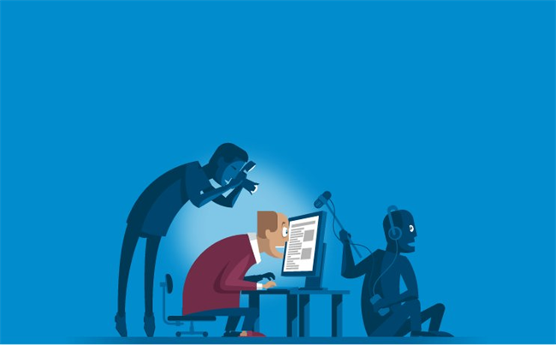
Reading Comprehension
წაკითხულის გააზრება
Does the development of technologies threaten the privacy of individuals?

Slide 24
Facial recognition technology is increasingly being used in many places in the United States and overseas. Such systems use machine learning tools to scan faces in an attempt to recognise particular individuals. Many police agencies across the worlds have used facial recognition technology to search for and help catch criminals. The technology has also been used at some US airports to help confirm the identity of passengers and get them on flights. It is also used to unlock phones or other electronic devices, and in some cases, even cars. Now, a similar technology – known as facial detection – is entering a new field: the business of advertising. Facial recognition technology is meant to identify a specific individual. Facial detection systems aim to detect the presence of a person and try to predict some facts about them.

Slide 25
Businesses use cameras set up inside the stores of the public area. The cameras scan the faces of individuals and predict their age and sex. Some systems are also designed to judge a person’s emotions. That information can then be used to target people with real-time advertisements on video screens during their visit to the store. One facial detection system developed by a company called Mood Media aims to judge a person’s “happiness” or “fear” level. Businesses could use such information to get real-time reactions from people as they look at products or video ads in the store. Such a system could also be used as part of a company’s efforts to test the popularity of specific products.

Slide 26
Another company, Cineplex Digital Media, showed off a camera-powered system designed for use in retail business, on the street or at bus stops. The company says its product can detect things like whether someone is wearing eyeglasses or has facial hair. That information could then be used to target those people with ads for new glassed or shaving equipment. Some privacy groups have criticised the use of such facial detection systems. Pam Dixon heads the World Privacy Forum, a not-for-profit group that researched privacy issues. “The creepy factor here is definitely a 10 out of 10”, she told the AP. Dixon added that the technology could lead to some discriminatory methods. For example, a business could raise the price of a product or service based on a person’s age. Or it could target a person with an ad for an anti-depression drug if the individual appears to have a sad facial expression. “We shouldn’t be gathering the emotional state of anyone”, Dixon said. Supporters of the technology say it could improve the buyer’s experience by drawing attention to products they might like or by offering them special deals.

Slide 27
False
Reading Activity
კითხვის დავალება
AI cameras have been used in police investigations in the
US only.
Many police agencies across the worlds have used facial recognition technology to search for and help catch criminals.

Slide 28
True
Reading Activity
კითხვის დავალება
AI cameras used in advertising are not the same as facial recognition cameras.
Facial recognition technology is meant to identify a specific individual. Facial detection systems aim to detect the presence of a person and try to predict some facts about them.

Slide 29
False
Reading Activity
კითხვის დავალება
The information gathered by facial detection cameras is used to send individual customers videos after their visit to the shop.
The cameras scan the faces of individuals and predict their age and sex.

Slide 30
Grammar
გრამატიკა
Conditionals

Slide 31
Grammar
გრამატიკა
Zero Conditional
Form
If + present simple, present simple
Use
General or scientific facts and definitions
Examples
If you have faith in something, you believe in something you cannot prove.

Slide 32
Grammar
გრამატიკა
First Conditional
Form
If + a present tense, will + bare infinitive
Use
Real or likely conditions in the present or future and their results in the present and future
Example
If you meet the manager, he’ll tell you the news.
If you are working till late, we’ll wait for you at home.
If you have spoken to him, he’ll come.

Slide 33
Grammar
გრამატიკა
We can also use may, might, can, could, shall, should, ought to, have to instead of will, depending on the meaning.
If you don’t follow the instructions, you might fail the course.

Slide 34
Grammar Activity
გრამატიკის დავალება
If you …………………. (mix) water and electricity, you………….. (get) a shock.
If you mix water and electricity, you get an electric shock.

Slide 35
Grammar Activity
გრამატიკის დავალება
If she ……………… (leave) at five o’clock, she’ll be there by half past seven.
If she leaves at five o’clock, she’ll be there by half past seven.

Slide 36
Grammar Activity
გრამატიკის დავალება
If you inform the board about the problem, they ….. (find) a solution.
If you inform the board about the problem, they will/might find a solution.

Slide 37
Summary
გაკვეთილის შეჯამება
Technology
ტექნოლოგია
Vocabulary
Reading
Grammar: Conditionals (zero & first)

Slide 38
Homework
საშინაო დავალება
Write a paragraph about advantages and disadvantages of technological advancement.

Slide 39
Homework
საშინაო დავალება
First, the evolution of technology is beneficial to humans for several reasons. At the medical level, technology can help treat more sick people and consequently save many lives and combat very harmful viruses and bacteria. Technology improves daily lives; allowing to move physical storage units to virtual storage banks and more. Scientists of the time are also able to send astronauts to the moon thanks to technology.
On the other hand, the evolution of modern technology has disadvantages, for example, dependence on new technology. Man no longer needs to think. Even if the calculator is a good invention, man no longer makes mental calculation and no longer works his memory. The decline of human capital implies an increase in unemployment. In some areas, devices can replace the human mind. The use of technology certainly needs rule and new laws. For example internet use is an individual freedom. However, the invention of the atomic bomb cannot be an individual freedom. In fact, regulations are difficult to implement when these technologies are introduced – such as regulation surrounding the impending arrival of autonomous vehicles.

