Slide 2
Architecture|არქიტექტურა
English for Specific Purposes | Level A2

Slide 3
Agenda
გაკვეთილის გეგმა
Introduction - შესავალი
Architecture
არქიტექტურა
Vocabulary - ლექსიკა
Reading Comprehension - წაკითხულის გააზრება
Grammar - გრამატიკა
Summary- შეჯამება
Homework- საშინაო დავალება

Slide 4
Introduction შესავალი
What kind of homes are popular nowadays?
Do you prefer to live in a private house or in a flat?

Slide 5
brick
(n.)
აგური
glass
(n.)
მინა
iron
(n.)
რკინა
wood
(n.)
ხე
Vocabulary
ლექსიკა
metal
(n.)
ლითონი
cement
(n.)
ცემენტი

Slide 6
Vocabulary
ლექსიკა
iron
(n.)
რკინა
The roof is made of sheets of iron.

Slide 7
Vocabulary
ლექსიკა
glass
(n.)
მინა
The road was covered with fragments of glass from the broken window.

Slide 8
Vocabulary
ლექსიკა
brick
(n.)
აგური
There was a brick wall around the house.

Slide 9
Vocabulary
ლექსიკა
wood
(n.)
ხე
The house was built of wood but faced with brick.

Slide 10
Vocabulary
ლექსიკა
metal
(n.)
ლითონი
Silver, gold, and platinum are precious metals.

Slide 11
Vocabulary
ლექსიკა
cement
(n.)
ცემენტი
We use brick and cement to build houses.

Slide 12
Vocabulary
ლექსიკა
brick
glass
metal
iron
wood
cement
A block of hard material used for building walls and houses.

Slide 13
Vocabulary
ლექსიკა
glass
metal
iron
wood
cement
A hard material that forms the branches and trunks of trees and can be used as a building material, for making things, or as a fuel.

Slide 14
Vocabulary
ლექსიკა
glass
metal
iron
cement
A chemical element that is a common grayish-colored metal. It is strong, used in making steel, and exists in very small amounts in blood.

Slide 15
Vocabulary
ლექსიკა
glass
metal
cement
A chemical element, such as iron or gold, or a mixture of such elements, such as steel, that is generally hard and strong.

Slide 16
Vocabulary
ლექსიკა
glass
cement
A gray powder that is mixed with water, sand, and other substances, becomes very hard when dry, and is used in construction.

Slide 17
Vocabulary
ლექსიკა
glass
A hard, transparent material, used to make windows, bottles, and other objects.

Slide 18
tiny
(adj.)
პატარა
space
(n.)
სივრცე
dome
(n.)
გუმბათი
Vocabulary
ლექსიკა
wheel
(n.)
ბორბალი
shape
(n.)
ფორმა
cosy
(adj.)
მყუდრო,
მოხერხებული

Slide 19
Vocabulary
ლექსიკა
space
(n.)
სივრცე
There is no space for books in this room.

Slide 20
Vocabulary
ლექსიკა
tiny
(adj.)
პატარა, მცირე ზომის
Her room was warm and comfortable, even though it was tiny.

Slide 21
Vocabulary
ლექსიკა
dome
(n.)
გუმბათი
The dome of the city hall can be seen in the distance.

Slide 22
Vocabulary
ლექსიკა
shape
(n.)
ფორმა
These buildings are all different shapes.

Slide 23
Vocabulary
ლექსიკა
cosy
(adj.)
მყუდრო
This room is nice and cosy in the winter.

Slide 24
Vocabulary
ლექსიკა
wheel
(n.)
ბორბალი
It was a house on wheels.

Slide 25
Reading Comprehension
წაკითხულის გააზრება

Slide 26
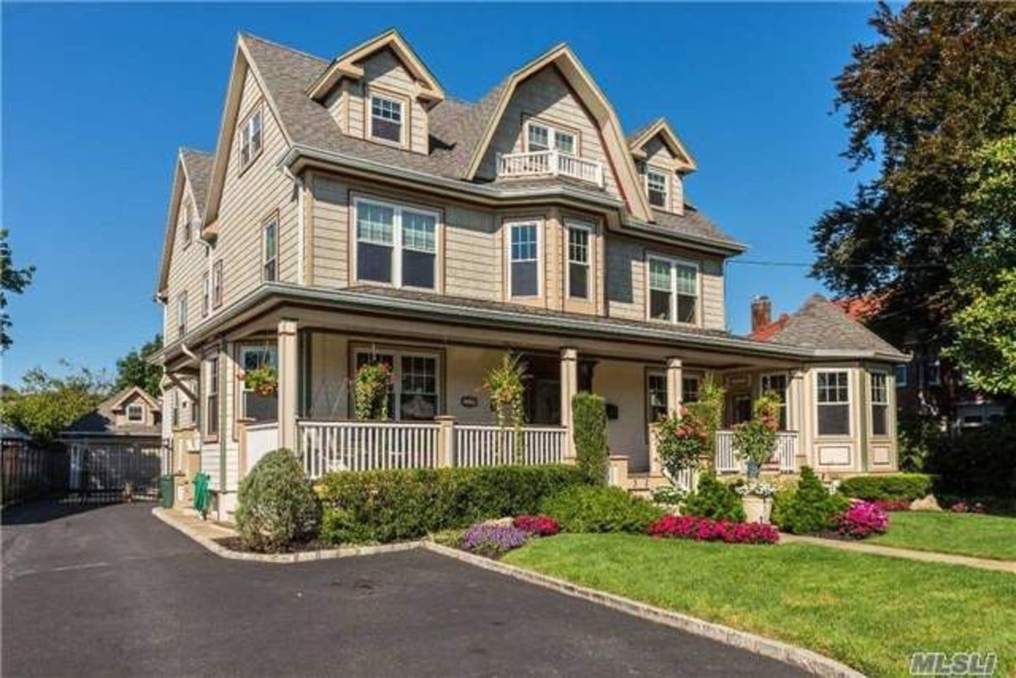
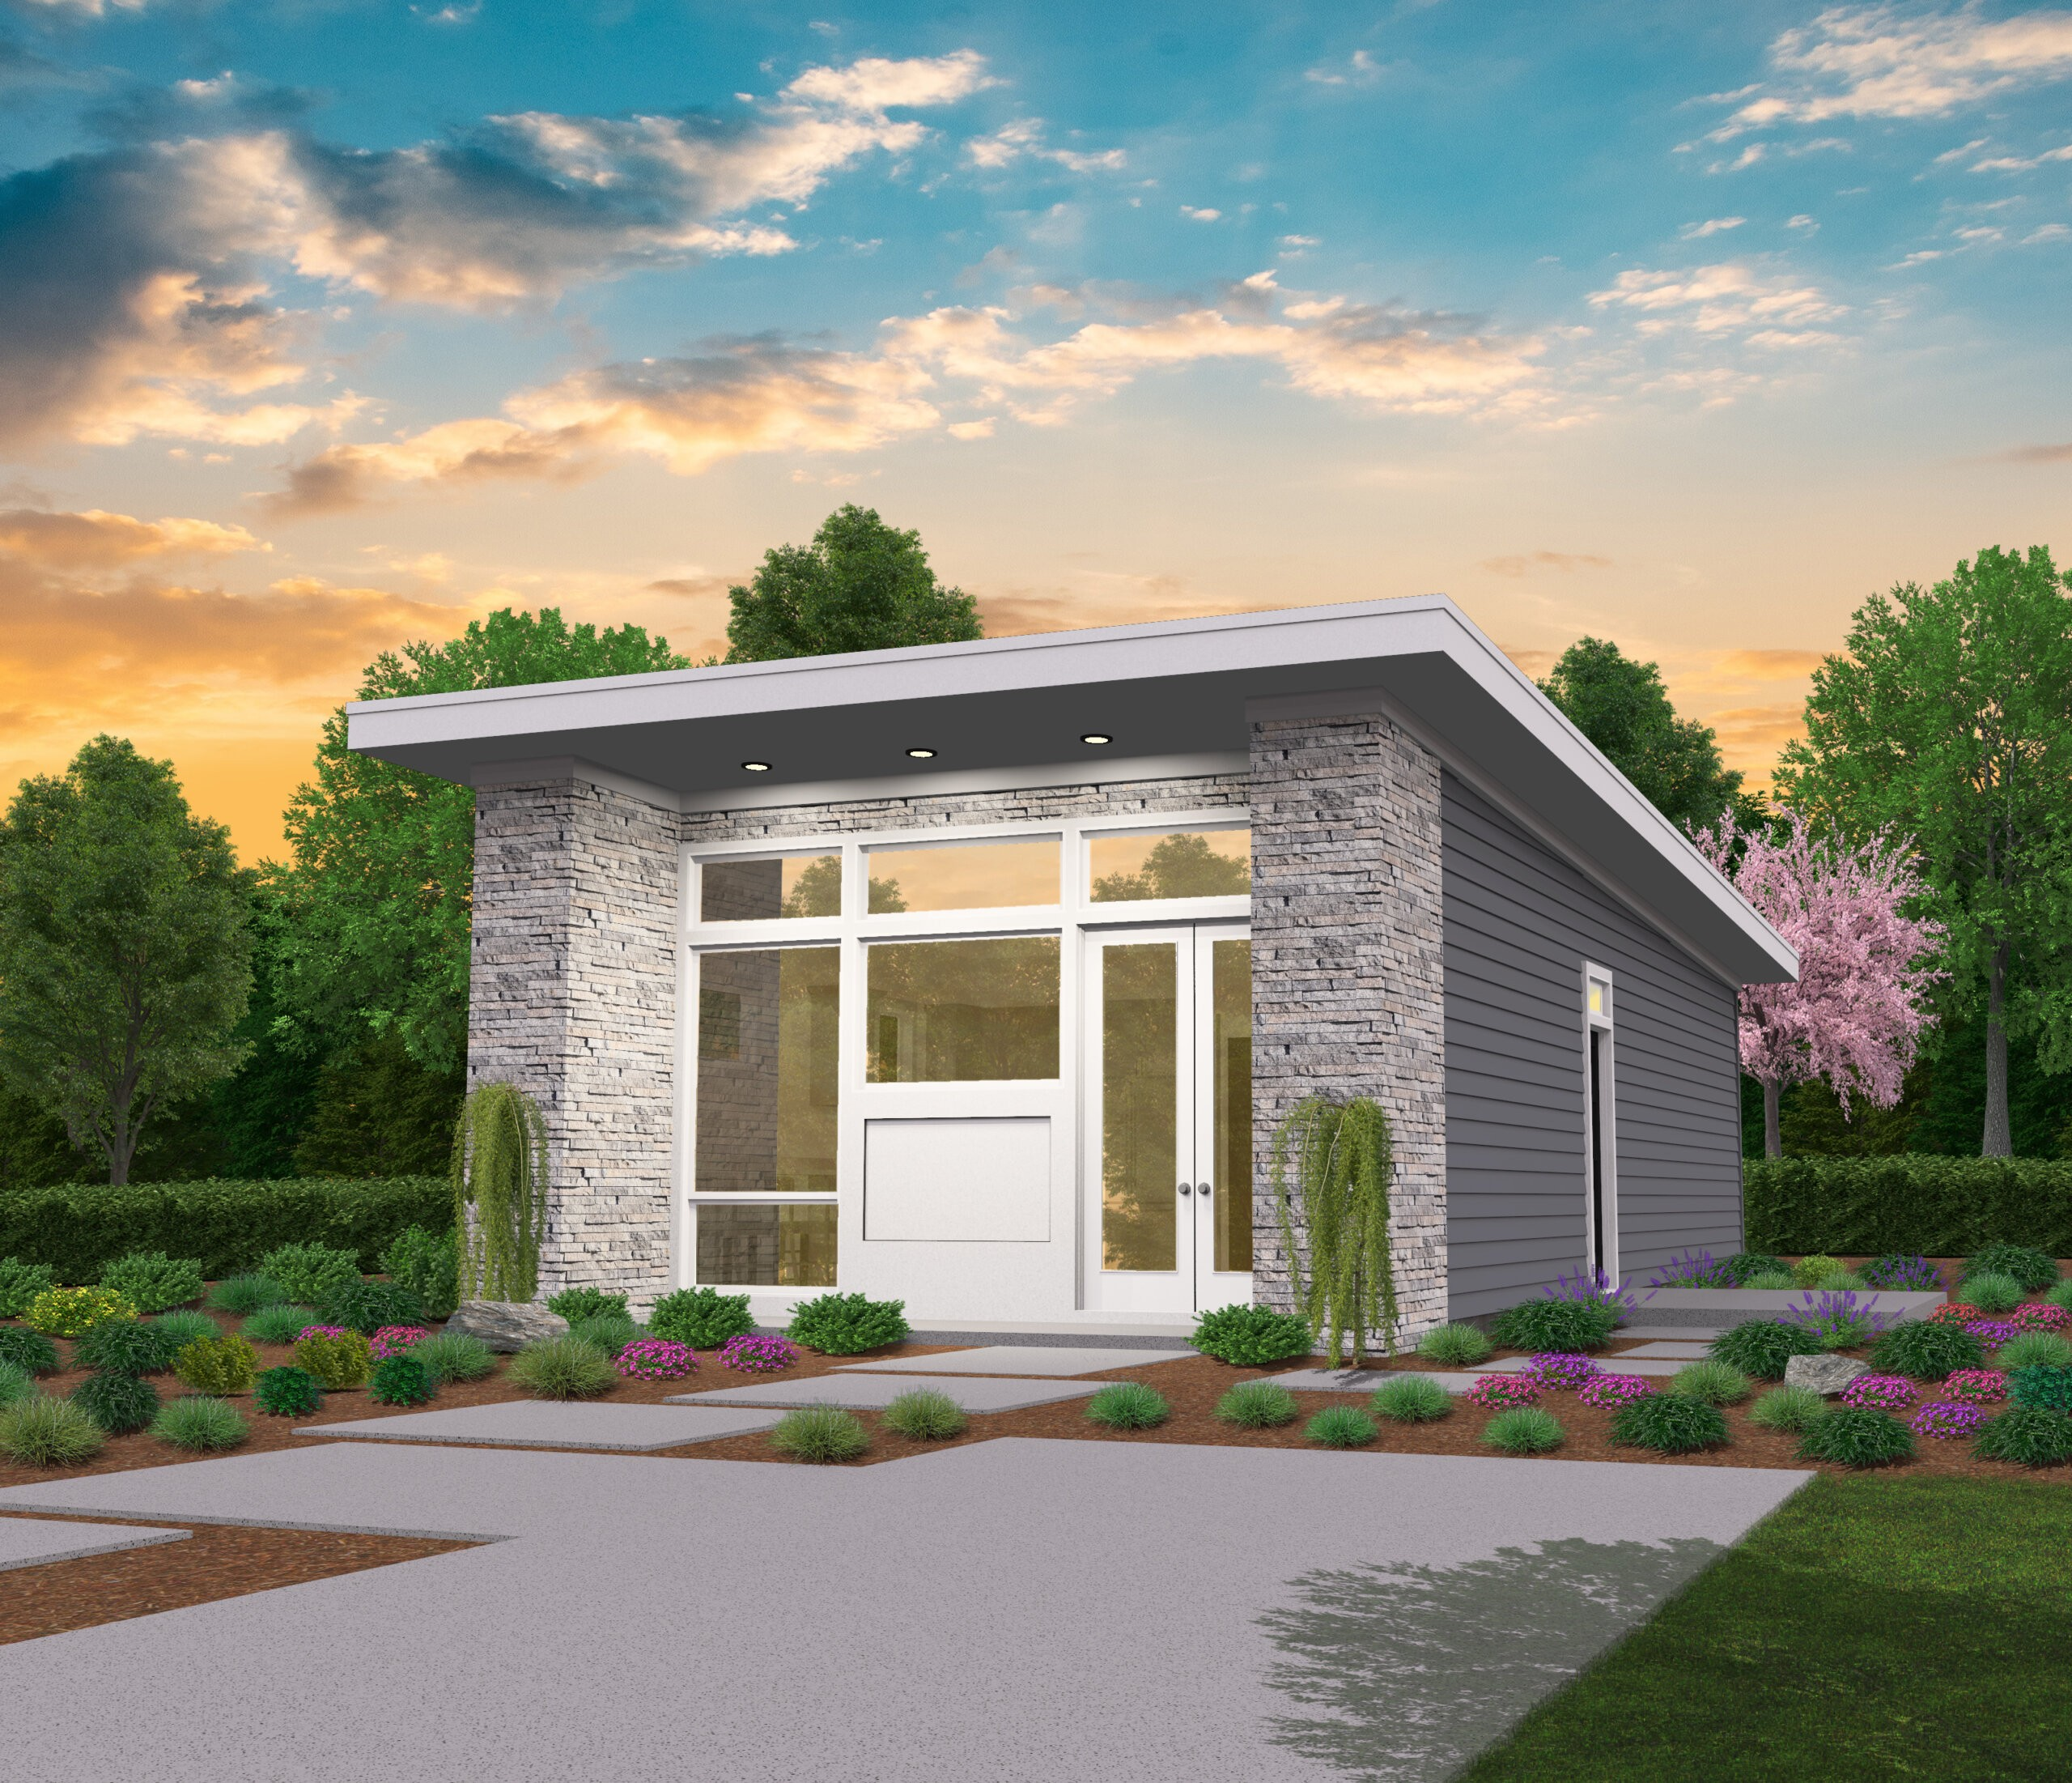
Reading Comprehension
წაკითხულის გააზრება
What do you think, is it more comfortable to live in a big or a small house? Why?

Slide 27
We often say “Home is where the heart is”, but often what makes a good home is a house that feels good when you are inside. In today’s world a new trend is occurring that is known as the tiny house movement and it is becoming popular worldwide. Because of the constant access and stress of seeing so many different people’s lives on social media, many people are trying to do the opposite. They believe a simple life is good, and so they’re trying to live comfortably in the smallest space possible. This is due to the increase in the cost of housing market worldwide and land scarcity, but it is also due to people just wanting to escape the stress of taking care of a big home.

Slide 28
When people who don’t own small homes see them, they first notice how small they are, but then see them for being so cosy and comfortable. There’s enough space for a bed, which can fold up into the wall during the day. And there’s a cupboard above and another one below the bed for our clothes, a cute mini-kitchen to cook, and a very compact bathroom. There are definitely sacrifices that must be made, such as a smaller wardrobe or book collection, and not as much room for furniture, but once adjusted to that many small home owners really enjoy their home.

Slide 29
People can buy their tiny house ready-made from a company called MHS on the internet. MHS designs mini-homes, and there is a choice of eight different models, including an A-shape cabin, a box cube and a round dome.
The company also delivers the new tiny homes complete with wheels so the new owners can park it anywhere and the customers who want to build their own tiny home, MSH sells the building materials, complete with the plans and step-by-step instructions. Most people pay only $7,000 for their tiny home, so it’s certainly inexpensive. But besides cost, what are the benefits for having a tiny house?

Slide 30
Many people think it’s a great feeling to know that they are living simply and not wasting space or material with rooms they don’t really need. Tiny homes use fewer materials and less energy, and it’s so friendly to the environment too. Not only that. It’s also definitely cosy, very cosy! And tiny home owners definitely don’t have much housework to do. While this trend is growing it is still very small compared to people wanting regular size homes, but this growing number of small home owners appreciate what they are doing and think that, “When it comes to home, less is more!”

Slide 31
False
Reading Activity
კითხვის დავალება
People who own tiny homes don’t want a simple life.
They believe a simple life is good, and so they’re trying to live comfortably in the smallest space possible.

Slide 32
True
Reading Activity
კითხვის დავალება
MHS offers eight different designs for tiny homes.
MHS designs mini-homes, and there is a choice of eight different models, including an A-shape cabin, a box cube and a round dome.

Slide 33
False
Reading Activity
კითხვის დავალება
The bathrooms in mini-houses are still quite large.
And there is a cupboard above and another one below the bed for our clothes, a cute mini-kitchen to cook, and a very compact bathroom.

Slide 34
False
Reading Activity
კითხვის დავალება
You can’t build your own mini-house.
Customers who want to build their own tiny home, MSH sells all the building materials, complete with plans and step-by-step instructions.

Slide 35
True
Reading Activity
კითხვის დავალება
Most of the houses cost around 7,000 dollars.
Most people pay only $7,000 for their tiny home, so it’s certainly inexpensive.

Slide 36
Grammar
გრამატიკა
There are some new houses.
We do not have any houseplants in our apartment.
Is there any furniture in the room?
There is not enough space for all our books.
There are too many books put in the bookcase.
We have too much furniture to fit in this room.

Slide 37
Grammar
გრამატიკა
You can add a quantifier before a noun to give more information.

Slide 38
Grammar
გრამატიკა
We can use these quantifiers with both countable and uncountable nouns:
all some more a lot of enough
no any most lots of less

Slide 39
Grammar
გრამატიკა
We do not normally use the quantifier some in negative and interrogative sentences. We normally use any:
Do you have any books at home?
Do you have any furniture?
We don't have any books.
I don’t have any furniture.
But we can use some for offers and requests:
Would you like some information?
I want some chairs for my new home.

Slide 40
Grammar
გრამატიკა
Form | Meaning | Example
(not) enough + noun | Indicates whether the number or amount of something is satisfactory or not | There is not enough space for all our books

Slide 41
Grammar
გრამატიკა
Form | Meaning | Example
too many + countable noun | Indicates that the number or amount of something is too high | There are too many unnecessary things in this room.

Slide 42
Grammar
გრამატიკა
Form | Meaning | Example
too much +uncountable noun | Indicates that the number or amount of something is too high | There is too much furniture in this room.

Slide 43
Grammar Activity
გრამატიკული დავალება
any
some
any
too much
too many
not enough
They do not have ……………… flowers in the garden yet.

Slide 44
Grammar Activity
გრამატიკული დავალება
any
some
too much
too many
not enough
Are there ……………... cupboards in the bedroom?

Slide 45
Grammar Activity
გრამატიკული დავალება
some
too much
too many
not enough
The space in this room is …………………….. for all the furniture we have.

Slide 46
Grammar Activity
გრამატიკული დავალება
too much
too many
some
There are …………………….. good restaurants in the neighbourhood.

Slide 47
Grammar Activity
გრამატიკული დავალება
too much
too many
There are ………………………. problems connected to this building.

Slide 48
Grammar Activity
გრამატიკული დავალება
too much
There is ………………………. traffic in the main street.

Slide 49
Summary
გაკვეთილის შეჯამება
Vocabulary
Architecture
არქიტექტურა
Reading about mini-homes
Grammar: quantifiers

Slide 50
Homework
საშინაო დავალება
Write a paragraph describing your home.

Slide 51
The shape of my home is a rectangle. It has a flat roof and not a dome. It is not very big but is very cosy. The outside walls are made of brick, while the inside walls are made of wood. There are small glass windows near the bedrooms and kitchen, but a very large window in front of the living room. Our bathroom is not tiny but is not very big. Most of the space of the house is for the kitchen and living room. The bedrooms are comfortable size, not too big, not too small.

