Slide 1
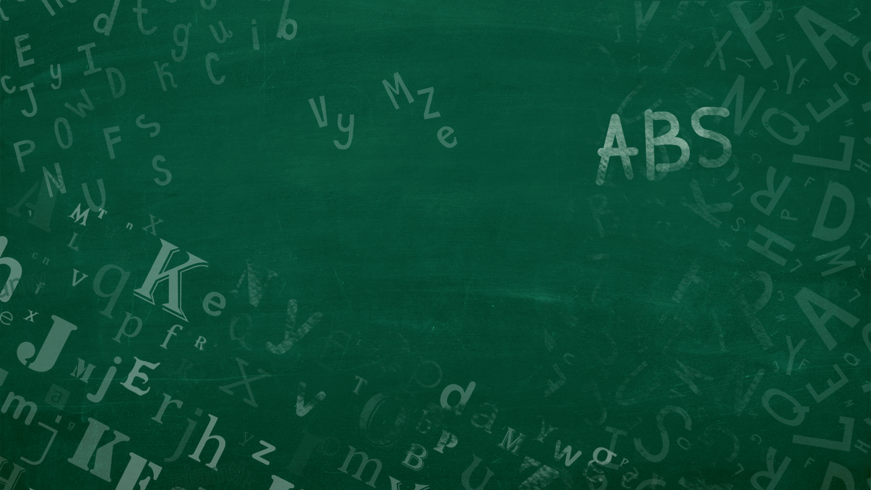
The Gruffalo - გრუფალო
By: Julia Donaldson - ჯულია დონალდსონი
Adapted for Grades 1-6
ადაპტირებულია I-VI კლასისთვის
Notes:
Did you hear the bell? That means it is time to start. My name is Ms. Nicole. My name is Ms. Amanda. We will be your teachers today. Welcome to our classroom.

Slide 2
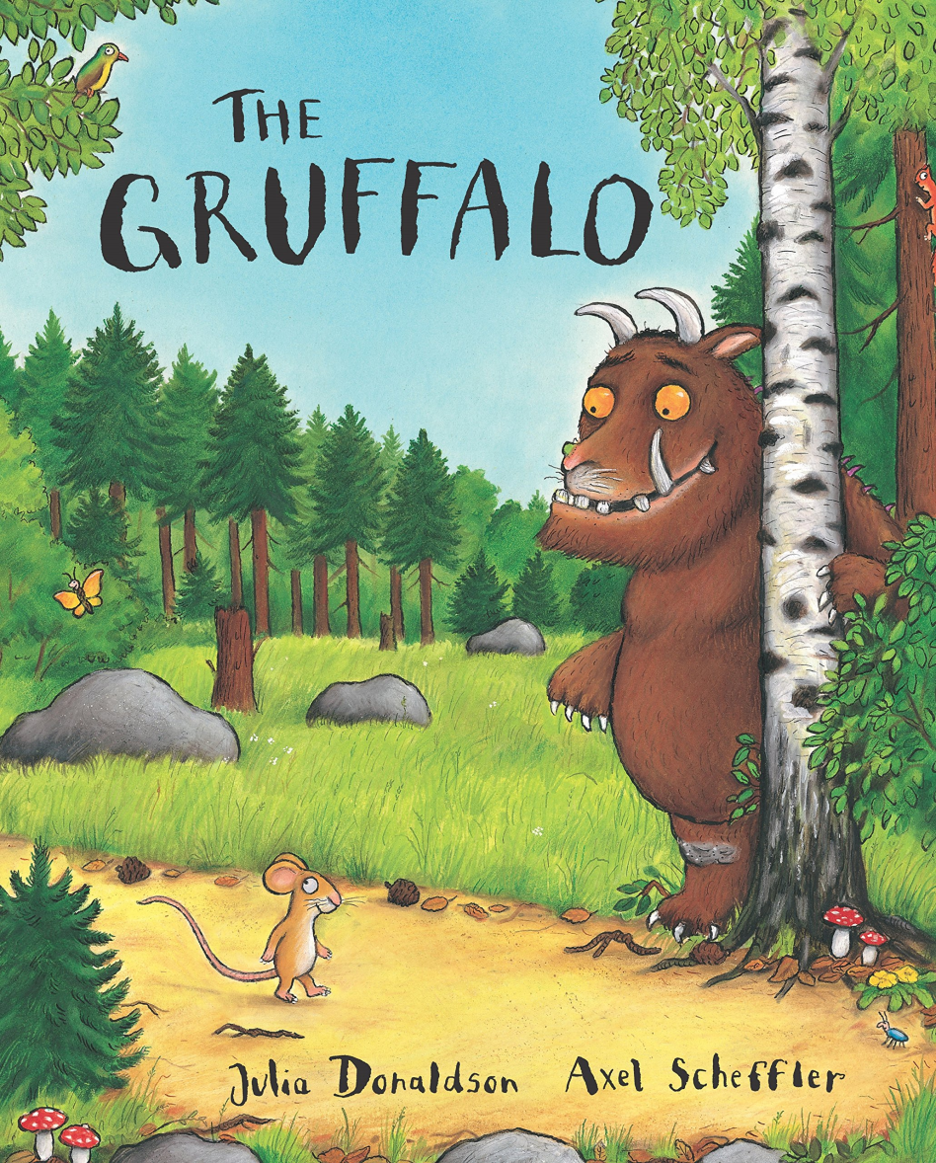
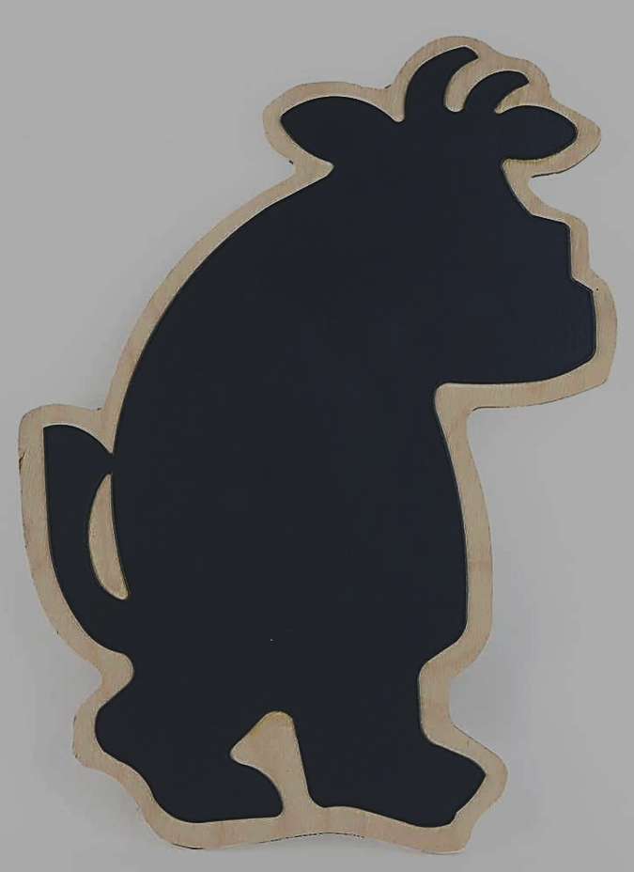
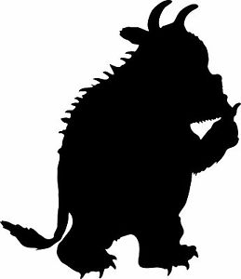
GRADES 1 – 6
I-VI კლასი
Preview
The King's and Queen's Club
Notes:
Today we will read the Gruffalo for Grades 1-6.

Slide 3
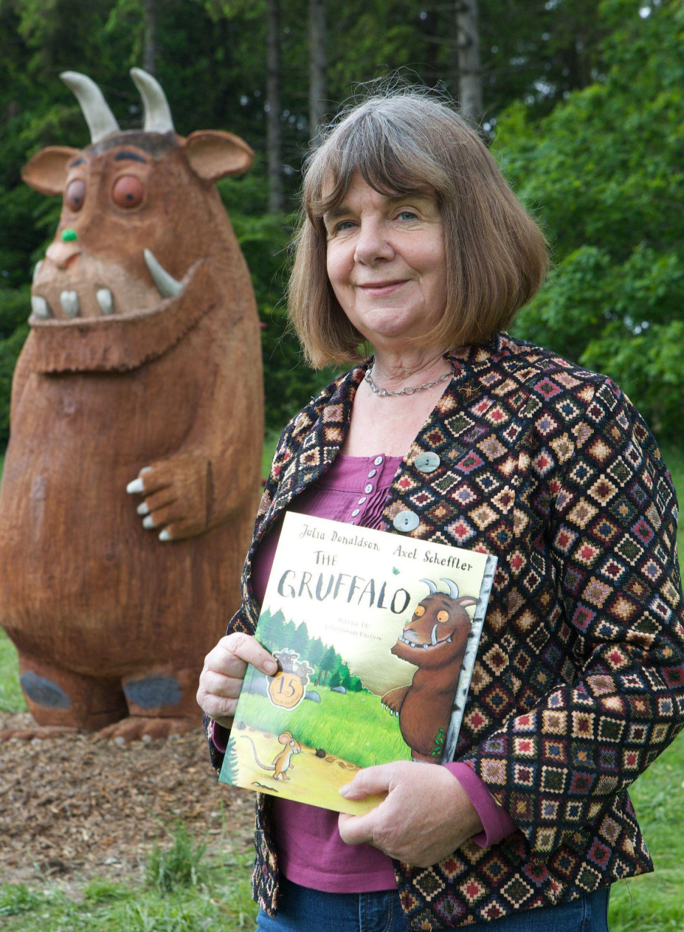
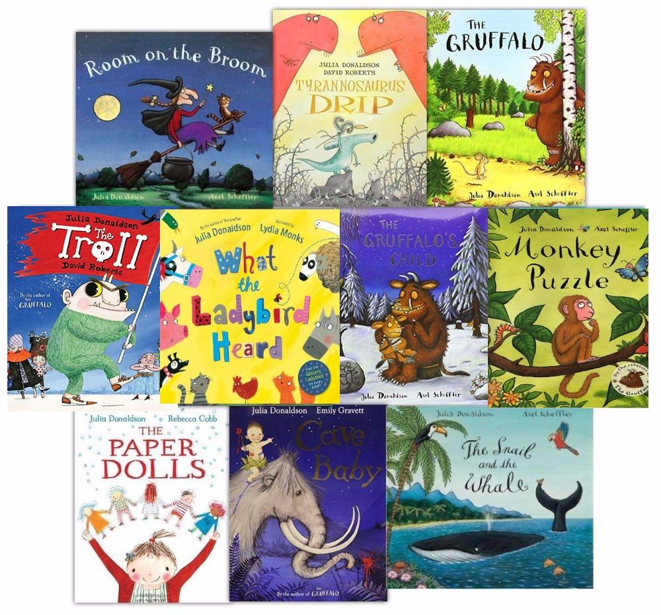
Author: ავტორი
Julia Donaldson
The King's and Queen's Club
Notes:
Julia Donaldson is the author of The Gruffalo. I like her books because they are funny. Her books make me laugh.

Slide 4
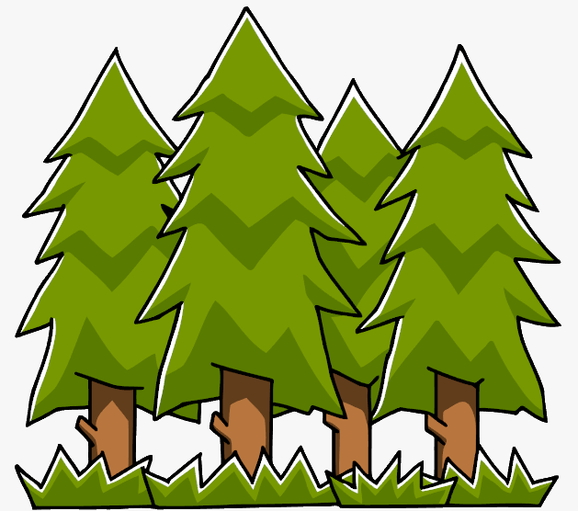
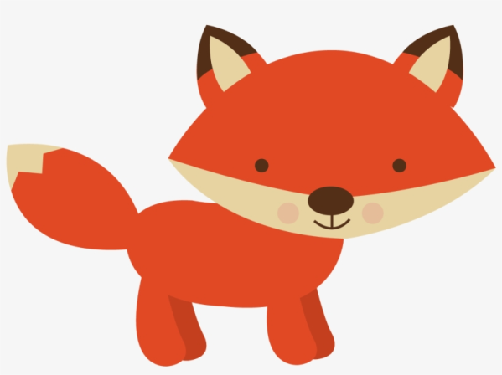
Vocabulary - ლექსიკა
Body parts - სხეულის ნაწილები
nose - ცხვირი
eyes- თვალები
mouth - პირი
tongue - ენა
ears - ყურები
Animals - ცხოველები
owl - ბუ
snake - გველი
fox - მელია
mouse - თაგვი
Places ადგილები
forest - ტყე
Notes:
We will learn many words today. We will learn about body parts and animals, and we will learn about the forest. Let’s learn these words. Nose. Nose. Eyes. Eyes. Mouth. Mouth. Tongue. Tongue. Toes. Toes. Good job. Let’s play a game. Are you ready? Nose. Nose, eyes. Nose, eyes, mouth. Nose, eyes, mouth, nose. Nose eyes, mouth, nose, eyes, tongue. Good job. Where are your toes? My toes are on my foot. What animals will we learn about today? The animals we will learn are…. Owl. Owl. Snake. Snake. Fox. Fox. Mouse. Mouse. Where do the animals live? In the forest. Can you say forest? Forest.

Slide 5
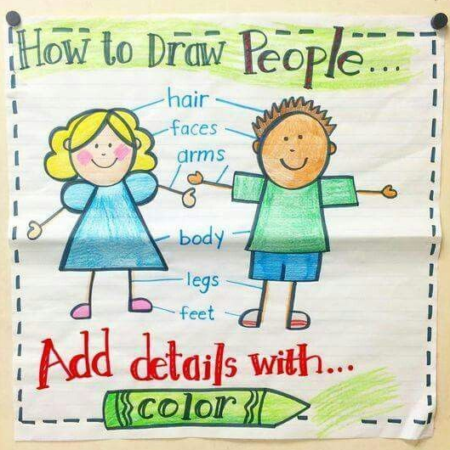
Preview
Learning Goals - სასწავლო მიზნები
Nose
ცხვირი
eye
თვალები
tongue
ენა
Notes:
We will learn how to draw a picture about the body parts. Look at the picture. Where is her nose? Where are her eyes? Where is her tongue?

Slide 6
READ - კითხვა
Preview
The King's and Queen's Club
Notes:
Before we read, let’s look at a picture of the book. What do you see? The mouse walks in the forest. What does he say? Maybe he says, “I want to eat!” Who will he meet? The Gruffalo!

Slide 7
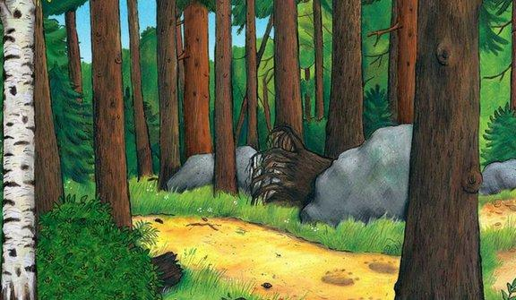
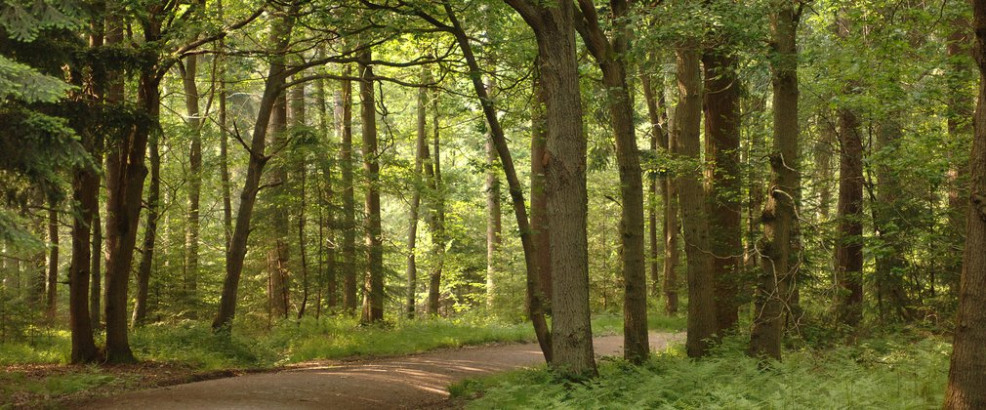
Forest - ტყე
animals - ცხოველები
tree - ხე
Notes:
The mouse walks in a forest. What do you know about a forest? There are many trees in a forest. There are many animals in a forest.

Slide 8
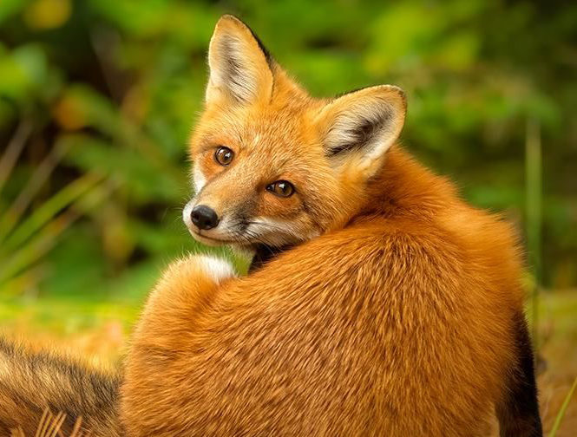
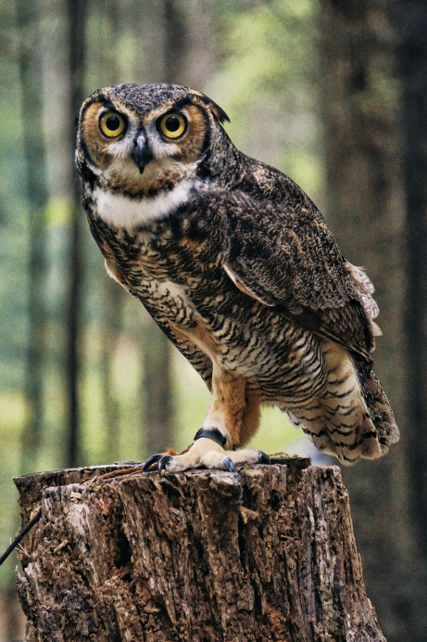
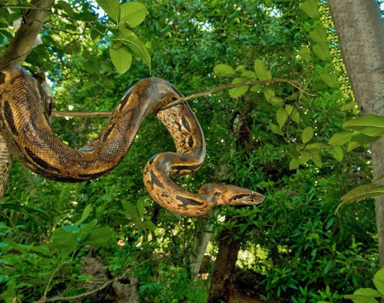
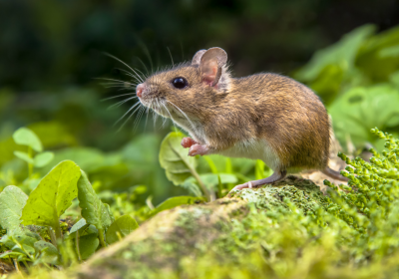
Animals - ცხოველები
fox - მელია
owl - ბუ
snake - გველი
mouse - თაგვი
Notes:
Wow! Which animals are in the forest? The owl is in the forest. The fox is in the forest. The snake is in the forest. The mouse is in the forest.

Slide 9
Animals - ცხოველები
Notes:
How are the owl, the fox, and the snake all the same? The owl wants to eat the mouse, the snake wants to eat the mouse, and the fox wants to eat the mouse. They all want to eat the mouse.

Slide 10
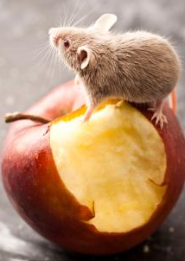
eat – ჭამა
berry- კენკრა
fruit- ხილი
Nut - თხილი
Notes:
What does the mouse eat? The mouse eats nuts, berries, and fruit. What do you know about this book?

Slide 11
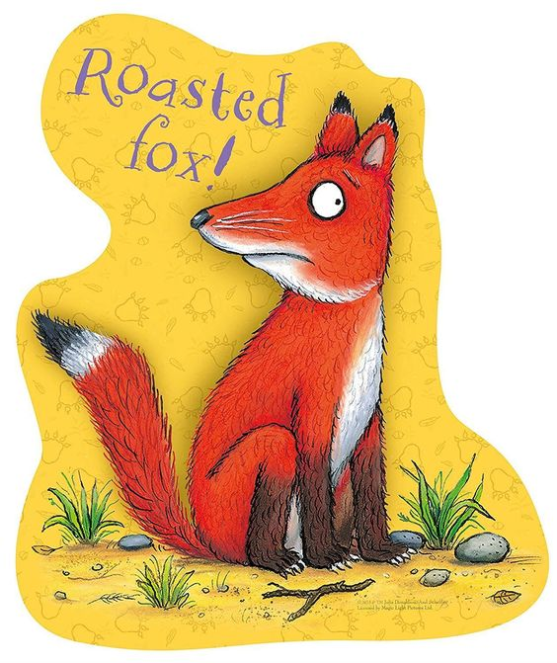
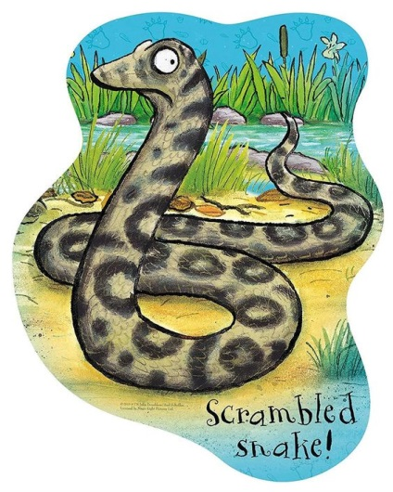
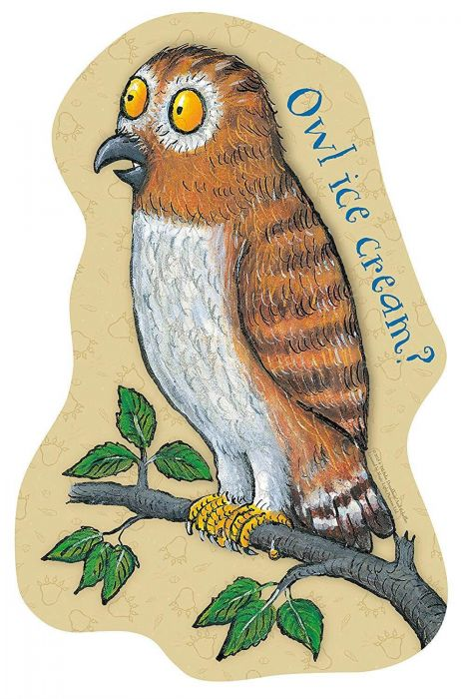
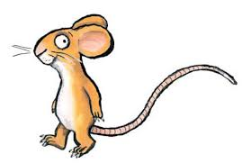
Summary - შინაარსი
In this book, the mouse walks in the forest. The mouse meets many animals, and the animals want to eat him! He meets a fox, an owl, and a snake. The animals want to trick the mouse, but he is too smart. The mouse tricks the animals! He says the Gruffalo has scary body parts. He says the Gruffalo will eat the fox, the snake, and the owl! The animals are afraid and go home!
Notes:
In this book, the mouse walks in the forest. The mouse meets many animals, and the animals want to eat him! He meets a fox, an owl, and a snake. The animals want to trick the mouse, but he is too smart. The mouse tricks the animals! He says the Gruffalo will eat the fox, the snake, and the owl! The animals are afraid and go home!

Slide 12
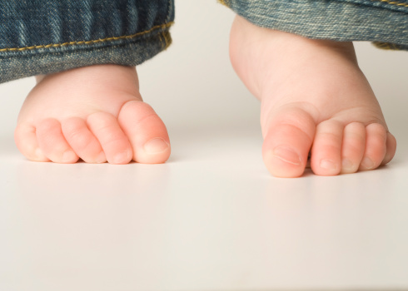
GRUFFALO BODY PARTS
toes
ფეხის თითები
tongue
ენა
eyes
თვალები
nose
ცხვირი
Terrible - საშინელი
Scary - საშიში
Notes:
In the story, the mouse tricks the other animals. He talks about the Gruffalo’s scary body parts. The Gruffalo has terrible eyes and a terrible nose, a terrible tongue and terrible toes. Terrible means very bad. Can we play our game again? I like that game. Ok. Nose. Nose, Tongue. Nose, Tongue, Nose. Nose, tongue, nose, eyes, nose. Nose, tongue, eyes, nose, toes. Nose, tongue, eyes, nose, toes, nose, toes. Good job!

Slide 13
READ - კითხვა
Preview
The King's and Queen's Club
Notes:
Are you ready to read? Yes! Let’s read.

Slide 14
MOUSE
MOUSE
Notes:
A mouse walks in the forest.

Slide 15
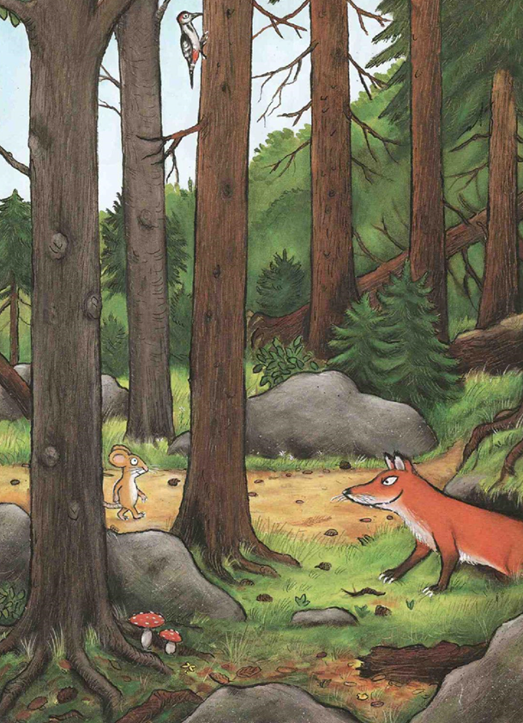
FOX
Notes:
The mouse sees a fox by the rocks.
The fox wants to eat the mouse. He says…
“Where will you go little mouse? Come, eat at my house.”
No. I will eat with the Gruffalo.
“A gruffalo? What is a gruffalo?”
“A gruffalo! Don’t you know?

Slide 16
nose - ცხვირი
tongue – ენა
eyes - თვალები
toe – ფეხის თითი
Notes:
“He has terrible eyes and a terrible nose. He has a terrible tongue and terrible toes.
“Where will you meet him?”
“Here, by these rocks. But you must go. The Gruffalo… likes to eat… fox.

Slide 17
Notes:
He likes to eat fox! “Goodbye, little mouse!”
He said goodbye to the mouse and went to his house.
“Silly old Fox! Doesn’t he know? There’s no such thing as a gruffalo?”

Slide 18
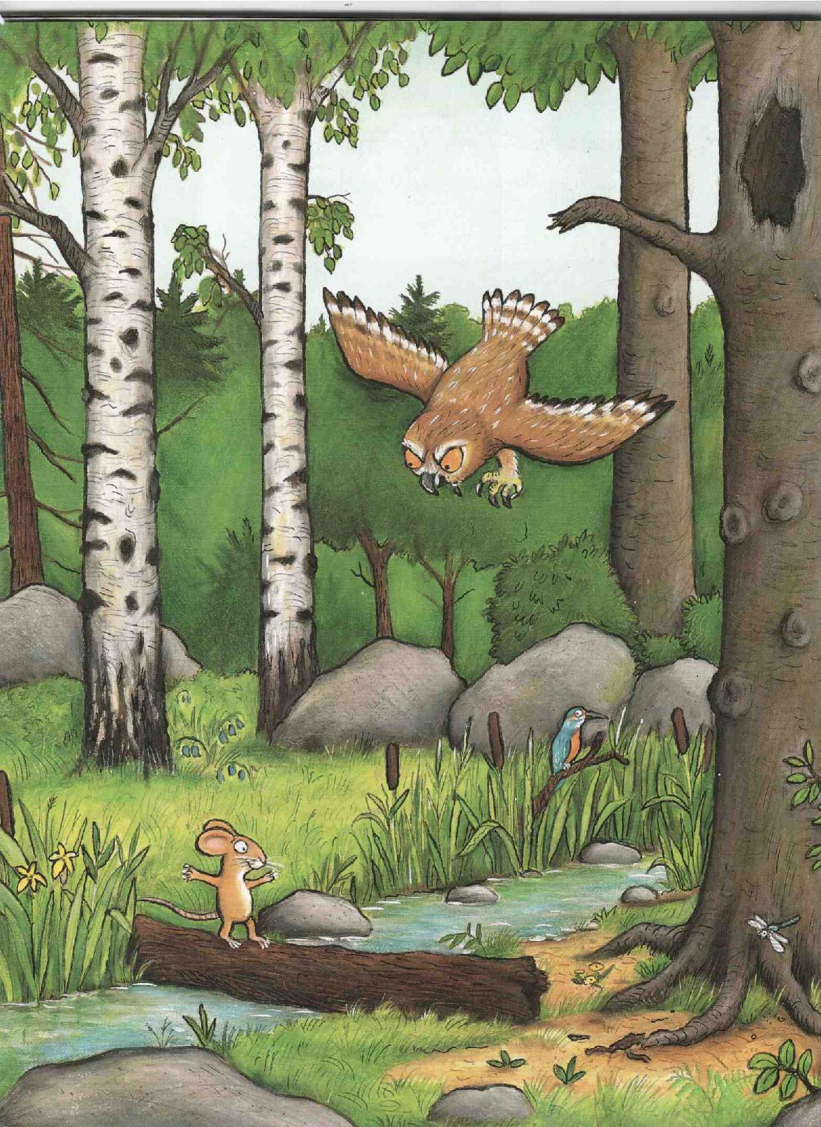
OWL
Notes:
The mouse walks and sees an owl in the trees.
“Where will you go little mouse? Come, eat at my house.”
No! I will eat with the Gruffalo.
“A gruffalo? What is a gruffalo?”
“A gruffalo! Don’t you know?

Slide 19
tongue – ენა
eyes - თვალები
nose - ცხვირი
toe – ფეხის თითი
Notes:
“He has terrible eyes and a terrible nose. He has a terrible tongue and terrible toes.
“Where will you meet him?”
“Here, by this stream. But you must go, now. The Gruffalo… likes to eat owl.

Slide 20
Notes:
He likes to eat owl! “Goodbye, little mouse!”
He said goodbye to the mouse and went to his house.
“Silly old Owl! Doesn’t he know? There’s no such thing as a gruffalo?”

Slide 21
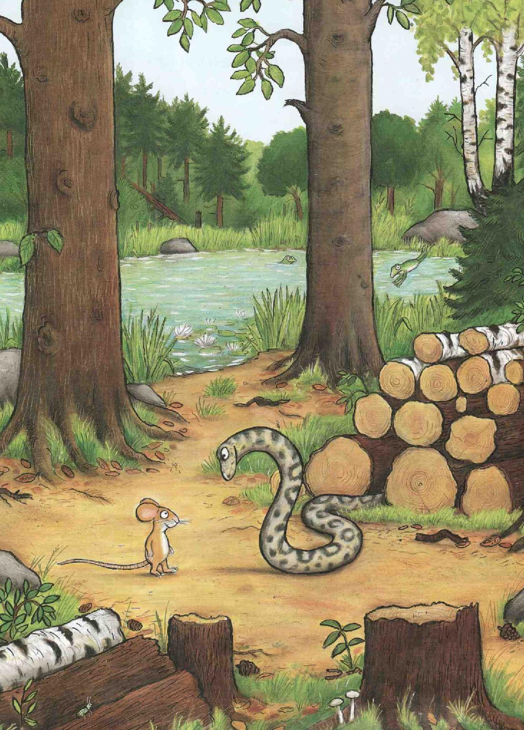
SNAKE
Notes:
The mouse walks and sees a snake by the lake.
Where will you go little mouse. Come, eat at my house.
No. I will eat with the Gruffalo.
“A gruffalo? What is a gruffalo?
A gruffalo! Don’t you know?

Slide 22
nose - ცხვირი
eyes - თვალები
toe – ფეხის თითი
tongue – ენა
Notes:
“He has terrible eyes and a terrible nose. He has a terrible tongue and terrible toes.
“Where will you meet him?”
“Here, by this lake. But you must go. The Gruffalo… likes to eat… snake.

Slide 23
Notes:
He likes to eat snake! “Goodbye, little mouse!”
He said goodbye to the mouse and went to his house.

Slide 24
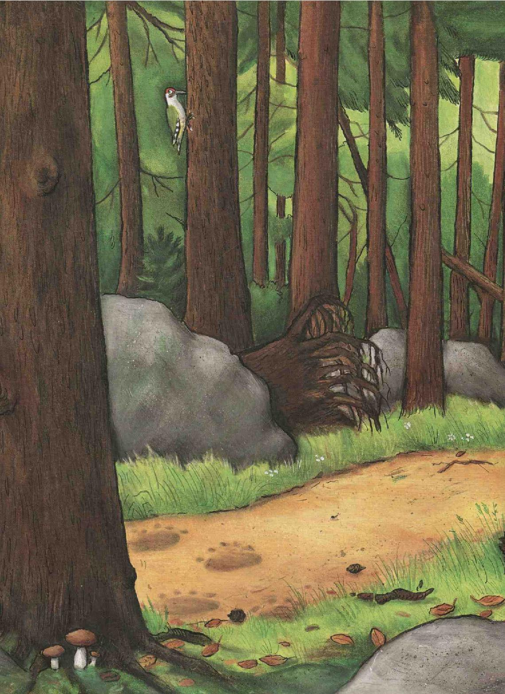
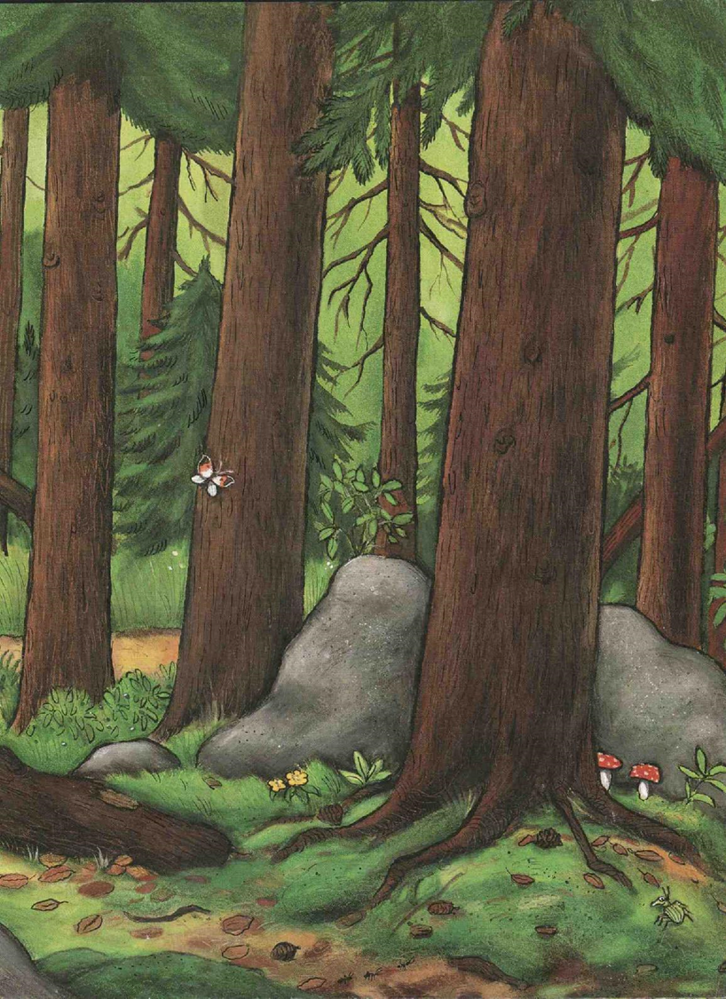
Notes:
Silly old Snake! Doesn’t he know? There’s no such thing as a gruffal… OH!

Slide 25
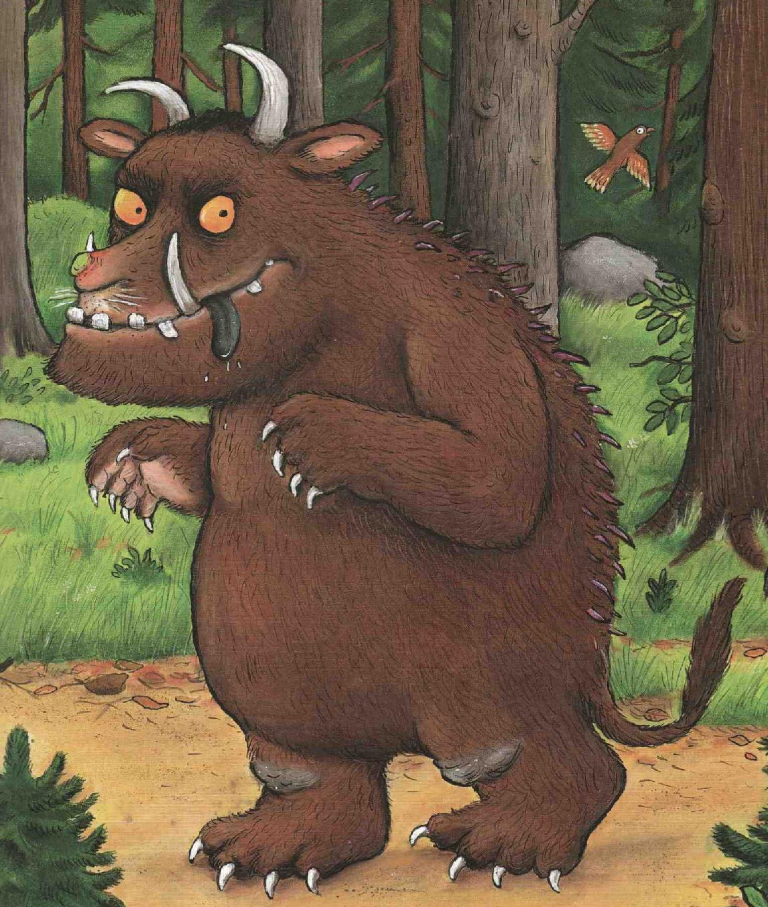
Notes:
He has terrible eyes and a terrible nose. He has a terrible tongue and terrible toes. Oh no! It’s a gruffalo!”

Slide 26
Notes:
The Gruffalo wants to eat the mouse. He says,
Where will you go little mouse? Come, I will eat you at my house.
Gruffalo, No! You will not eat me. Come, and you will see. The animals are all afraid of me.

Slide 27
Notes:
The Gruffalo laughs, and together they go.
The mouse first, and then behind, the Gruffalo.
They walked and walked till the Gruffalo said,
“What is that I hear ahead.”

Slide 28
Notes:
“It’s Snake,” said the mouse. “Snake, hello!”
Snake took one look at the Gruffalo.
He said, “Goodbye little mouse,”
He said goodbye to the mouse and went to his house.

Slide 29
Notes:
“You see? Said the mouse. “I told you so,”
“Wow!” said the Gruffalo.
They walked some more till the Gruffalo said,
“What is that I hear ahead?.”

Slide 30
Notes:
“It’s Owl,” said the mouse. “Owl, hello!”
Owl took one look at the Gruffalo.
He said, “Goodbye little mouse,”
He said goodbye to the mouse and went to his house.

Slide 31
Notes:
“You see?” said the mouse. “I told you so.”
“Wow!” said the Gruffalo.
They walked some more till the Gruffalo said,
“What is that I hear ahead?”

Slide 32
Notes:
“It’s Fox,” said the mouse. “Fox, hello!”
Fox took one look at the Gruffalo.
He said, “Goodbye little mouse,”
He said goodbye to the mouse and went to his house.

Slide 33
Notes:
I told you so! Now, you see?
The animals are all afraid of me!
You cannot eat me, and now you must go!
Or else I will eat a Gruffalo!
The Gruffalo said, “Goodbye little mouse.”
He said goodbye to the mouse and went to his house.

Slide 34
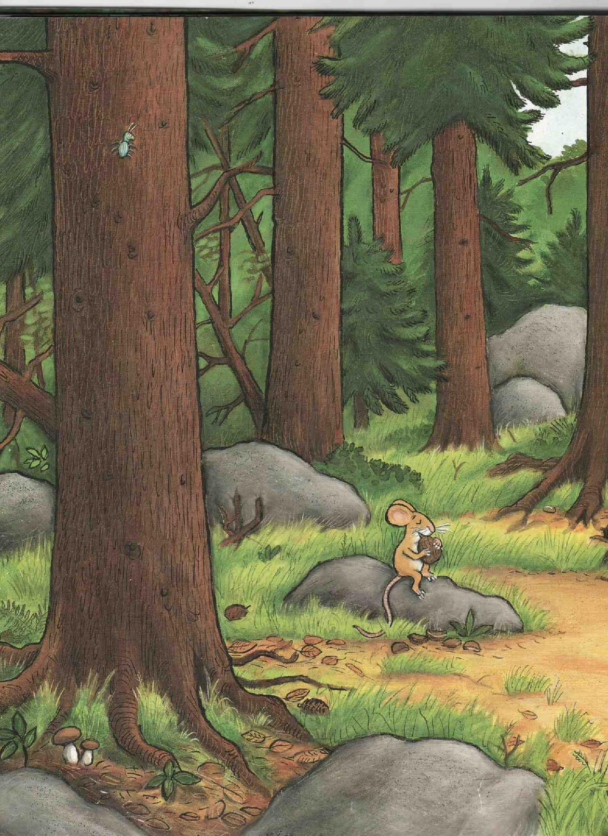
Notes:
The mouse found a nut to eat at his house.
That’s the end, goodbye little mouse.

Slide 35
Notes:
I love this book. It is so funny.

Slide 36
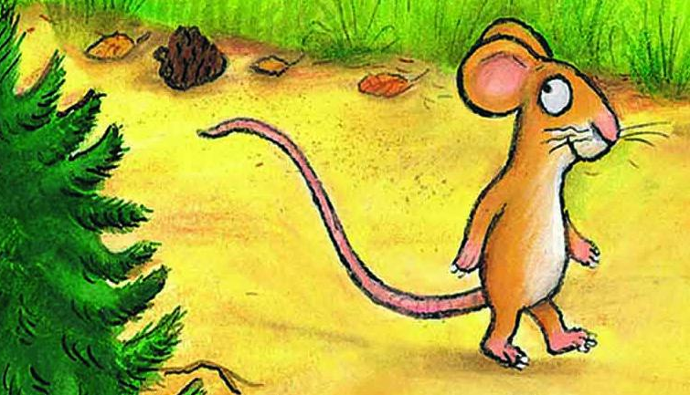
Question - შეკითხვა
Where does the mouse walk?
Notes:
Where does the mouse walk?

Slide 37
Answer - პასუხი
The mouse walks in the forest.
Forest - ტყე
Notes:
The mouse walks in the forest.

Slide 38
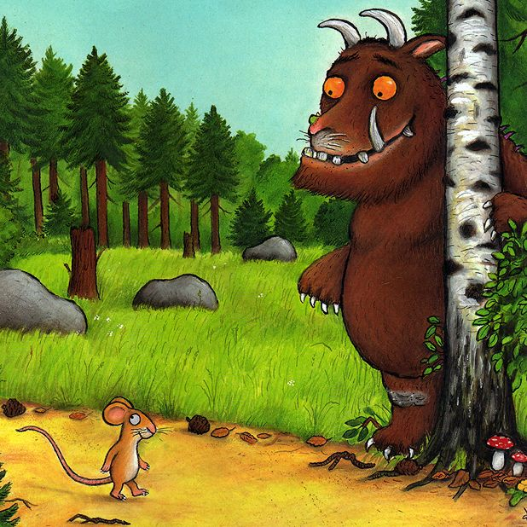
Question - შეკითხვა
Who wants to eat the mouse?
Notes:
Who wants to eat the mouse?

Slide 39
Answer - პასუხი
snake –
გველი
fox - მელია
owl - ბუ
The snake, the fox, the owl, and the Gruffalo all want to eat the mouse.
Notes:
The snake, the fox, the owl, and the Gruffalo all want to eat the mouse.

Slide 40
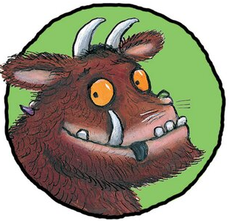
Question - შეკითხვა
Do you want to eat
with the Gruffalo? Why?
Notes:
Do you want to eat with the Gruffalo?

Slide 41
Answer - პასუხი
nose - ცხვირი
eyes - თვალები
tongue – ენა
Yes. I want to see his terrible eyes, nose, and tongue.
Notes:
Yes, I want to see how funny he looks. Yes, I want to see his terrible tongue, eyes, and nose.

Slide 42
GRUFFALO BODY PARTS
Where are your toes?
foot ტერფი
toes ფეხის თითები
Notes:
I want to see his terrible toes. Where are your toes? My toes are on my foot.

Slide 43
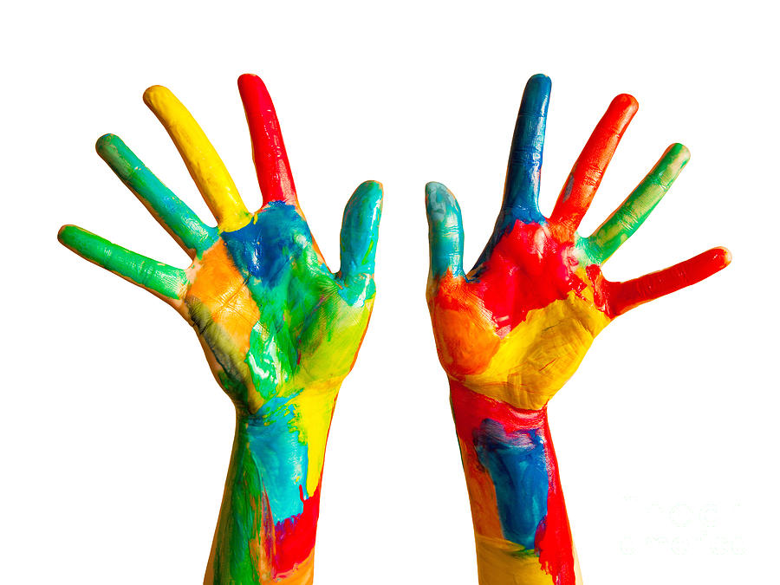
GRUFFALO BODY PARTS
Where is your finger?
finger
თითი
hand
ხელი
Notes:
Where is your finger? My finger is on my hand.

Slide 44
BODY PARTS
Where is your tongue?
tongue
ენა
mouth
პირი
Notes:
Where is your tongue? My tongue is in my mouth.

Slide 45
GRUFFALO BODY PARTS
Where are your ears?
head
თავი
ear
ყური
Notes:
Where are your ears? My ears are on my head.

Slide 46
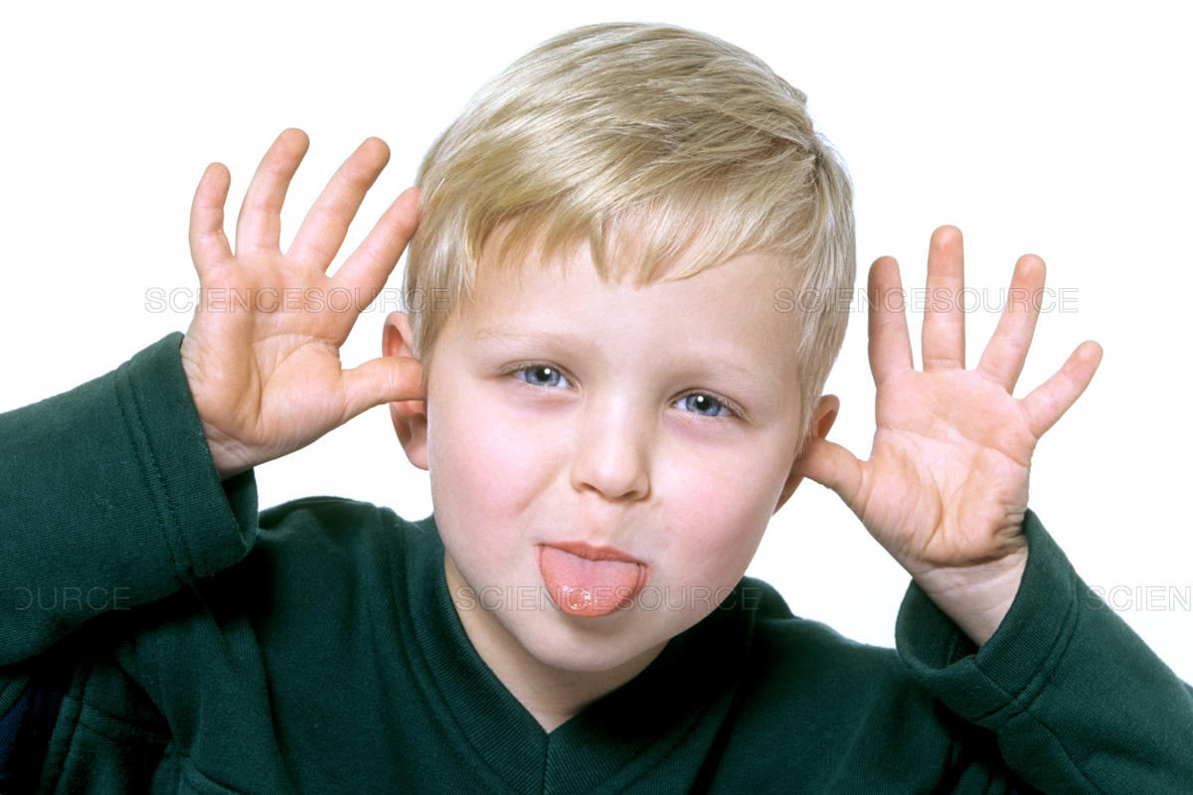
BODY PARTS REVIEW
Directions: Match the English word for each body part
with the correct Georgian word to complete the diagram.
თავი
ცხვირი
თვალი
eye
nose
tongue
ear
head
ცხვირი
ენა
ყური
Notes:
Good job! Let’s match the English words in the box with the Georgian words. Where is his hand? His hand is here. Where is his tongue. His tongue is here. Where is his ear? His ear is here. Where is his nose. His nose is here. Where is his eye? His eye is here.

Slide 47
BODY PARTS REVIEW
Directions: Did you get the correct answers?
head
ცხვირი
eye
eye
nose
tongue
ear
head
nose
tongue
ear
Notes:
Did you get the correct answers?

Slide 48
Homework
საშინაო დავალება
Body Parts
head
nose
eyes
ears
mouth
tongue
hand
foot
fingers
toes
Can you draw a picture and write the body parts?
Notes:
Can you draw a picture and write the body parts?

Slide 49
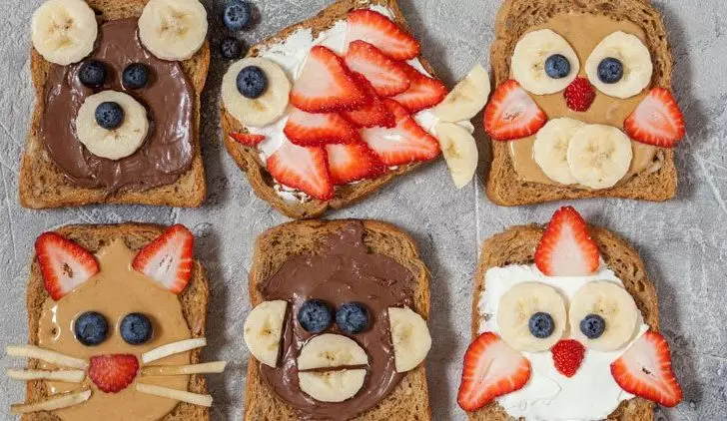
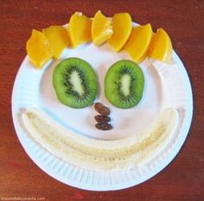
Fun Activity | სახალისო აქტივობა
MAKE A FOOD FACE
Make a snack that looks likes a face.
Say each body part before you eat.
Notes:
If you want a challenge, you can draw a picture of the Gruffalo and write his body parts too!

Slide 50
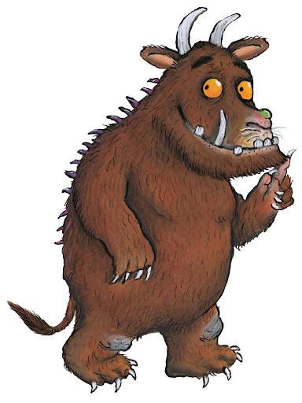
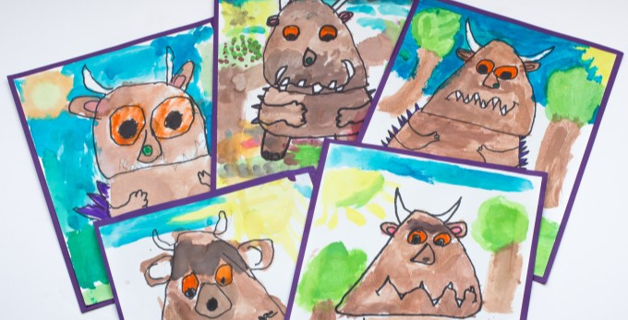
Fun Activity | სახალისო აქტივობა
Draw a picture of the Gruffalo and write the body parts.
GRUFFALO
BODY PARTS
Tell the story to someone you love.
Notes:
If you want a challenge, you can draw a picture of the Gruffalo and write his body parts too!

Slide 51
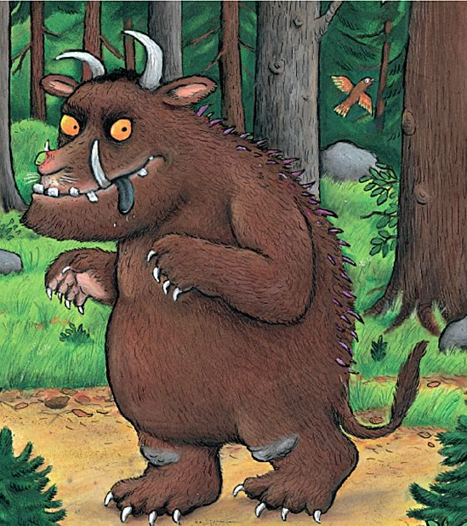
Example - მაგალითი
EAR
EYE
NOSE
TONGUE
TOES
GRUFFALO BODY PARTS
Notes:
Your picture of the Gruffalo might look something like this.

Slide 52
Review Animals
ცხოველების გამეორება
Notes:
Let’s review. Which animals live in the forest?

Slide 53
Animals - ცხოველები
fox - მელია
owl - ბუ
snake -გველი
mouse - თაგვი
Notes:
Owl, fox, snake, mouse

Slide 54
Review Body Parts
სხეულის ნაწილების გამეორება
Notes:
Which body parts do we know?

Slide 55
Review Body Parts
Body parts - სხეულის ნაწილები
ear- ყური nose - ცხვირი
eyes- თვალები mouth - პირი
tongue - ენა head - თავი
hand- ხელი finger - თითი
foot - ტერფი toes - ფეხის თითები
Notes:
Ears, eyes, nose, tongue, mouth, head, hand, finger, foot, and toes.

Slide 56
Vocabulary for Homework
საშინაო დავალება: ლექსიკური ერთეულები
Body parts - სხეულის ნაწილები
ear- ყური nose - ცხვირი
eyes- თვალები mouth - პირი
tongue - ენა head - თავი
hand- ხელი finger - თითი
foot - ტერფი toes - ფეხის თითები
Notes:
Here are the words we learned about body parts again. You will need these to do your homework. We will be happy to see pictures or videos of your homework. You can make a video talking about your picture or your food face. Thank you for learning with us. Now it is time to say goodbye.

Slide 57
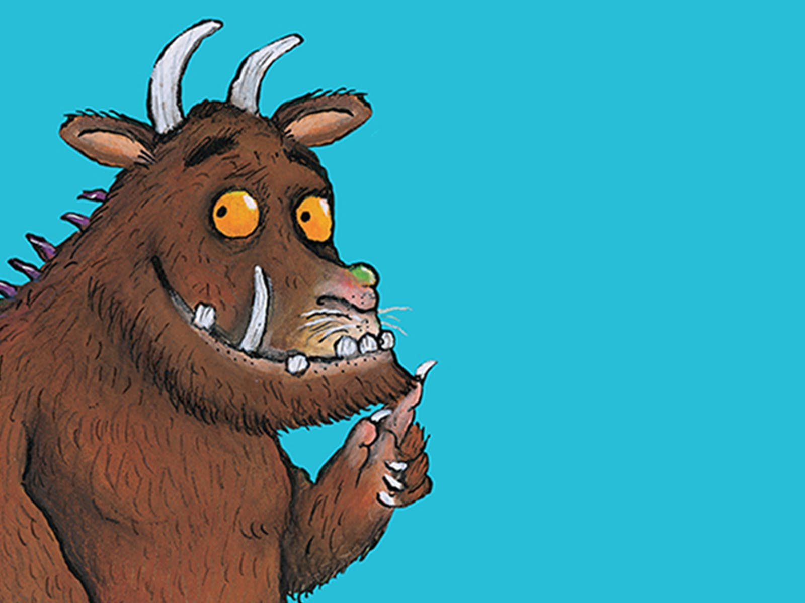
Notes:
Great job! Thank you for joining our class. We will see you next Friday! Goodbye!

