Slide 2
Architecture | არქიტექტურა
English for Specific Purposes | Level B2

Slide 3
Agenda გაკვეთილის გეგმა
Introduction - შესავალი
Architecture
არქიტექტურა
Vocabulary - ლექსიკა
Reading Comprehension - წაკითხულის გააზრება
Grammar - გრამატიკა
Summary- შეჯამება
Homework- საშინაო დავალება

Slide 4
Introduction შესავალი
Which is your favourite city in the world?
What can you say about its architecture?

Slide 5
hideous
(adj.)
საშინელი,
საზარელი
awe-inspiring
(adj.)
შთამბეჭდავი
to renovate
(v.)
განახლება, აღდგენა
Vocabulary
ლექსიკა
derelict
(adj.)
მიგდებული, მიტოვებული
dilapidated
(adj.)
დანგრევის პირას მისული, ნახევრად დანგრეული

Slide 6
Vocabulary
ლექსიკა
awe-inspiring
(adj.)
შთამბეჭდავი
Niagara Falls really is an awe-inspiring sight.

Slide 7
Vocabulary
ლექსიკა
hideous
(adj.)
საშინელი, საზარელი
They've just built some hideous new apartment blocks on the seafront.

Slide 8
Vocabulary
ლექსიკა
to renovate
(v.)
განახლება, აღდგენა
He renovates old houses and sells them at a profit.

Slide 9
Vocabulary
ლექსიკა
dilapidated
(adj.)
დანგრევის პირას მისული, ნახევრად დანგრეული
The hotel we stayed in was really dilapidated.

Slide 10
Vocabulary
ლექსიკა
derelict
(adj.)
მიგდებული, მიტოვებული
The theatre has been left to stand/lie derelict.

Slide 11
Vocabulary
ლექსიკა
awe-inspiring
hideous
renovate
dilapidated
derelict
They've just built some ……………………..new apartment blocks on the seafront. They’ve made the city ugly.

Slide 12
Vocabulary
ლექსიკა
awe-inspiring
renovate
dilapidated
derelict
It will take over a year to ……………………..the historical hotel.

Slide 13
Vocabulary
ლექსიკა
awe-inspiring
dilapidated
derelict
The building was …………………………in size and design.

Slide 14
Vocabulary
ლექსიკა
dilapidated
derelict
They bought a …..………………………house when they got married, and are gradually doing it up.

Slide 15
Vocabulary
ლექსიკა
derelict
The ………………………..buildings are the signs of a town in decay.

Slide 16
Are there any buildings in Tbilisi which generate controversial responses?

Slide 17
wall hanging
(n.)
კედლის გობელენი
horrendous
(adj.)
საშინელი, საზარელი
proximity
(n.)
სიახლოვე
Vocabulary
ლექსიკა
plain
(adj.)
უბრალო
outrage
(n.)
რისხვა
futuristic
(adj.)
ფუტურისტული, მეტისმეტად თანამედროვე

Slide 18
Vocabulary
ლექსიკა
horrendous
(adj.)
საშინელი, საზარელი
Exhibits show how horrendous the living conditions there were.

Slide 19
Vocabulary
ლექსიკა
wall hanging
(n.)
კედლის გობელენი
The wall hangings are thought to be roughly contemporary with the tiled floors.

Slide 20
Vocabulary
ლექსიკა
proximity
(n.)
სიახლოვე
The site is in close proximity to motorways and an airport.

Slide 21
Vocabulary
ლექსიკა
outrage
(n.)
რისხვა
The case generated public outrage.

Slide 22
Vocabulary
ლექსიკა
futuristic
(adj.)
ფუტურისტული, მეტისმეტად თანამედროვე
That art gallery has one of the most futuristic-looking designs I’ve ever seen.

Slide 23
Vocabulary
ლექსიკა
plain
(adj.)
უბრალო
The building style is plain, with very little ornament.

Slide 24
Reading Comprehension
წაკითხულის გააზრება
Four highly controversial designs
Even with top architects, the best of intentions and a huge budget it’s still possible to get a building’s design horribly wrong. Or is it? Beauty is in the eye of the beholder, and what may be horrendous to one is a symbol of style and modernism to another. The following four buildings all provoked strong reactions when they were first built, and yet have their fair share of fervent admirers. In some cases they have even become national treasures.

Slide 25
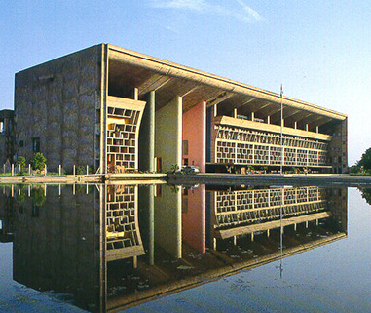
Reading Comprehension
წაკითხულის გააზრება
The High Court, Chandigarh (Chandigarh, India)
The High Court Chandigarh, part of a whole city designed by the French architect Le Corbusier, attracted praise from cities all over the world for its clean sculptural lines. But the building proved decidedly less popular with the high court judges, both in terms of design and functionality. They took down the abstract wall hangings in the courtrooms and parked their cars defiantly on the pedestrian walkways under the parasol roof – causing Corbusier to remark that they were judges of law and not judges of art.

Slide 26
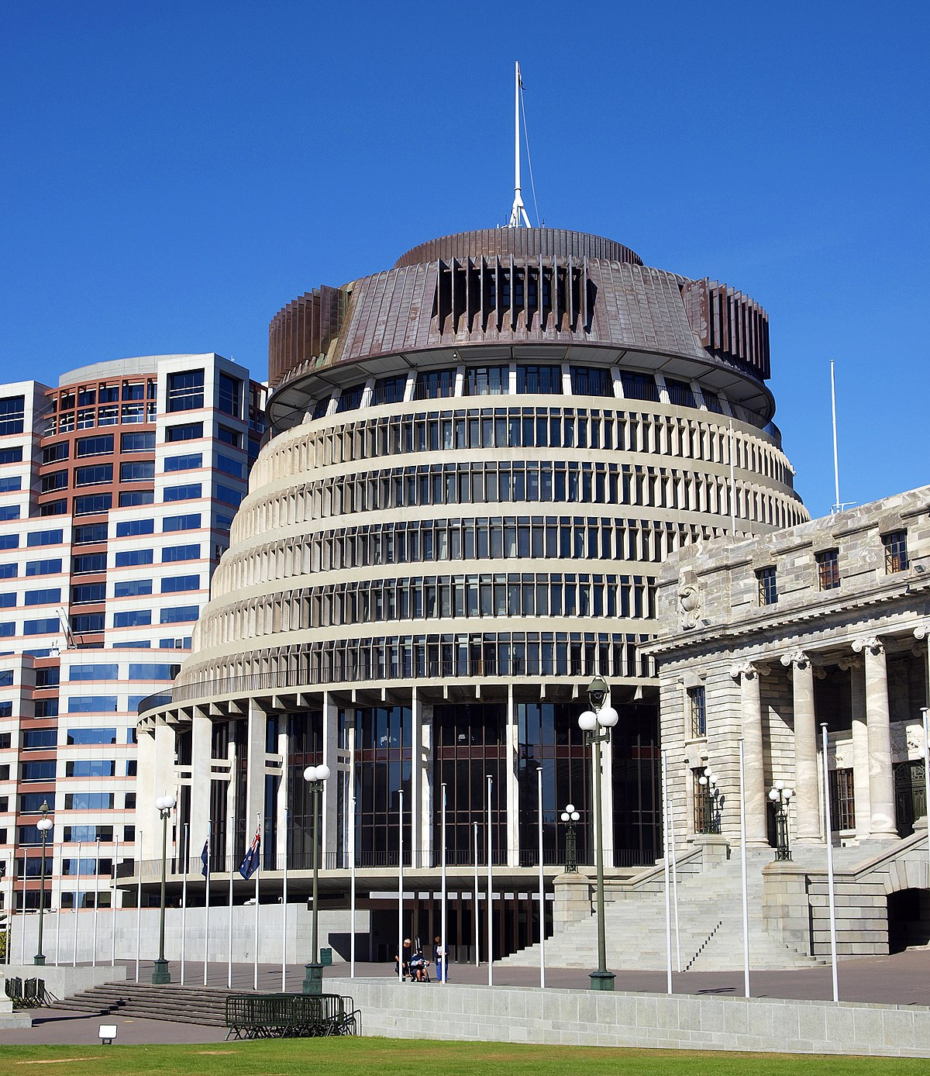
Reading Comprehension
წაკითხულის გააზრება
The Beehive (Wellington, New Zealand)
A slide projector that fell on a wedding cake that fell on a waterwheel is one description of this impressive building known as “The Beehive”- one of the New Zealand government buildings. The Beehive was built during the 1970s. Part of its problem was its proximity to the neighbouring Edwardian neoclassical Parliament House, which only accentuates the architectural aspects of Beehive that many disliked.

Slide 27
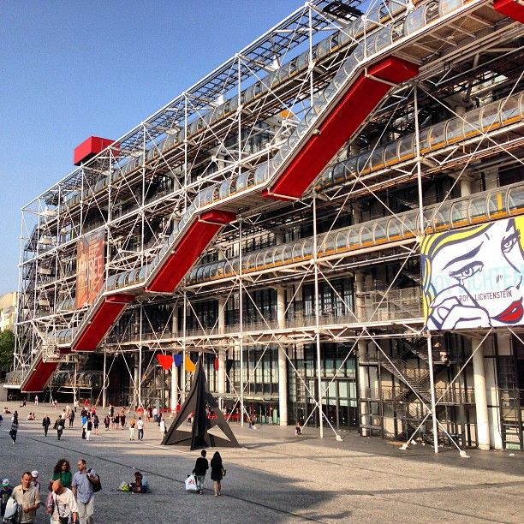
Reading Comprehension
წაკითხულის გააზრება
Pompidou Cultural Centre (Paris, France)
Once referred to as “the Back of Refrigerator”, the Pompidou Cultural Centre has also been called grotesque, monstrous or just plain ugly. Its distinguishing feature is that all of its piping elevators, and so on, are on the exterior freeing up space for displays of artworks. The Centre is in one of the oldest neighbourhoods in Paris, which added to many local residents outrage. However, it gained instant acclaim on its opening in 1977 and remains one of the most visited places in the city.

Slide 28
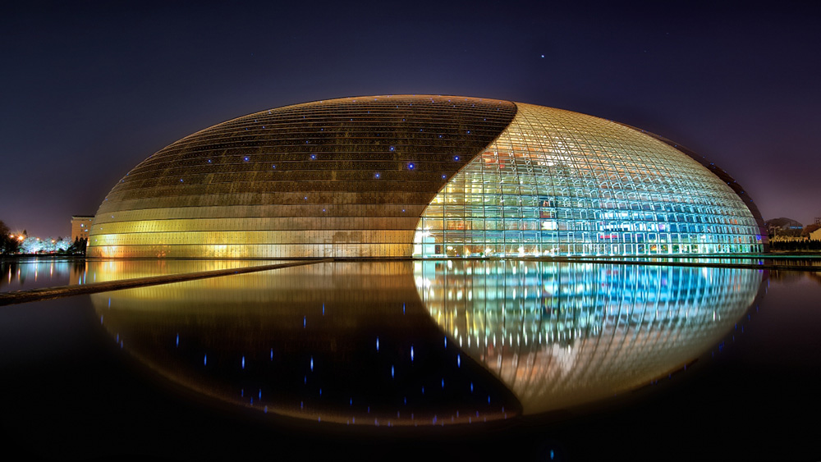
Reading Comprehension
წაკითხულის გააზრება
National Centre for the Performing Arts (NCPA) (Beijing, China)
Nicknamed “the egg”, the NCPA divided opinion even before its opening concert in 2007. The titanium and glass dome set in an artificial lake is just a stone’s throw from the ancient Forbidden City and was felt by many to be out of keeping with the latter’s imperial architecture – although others applauded its futuristic design. At $336 million, the cost of the building – like many other major architectural projects – also sparked debates.

Slide 29
Reading Comprehension
წაკითხულის გააზრება
Which building is controversial because of its surroundings?
The Beehive
Part of its problem was its proximity to the neighbouring Edwardian neoclassical Parliament House, which only accentuates the architectural aspects of Beehive that many disliked.

Slide 30
Reading Comprehension
წაკითხულის გააზრება
Which building was extremely expensive to build?
National Centre for the Performing Arts
At $336 million, the cost of the building – like many other major architectural projects – also sparked debates.

Slide 31
Reading Comprehension
წაკითხულის გააზრება
Which building got mixed reactions?
National Centre for the Performing Arts
The titanium and glass dome set in an artificial lake is just a stone’s throw from the ancient Forbidden City and was felt by many to be out of keeping with the latter’s imperial architecture – although others applauded its futuristic design.

Slide 32
Grammar
გრამატიკა
Future Continuous Tense

Slide 33
Grammar
გრამატიკა
Meaning
Future Continuous is used to say that an action will be in progress at a specific time in the future.
Example
This time on Thursday I’ll be flying to Thailand.
In two hours she’ll be leaving work.

Slide 34
Grammar
გრამატიკა
Future Continuous is used for an action in progress in the future which is interrupted by a shorter action.
Example
I’ll be waiting for you when you get back.
Future Continuous is used to predict the present.
Example
Don’t call him now, he’ll be sleeping.

Slide 35
Grammar
გრამატიკა
Future Continuous is used for arrangements, often as a reminder or warning.
Example
We’ll be leaving at 10 o’clock (So don’t be late!).
Future Continuous is used to make polite enquiries about someone’s plans (without wishing to influence these plans).
Example
Will you be watching TV this evening? (You simply want to know if the TV will be free)

Slide 36
Grammar
გრამატიკა
Form
We form the Future Continuous with the modal verb “will”, the auxiliary verb “be” and the present participle of the main verb.
will + be+ present participle

Slide 37
Grammar Activity
გრამატიკის დავალება
I (not / work) ………………………all day.
I won’t be working all day.

Slide 38
Grammar Activity
გრამატიკის დავალება
We ________ (watch) the news at 10pm.
We will be watching the news at 10pm.

Slide 39
Grammar Activity
გრამატიკის დავალება
Tomorrow at 8 o’clock, the designers ……………….. (discuss) the new project.
Tomorrow at 8 o’clock, the designers will be discussing the new project.

Slide 40
Summary გაკვეთილის შეჯამება
Vocabulary
Architecture
არქიტექტურა
Reading about controversial designs
Grammar: Future Continuous Tense

Slide 41
Homework
საშინაო დავალება
Write a paragraph describing what the architecture of museums and art galleries can mean to people.

Slide 42
Homework
საშინაო დავალება
Throughout the world, museums and cultural institutions beckon people to explore new cultures and topics through their carefully curated collections and transcending exhibitions. For those quick to dismiss the museum experience as boring, it's time to think again: Galleries in all corners of the world, from Senegal to Japan, have mastered the art of creating engaging exhibits on art, history, and culture that can change any critic’s mind. Many of these museums are also known for their incredible restaurants and cafes. Whether you're interested in discovering the ancient gems of Egypt or learning about post-impressionist works of Van Gogh, their incredible collections are well worth the trip.

