Slide 1
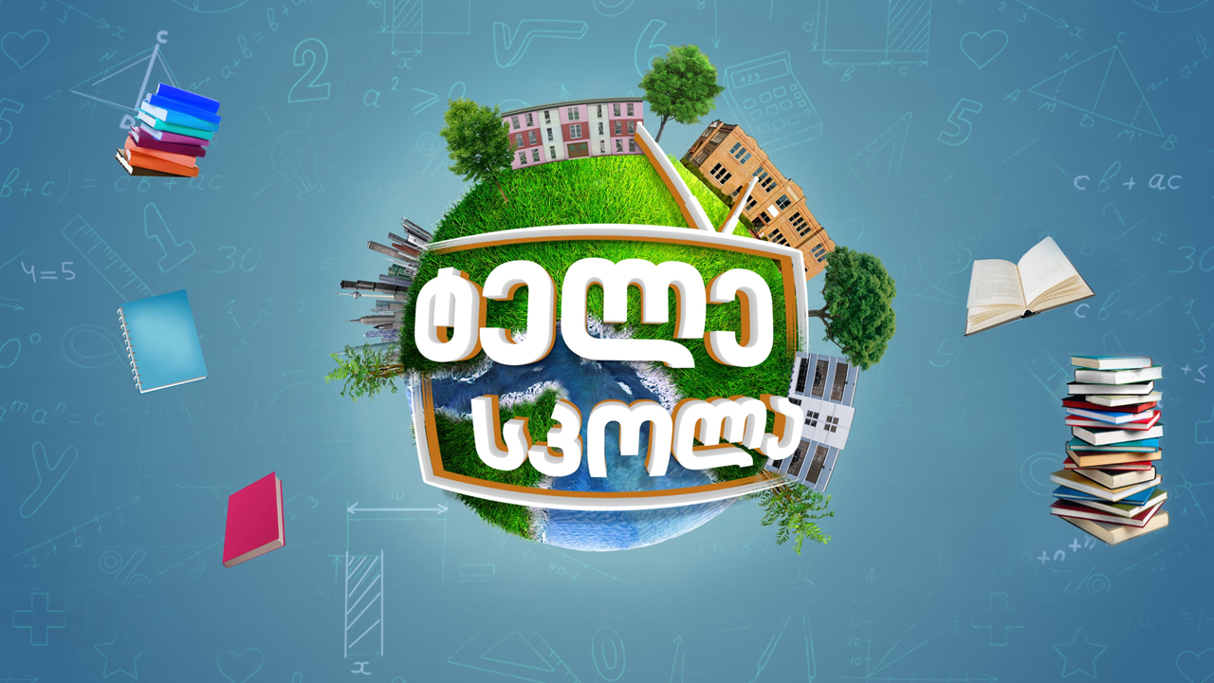

Slide 2


Technology ǀ ტექნოლოგია
English for Specific Purposes | Level B1

Slide 3
Agenda
გაკვეთილის გეგმა
Introduction - შესავალი
Vocabulary - ლექსიკა
Vertical Greenhouses
ვერტიკალური სათბურები
Reading Comprehension - წაკითხულის გააზრება
Grammar - გრამატიკა
Summary- შეჯამება
Homework- საშინაო დავალება

Slide 4
Introduction შესავალი
How do you think technology can develop in future?

Slide 5
access
(n.)
წვდომა
gadget
(n.)
მოწყობილობა
advancement
(n.)
წინსვლა; განვითარება
Vocabulary
ლექსიკა
user-friendly
(adj.)
ადვილად გამოსაყენებელი
state-of-the-art
(adj.)
თანამედროვე

Slide 6
Vocabulary
ლექსიკა
advancement
(n.)
წინსვლა, განვითარება
We are expecting great technological advancement in the future.

Slide 7
Vocabulary
ლექსიკა
access
(n.)
წვდომა
They have no access to the updated version of the machine.

Slide 8
Vocabulary
ლექსიკა
gadget
(n.)
მოწყობილობა
He is skilled at using electronic gadgets.

Slide 9
Vocabulary
ლექსიკა
user-friendly
(adj.)
ადვილად გამოსაყენებელი
The company's high-tech tools help manufacturers make their appliances more user-friendly for consumers.

Slide 10
Vocabulary
ლექსიკა
state-of-the-art
(adj.)
თანამედროვე
The center is 20 years old and will need capital improvements to remain state-of-the-art.

Slide 11
Vocabulary
ლექსიკა
advancement
access
gadget
user-friendly
state-of-the-art
He has ………………………..to the stored information.

Slide 12
Vocabulary
ლექსიკა
advancement
gadget
user-friendly
state-of-the=art
The ……………………….we’ve made in technology has been unbelievable.

Slide 13
Vocabulary
ლექსიკა
gadget
user-friendly
sate-of-the-art
An easy to follow the menu makes the computer program
very………………………….

Slide 14
Vocabulary
ლექსიკა
gadget
state-of-the-art
What's your favourite non-electrical……………………………?

Slide 15
Vocabulary
ლექსიკა
state-of-the-art
The plane uses ………………………….....navigation equipment.

Slide 16
greenhouse
(n.)
სათბური
additional
(adj.)
დამატებითი
skyscraper
(n.)
ცათამბრჯენი
Vocabulary
ლექსიკა
artificial
urban
(adj.)
ქალაქის,საქალაქო
artificial
(adj.)
ხელოვნური
achievable
(adj.)
მიღწევადი
rooftop
(n.)
შენობის სახურავი
rural
(adj.)
სოფლის, სასოფლო

Slide 17
Vocabulary
ლექსიკა
greenhouse
(n.)
სათბური
Gladys grows a lot of tomatoes in her greenhouse.

Slide 18
Vocabulary
ლექსიკა
additional
(adj.)
დამატებითი
An additional grant has enabled the team to push forward with research plans.

Slide 19
Vocabulary
ლექსიკა
artificial
(adj.)
ხელოვნური
Artificial light is used in the greenhouse.

Slide 20
Vocabulary
ლექსიკა
achievable
(adj.)
მიღწევადი
His goals are easily achievable.

Slide 21
Vocabulary
ლექსიკა
urban
(adj.)
ქალაქის, საქალაქო
Many Americans were leaving the farm for the promise of urban life.

Slide 22
Vocabulary
ლექსიკა
rooftop
(n.)
შენობის სახურავი
The farm will be located on the rooftop.

Slide 23
Vocabulary
ლექსიკა
rural
(adj.)
სოფლის, სასოფლო
The area is still very rural and undeveloped.

Slide 24
Vocabulary
ლექსიკა
skyscraper
(n.)
ცათამბრჯენი
The restaurant is at the top of one of the big downtown skyscrapers.

Slide 25
Reading Comprehension
წაკითხულის გააზრება

Slide 26
Reading Comprehension
წაკითხულის გააზრება
What kind of challenges would the growth of population cause for mankind?

Slide 27
Reading Comprehension
წაკითხულის გააზრება
Skyscrapers are the ultimate symbol of urban life. City dwellers are used to seeing tall office buildings, multistory five-star hotels and apartment towers with thousands of residents. Farms, on the other hand, are associated with rural life. However, there are experts who think that some skyscrapers should become farms in order to meet the increasing food needs of our planet.
Vertical farms, where urban farmers could grow crops like wheat and rice in environmentally friendly skyscrapers, could be the solution. In spite of concerns over high costs, environmental health experts want to make urban farms a reality and use these skyscrapers to grow crops. They believe that we can increase food production by changing our thinking from out to up.

Slide 28
Reading Comprehension
წაკითხულის გააზრება
Critics of vertical farming point out that although crops growing in tall glass building would get natural sunlight during the day, it wouldn’t be enough. The plants closest to the windows would grow much more quickly than the plants further inside. The plants growing away from the windows may not produce as many or as high quality vegetables. For these reasons vertical farms would need additional light sources. Researchers have found that even in single-story greenhouses, artificial light is often needed for year-round crops. Experts have concluded that generating enough solar energy to support growth requires an area about 20 times larger than the planting area. Therefore, natural light cannot be a workable solution for vertical farms.

Slide 29
Reading Comprehension
წაკითხულის გააზრება
Another way of growing fresh food year-round is to build urban farms on rooftops. This more practical approach may be more achievable than the idea of farms in glass skyscrapers, researchers suggest. However, rooftop farming is expensive, and unless people want to pay more for fresh, local food, the technique may not succeed in the marketplace.
Experts agree that innovative farming practices are needed to support the planet’s need for more food at affordable costs, both to the farmer and to the consumer. Vertical and rooftop farms may be small-scale answer, but the best ideas could be yet to come.

Slide 30
False
Reading Activity
კითხვის დავალება
Urban farms is a cheap project.
In spite of concerns over high costs, environmental health experts want to make urban farms a reality and use these skyscrapers to grow crops.

Slide 31
True
Reading Activity
კითხვის დავალება
Vertical farms can meet the increasing food needs of
our planet.
Some skyscrapers should become farms in order to meet the increasing food needs of our planet.

Slide 32
False
Reading Activity
კითხვის დავალება
All the plants in vertical farms will get enough sunlight.
The plants closest to the windows would grow much more quickly than the plants further inside.

Slide 33
True
Reading Activity
კითხვის დავალება
The idea of rooftop farms is less achievable than the vertical farms.
Another way of growing fresh food year-round is to build urban farms on rooftops. This more practical approach may be more achievable than the idea of farms in glass skyscrapers, researchers suggest.

Slide 34
Grammar
გრამატიკა
By 2010, scientists had already found the solution to the problem.
By the time the government announced the breakthrough, the news had already become public.

Slide 35
Grammar
გრამატიკა
Completed action before something in the Past.
I did not have any money because I had lost my wallet.

Slide 36
Grammar
გრამატიკა
Duration before something in the Past (Non-Continuous Verbs).
We had had that car for ten years before it broke down.

Slide 37
Grammar
გრამატიკა
To form past perfect tense we use had + past participle.
The town had had the water shortage before the drought.
To form interrogative sentence we start sentence with had.
Had she left the party before your arrival?
To form negative sentence we add not.
She had not seen a bear before she moved to Alaska.

Slide 38
Grammar Activity
გრამატიკის დავალება
She soon realised that she ……… (spend) all the money.
She soon realised that she had spent all the money.

Slide 39
Grammar Activity
გრამატიკის დავალება
When all the guests …… (leave) I started tidying.
When all the guests had left I started tidying.

Slide 40
Grammar Activity
გრამატიკის დავალება
She ………. (be/not) very upset when he did not answer the email.
She had not been very upset when he did not answer the email.

Slide 41
Grammar Activity
გრამატიკის დავალება
……. the film already ……. (start) when you arrived?
Had the film already started when you arrived?

Slide 42
Summary
გაკვეთილის შეჯამება
Technology
ტექნოლოგია
Vocabulary
Reading
Grammar: Past Perfect

Slide 43
Homework
საშინაო დავალება
Write a paragraph about some innovative projects.

Slide 44
Homework
საშინაო დავალება
The International Space Station (ISS) is a habitable artificial satellite in Earth’s orbit. It is a multinational collaborative project between five participating space agencies: America, Russia, Japan, Europe, and Canada. The ownership and use of the space station is established by intergovernmental treaties and agreements. The station serves as a space environment research laboratory in which scientific research is conducted in astrobiology, astronomy, meteorology, physics, and other fields. The ISS is used for testing the spacecraft systems and equipment required for possible future long-duration missions to the Moon and Mars.

