Slide 2
Engineering|ინჟინერია
English for Specific Purposes | Level B2

Slide 3
Agenda
გაკვეთილის გეგმა
Introduction - შესავალი
Engineering
ინჟინერია
Vocabulary - ლექსიკა
Reading Comprehension- წაკითხულის გააზრება
Grammar - გრამატიკა
Summary- შეჯამება
Homework- საშინაო დავალება

Slide 4
Introduction შესავალი
Which is the most amazing building in your home city?
What kind of building is it?

Slide 5
Vocabulary
ლექსიკა
pillar
(n.)
სვეტი, კოლონა
facade
(n.)
ფასადი
arch
(n.)
თაღი
Vocabulary
ლექსიკა
foundation
(n.)
საძირკველი
spire
(n.)
შპილი, წვეტი

Slide 6
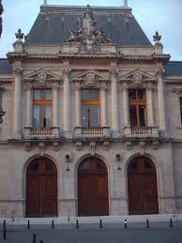
Vocabulary
ლექსიკა
facade
(n.)
ფასადი
The facade is made of limestone.

Slide 7
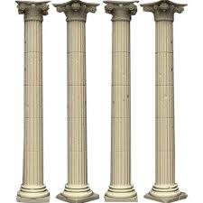
Vocabulary
ლექსიკა
pillar
(n.)
სვეტი, კოლონა
A row of reinforced concrete pillars supports the bridge.

Slide 8
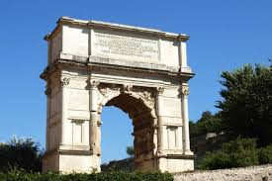
Vocabulary
ლექსიკა
arch
(n.)
თაღი
In many churches the side aisles are separated from the central aisle by a row of arches.

Slide 9
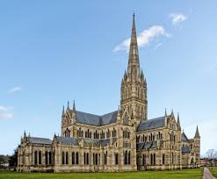
Vocabulary
ლექსიკა
spire
(n.)
შპილი, წვეტი
The town, with its numerous spires, is very picturesque.

Slide 10
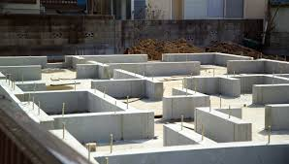
Vocabulary
ლექსიკა
foundation
(n.)
საძირკველი
The foundations will have to be reinforced to prevent the house from sinking further into the ground.

Slide 11
Vocabulary
ლექსიკა
facade
pillar
spire
arch
foundation
A structure, consisting of a curved top on two supports, that holds the weight of something above it

Slide 12
Vocabulary
ლექსიკა
facade
pillar
spire
foundation
A tall, pointed structure on top of a building, especially on top of a church tower

Slide 13
Vocabulary
ლექსიკა
facade
pillar
foundation
The structures below the surface of the ground that support a building

Slide 14
Vocabulary
ლექსიკა
facade
pillar
A strong column made of stone, metal, or wood that supports part of a building

Slide 15
Vocabulary
ლექსიკა
facade
The front of a building, especially a large or attractive building

Slide 16
Vocabulary
ლექსიკა
construction site (n.)
სამშენებლო მეოდანი
steel
(n.)
ფოლადი
frame
(n.)
კარკასი
Vocabulary
ლექსიკა
parasol
(n.)
მზისგან დამცავი ქოლგა
eyesore
(n.)
სიმახინჯე

Slide 17
Vocabulary
ლექსიკა
construction site (n.)
სამშენებლო მოედანი
He was offered the job of foreman on an industrial construction site.

Slide 18
Vocabulary
ლექსიკა
frame
(n.)
კარკასი
The houses have wood frames built on concrete slabs.

Slide 19
Vocabulary
ლექსიკა
steel
(n.)
ფოლადი
The gates were locked with a heavy steel chain.

Slide 20
Vocabulary
ლექსიკა
eyesore
(n.)
სიმახინჯე
They think the new library building is an eyesore.

Slide 21
Vocabulary
ლექსიკა
parasol
(n.)
მზისგან დამცავი ქოლგა
The woman’s parasol turned out to be very useful in the afternoon heat.

Slide 22
Reading Comprehension
წაკითხულის გააზრება

Slide 23
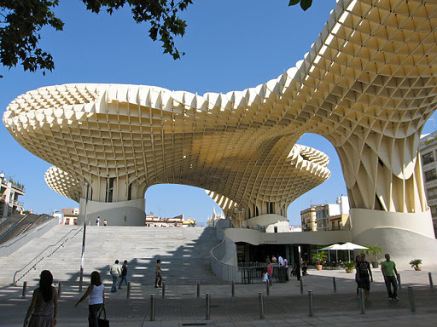
Reading Comprehension
წაკითხულის გააზრება
What is your opinion about the building?

Slide 24
Reading Comprehension
წაკითხულის გააზრება
While beginning construction on a new parking garage in 2003, workers in Seville, Spain were suddenly faced with a dilemma. The garage’s construction site was right on top of a large area of ancient Roman ruins. Seville city officials knew that preserving these priceless treasures from ancient history was far more important to their city than adding a few parking spaces. The mayor stopped construction immediately, and the city devised a new plan for the space.
After many long meetings, officials finally reached a decision. They would convert the space into a museum where visitors from near and far could view the artifacts. But they didn’t want just another building. They felt that the centre of Seville needed an inviting community centre, where people would meet friends, sit outdoors and read a book, shop, eat in restaurants, and just enjoy themselves.

Slide 25
Reading Comprehension
წაკითხულის გააზრება
To select the design, the city held a competition for architects around the world. The aim was to create a unique structure that would protect the ruins while also creating a lively, open public space. After reviewing hundreds of applications from around the world, the judges settled on a design by Jurgen Mayer, who is a German architect. Mayer called his design the Metropol Parasol.

Slide 26
Reading Comprehension
წაკითხულის გააზრება
Building the parasol was no easy feat. Protecting the Roman ruins was a priority. As a result, workers were not allowed to dig large areas of the ground. Instead, the parasol was designed to “float” above the ground. In fact, in an area covering 18 000 square meters, the four-storey, 29-meter-high structure only touches the ground in six places! With this unusual design, safety had to be considered very carefully. The wooden exterior was put in place over a super strong frame of concrete, steel, ad granite. Building took seven years and cost 90 million euros to complete. Today the parasol complex houses an underground archaeological museum, a farmer’s market, and many cafes and restaurants. On the upper level, visitors can enjoy views of Seville from the panorama deck.

Slide 27
Reading Comprehension
წაკითხულის გააზრება
So, how will the Metropol Parasol influence future city planning and architectural design? As with any elements of design, the Parasol is attracting differing opinions. Some say the structure is an iconic landmark and a work of art. Opponents call it an overpriced eyesore and say the odd mushroom shape doesn’t fit with the rest of the city. Are the critics overreacting? Will these kinds of manufactured landscapes be the way of the future? We’ll have to wait and see.

Slide 28
False
Reading Activity
კითხვის დავალება
The construction site was originally planned as a gas station.
While beginning construction on a new parking garage in 2003, workers in Seville, Spain were suddenly faced with a dilemma.

Slide 29
True
Reading Activity
კითხვის დავალება
The buildings are raised off the ground to protect the ruins below.
Protecting the Roman ruins was a priority. As a result, workers were not allowed to dig large areas of the ground. Instead, the parasol was designed to “float” above the ground.

Slide 30
True
Reading Activity
კითხვის დავალება
The structure was designed to be a museum, a shopping centre, and a meeting place.
They felt that the centre of Seville needed an inviting community centre, where people could meet friends, sit outdoors and read a book, shop, eat in restaurants, and just enjoy themselves.

Slide 31
Grammar
გრამატიკა
Relative Clauses
They give us extra information about something/someone or identify which particular thing/ person we are talking about. They are often introduced by the following words:

Slide 32
Grammar
გრამატიკა
which (for things and animals) | Did you see the film which was on TV last night?
who (for people) | Tom Davis, who is appearing in concert in Reading this week, is with me in the studio.
when (for time) | Do you remember the day when we met?
where (for places) | This is the place where they filmed Citizen Kane.
why (for reasons) | That’s the reason why he’s so popular.
whom (for people as the object of the relative clause) | Is that the man whom we saw at the cinema yesterday?
whose (for possession) | My next guest on the show is John, whose career goes back to the early seventies.

Slide 33
Grammar
გრამატიკა
Defining Relative Clauses
Defining relative clauses tell us which one of a group of things/people we are talking about. The sentence doesn’t usually make complete sense without the relative clause.

Slide 34
Grammar
გრამატიკა
Defining relative clauses are not separated from the rest of the sentence by commas.
This is the DVD which I told you about the other day.
We can also use that to introduce the relative clause.
This is the DVD that I told you about the other day.
We can often leave out the word which introduced the relative clause when it is the object of the clause.
This is the DVD I told you about the other day.
Notice that we do not need a preposition when we use where or when.
The theatre where I first acted is somewhere around here.
The theatre where I first acted in is somewhere here.

Slide 35
Grammar Activity
გრამატიკის დავალება
Here’s a photo of the hotel where we stayed in when we were in Beijing.
Here’s a photo of the hotel where we stayed when we were in Beijing.

Slide 36
Grammar Activity
გრამატიკის დავალება
He is a person for who very few people feel much sympathy.
He is a person for whom very few people feel much sympathy.

Slide 37
Grammar Activity
გრამატიკის დავალება
This is the first occasion on which the leaders of these two countries have met.
This is the first occasion where the leaders of these two countries have met.

Slide 38
Summary
გაკვეთილის შეჯამება
Vocabulary
Engineering
ინჟინერია
Reading
Grammar: Defining Relative Clauses

Slide 39
Homework
საშინაო დავალება
Write a paragraph describing the most fascinating building in your town.

Slide 40
Homework
საშინაო დავალება
The CN Tower is a telecommunications tower in Toronto, Ontario, Canada. It is 553.33 metres tall and it is the tallest free-standing structure (meaning it cannot have wires to keep it standing) in Canada, North America, and the Western Hemisphere. It is not the tallest building as there are no floors for people to work or live in. That title goes to One World Trade Center in New York City, New York, United States, which is a bit shorter at 541 metres tall. It is not the tallest structure of any kind in the Americas either, as the KVLY-TV mast in North Dakota, also in the United States, is taller at 629 metres, but that needs wires to keep it upright. Today, the CN Tower is an important icon of Toronto and has more than two million tourists and visitors every year.

